Slide 1
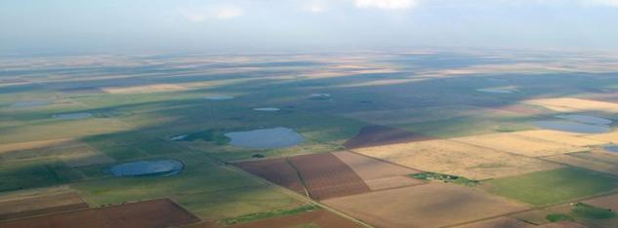
Somewhere between Falling Into and Creating Non-traditional Partnerships

Slide 2
Playa Lakes Joint Venture
Playa Lakes Joint Venture
Dedicated to conserving the playas, prairies and landscapes of the western Great Plains for the benefit of birds, other wildlife, and people.
Notes:
Playa Lakes Joint Venture is a regional partnership of federal and state wildlife agencies, conservation groups and private industry dedicated to conserving bird habitat throughout the western Great Plains — including portions of Colorado, Kansas, Nebraska, New Mexico, Oklahoma and Texas. PLJV provides science-based planning tools, decision support tools and outreach to help habitat managers become more efficient and effective at delivering on-the-ground conservation.

Slide 3
About Playas
Small, temporary wetlands
Critical wildlife habitat
Primary source of groundwater recharge
#1 existing impact is pits
#1 continuing threat is sediment accumulation
Specific USDA conservation programs are available

Slide 4
The Problem With Pits
Interrupt playas’ natural hydrology
Reduce ability to provide food and habitat to wildlife
May reduce recharge to the aquifer
Essentially “on” versus “off” for a playa
Notes:
Here is a close up view of a pit. In the background you can see the spoil pile. What we are finding is that for just a little bit of money, something on the order of $3-5K per playa we can push the fill back into the pit resulting in turning this playa “on” for wildlife. There are thoughts that it also benefits recharge but those specific studies have not been started to our knowledge. [maybe relay Todd M’s comment, with DU, who says he can sell this restoration activity all day long to get that much bang for the buck].

Slide 5
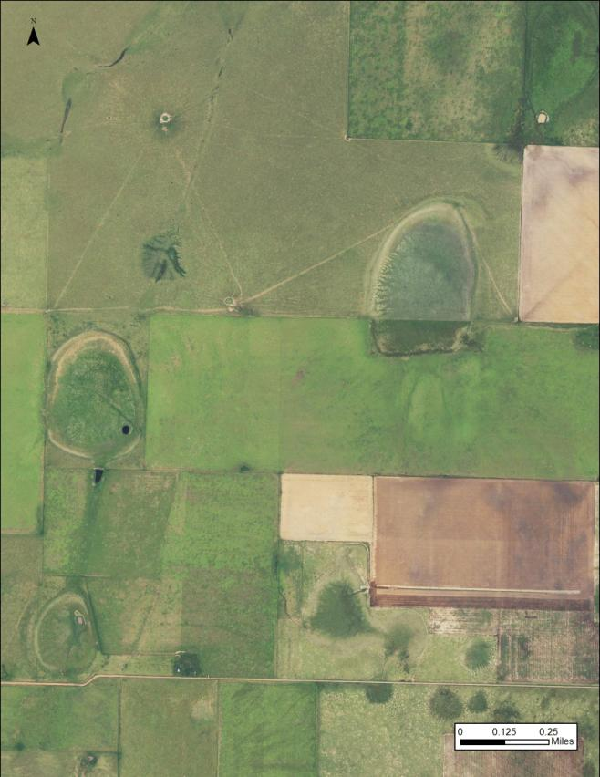
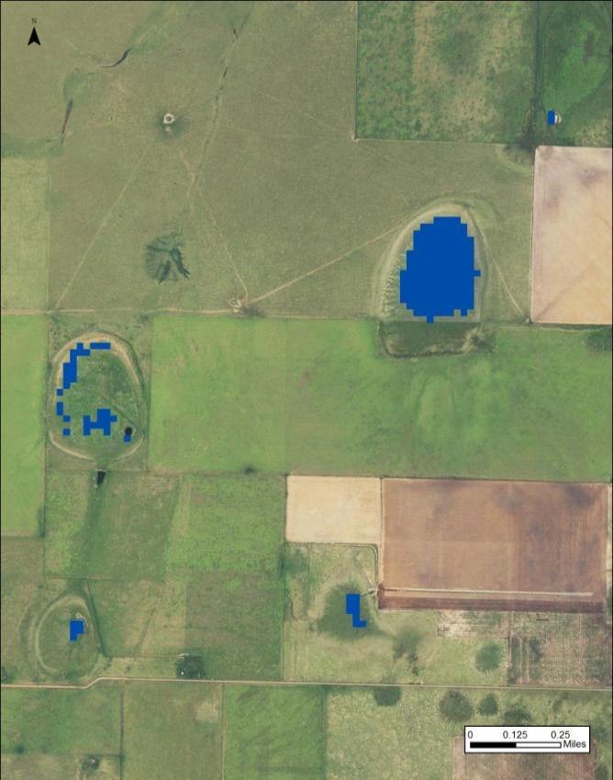
Action That Benefits Birds and People

Slide 6
Phase 1: 2006 Landowner/Producer Survey
DJ Case & Associates &
Farm Services Agency
Notes:
In 2006, PLJV worked with DJ Case & Associates, a communications consulting firm that specializes in natural resources issues, to conduct a landowner survey. DJ Case works with natural resources agencies and organizations throughout the country helping them communicate with the public about conservation issues.

Slide 7
PLJV Asked
1,800 farmers and ranchers in the PLJV region what they thought about playas, wildlife, & conservation
26% responded
95% confidence level (margin of error for this sample is +/-2 to 5%)
Notes:
Surveys were sent to 1,800 farmers and ranchers in the PLJV region, asking them what they thought about playas, wildlife and conservation. They had a 26% response rate, with a 95% confidence level.

Slide 8
Support Conservation
Ogallala Aquifer
Conservation Reserve Program
Native grasslands
Playas
Farm ponds
Reservoirs/lakes
River corridors
Wetlands
Hunted wildlife species
Non-hunted wildlife species
Sand sage prairie
Threatened and endangered species
Prairie dogs
Notes:
Which of 13 possible resources might warrant additional conservation effort?
Supported “more conservation than now” for only one resource, the Ogallala Aquifer
Conservation Reserve Program ranked #2, with “same support as now”

Slide 9
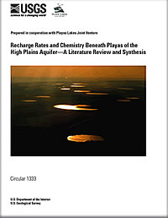
Communications Efforts
Since the 2006 survey, PLJV promoted the role of playas in groundwater recharge in various ways:
USGS Circular – Recharge Rates and Chemistry Beneath Playas of the High Plains Aquifer
Playa Film – Reflection of Life on the Plains
Playa Country radio show
PLJV website
Playas & the Ogallala Aquifer Fact sheet
Notes:
Going forward, PLJV focused on two things when communicating: 1) playas recharge the aquifer and 2) telling the “story” in terms of what helps the producer’s bottom line.
50% did not know whether or not playas recharge groundwater. Upon learning this, PLJV saw an opportunity (and a need) to communicate this link, and it has been a key message ever since. Promoted groundwater recharge through a literature review, playa film, the radio show, website and a fact sheet

Slide 10
Phase 2: 2013 Focus Groups
DJ Case & Associates,
Rainwater Basin JV &
Great Plains lCC
Notes:
The survey was just the beginning. In order to be more effective in fostering playa conservation, PLJV is again working with DJ Case to ask for landowner and producer opinions and attitudes about playas and playa conservation. The project is made possible through a grant from the Great Plains Landscape Conservation and addresses one of their playa research priorities, an analysis of the socioeconomic impediments to playa conservation.

Slide 11
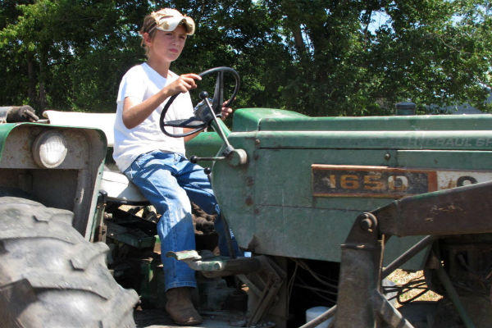
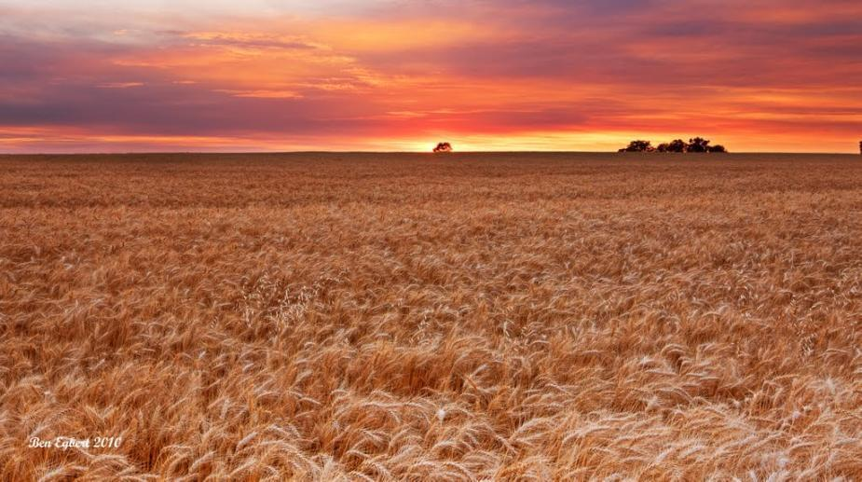
Our Question What motivates landowners to enroll, or not, in a playa conservation program? More detail on playas, aquifer and the future
Notes:
MC need a picture of a landowner pondering something or a family showing cultural roots

Slide 12
Landowner Focus Groups
Conducted 13 focus groups across the Playa Lakes & Rainwater Basin JVs
Talked with farmers and ranchers who have playas on their property
Held in areas with large playa clusters as identified by PLJV's Playa Decision Support System
Notes:
Objectives: 1) Understand what functions and values landowners seek from land; 2) Identify what motivates landowners’ management behavior; 3) Understand what landowners in target areas think, feel, and believe regarding playas and playa conservation; 4) Pinpoint what incentives/disincentives are effective for landowners
Total cost includes staff time for PLJV and RWBJV (taken from grant proposal budget)

Slide 13
Genesis of Mudhole Joint Venture
From the Focus Groups:
Use local vernacular when referring to playas
So we now say “playas, you know, those wet spots sometimes called mudholes”

Slide 14
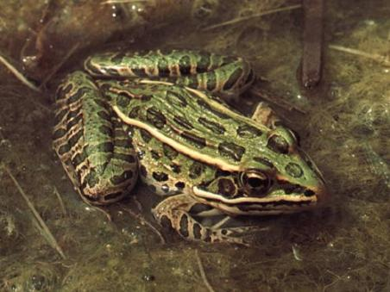
What We Heard: If Convinced Playas Provided Benefits
Majority would conserve playas to help the aquifer
IF they were convinced
Fewer would conserve playas for wildlife benefits only
But most would consider it

Slide 15
What We Heard: Key Beliefs About Playas & the Aquifer
Amount of recharge is not significant
Need more information! How much recharge? How long does it take?
Info must be from a credible source

Slide 16
Phase 3: Playa Summit 2015
DJ Case & Associates &
Great Plains lCC
Notes:
The survey was just the beginning. In order to be more effective in fostering playa conservation, PLJV is again working with DJ Case to ask for landowner and producer opinions and attitudes about playas and playa conservation. The project is made possible through a grant from the Great Plains Landscape Conservation and addresses one of their playa research priorities, an analysis of the socioeconomic impediments to playa conservation.

Slide 17
Refining messages
Playa Summit in November 2015
14 scientists: hydrologists, economists, ecologists
What can we say about playas and recharge?
Recharge ~3 inches/year
Not enough to offset irrigation
Enough to support rainfed and grazing productions
Support municipal supplies
Playas provide clean water
Remove suspended contaminants
Remove dissolved compounds (nitrogen)

Slide 18
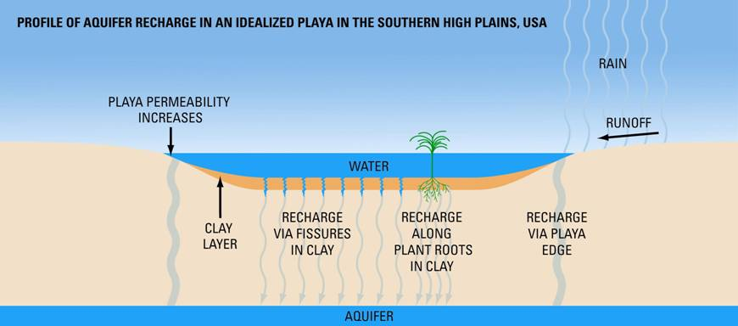
Playas Recharge the High Plains (Ogallala) Aquifer
Recharge is 10-100 times greater under playas than inter-playa areas

Slide 19
About Clovis, New Mexico
40,00 residents
40% Hispanic
Nearby Airbase
Farming Community
Sense of Place

Slide 20
North American Wetland Conservation Act (NAWCA) Grants
Standard Grants
Small Grants
Grant requests up to $1,000,000
Match must be 2:1 ratio of non-federal cash or in-kind
Large waterfowl numbers and wetland acres are key
A wide variety of partners contributing 10% of request is critical
Grant requests up to $100,000
Match must be 1:1 ratio of non-federal cash or in-kind
Emphasis on habitat, less on waterfowl
Point of entry into the program

Slide 21
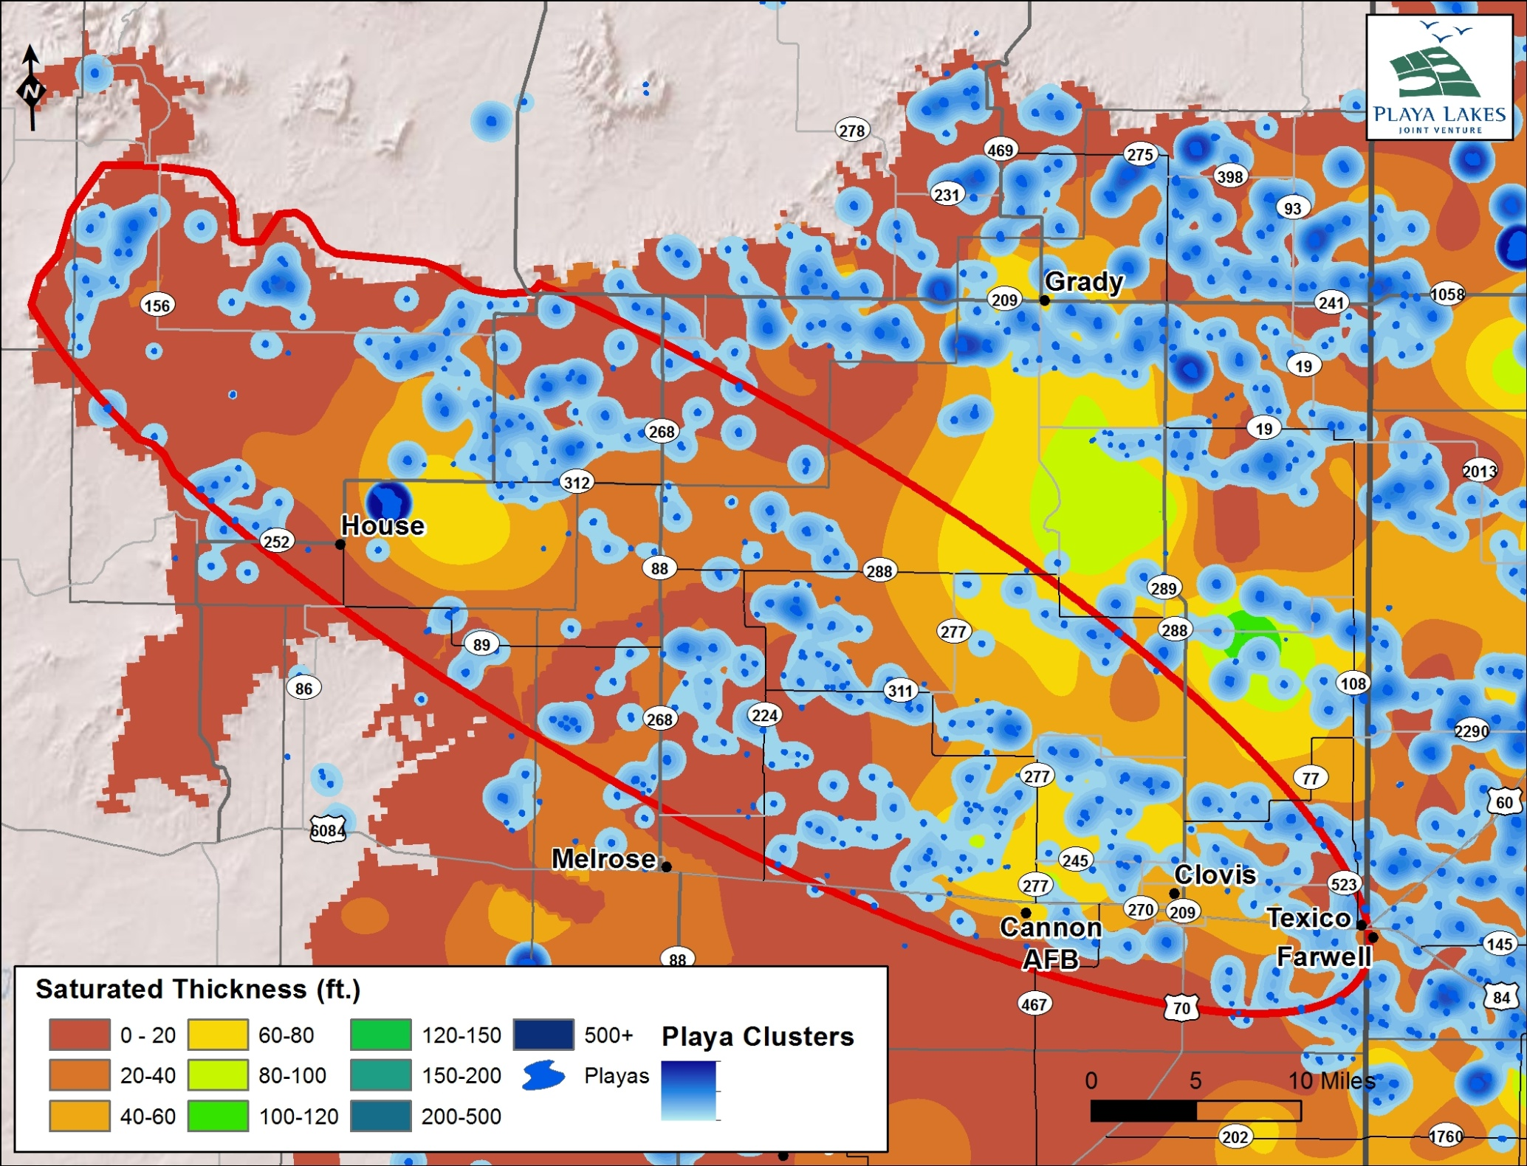
Notes:
Assuming 100 gallons per person per day and 32667 people (2010 census) equates to 1.3 billion gallons per year

Slide 22
Clovis Playa Restoration Potential

Slide 23
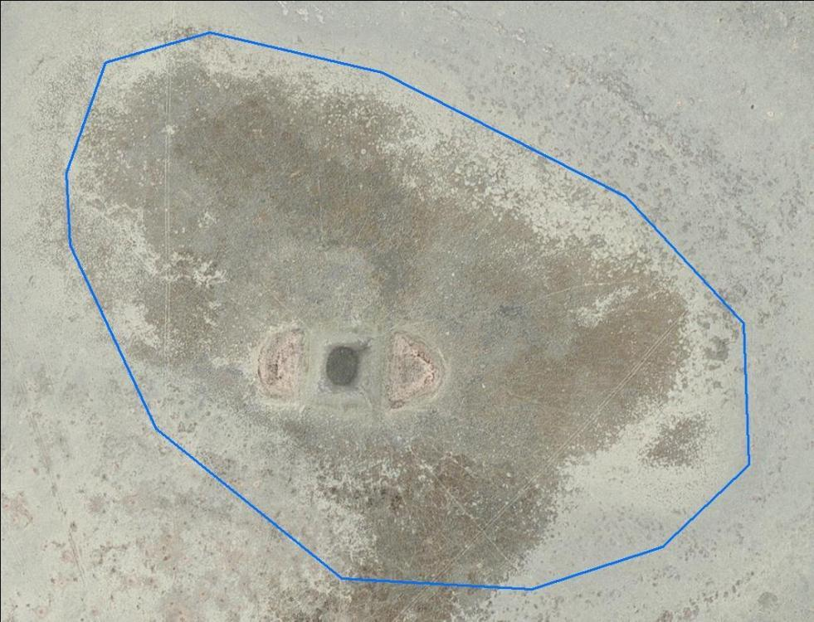
Conservation Actions for Playas
Remove pits.
Remove sediment.
Protect with native grass grass buffer .
Notes:
This is a pitted playa, and restoring these is what the WCS proposal is all about.
Pits have always been viewed as a negative for playas.
We’ve been assuming for a long time that is you have a pit or a ditch in a playa that it is effectively turned off, that is it won’t fill up with water, or even if it does it will be wet for much much shorter than a proper functioning playa. (the on versus off nature of playas and pits using this image)
WCS: background - this is 3rd funded WCS proposal and first funded by WCS Climate Adaptation Fund (Doris Duke); $147,000 grant; will fill 20+ pits (~12 on USFS and ~8+ on private land), PP stories and 6 PCR episodes; increase resilience of landscape; demonstration for pit-filling. Goal to is use this as platform to launch large-scale pit-filling by NRCS/OAI. Mike, mention Bozeman training if you want.
! Note that several of these were “found” using the Playa modifications assessment
Probably the single best cheapest management action for playas
That is also an climate adaptation action.

Slide 25
Conversations

Slide 26
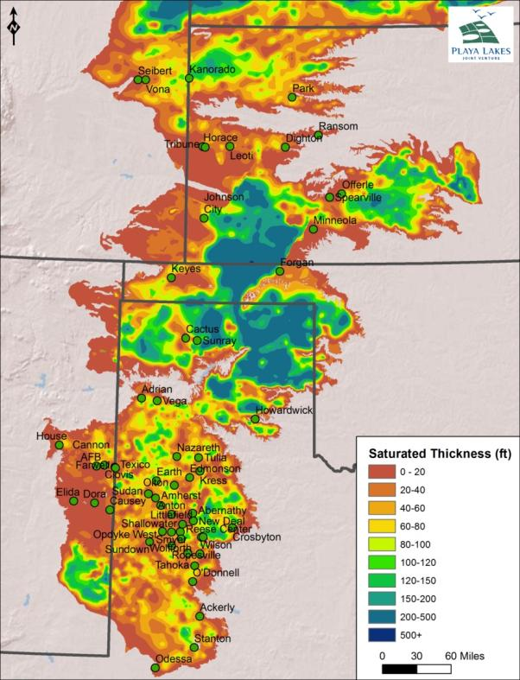
56 Towns like Clovis
Playa Density (Log₂)
Saturated Thickness (Log₂)

Slide 27
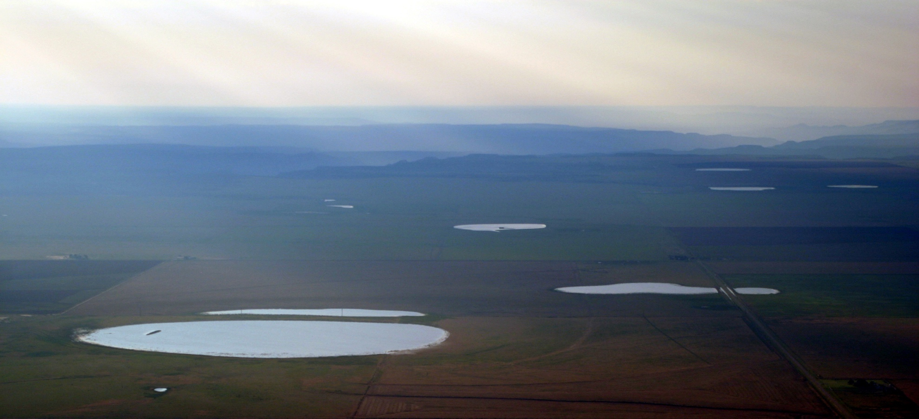
Thank You

Slide 28
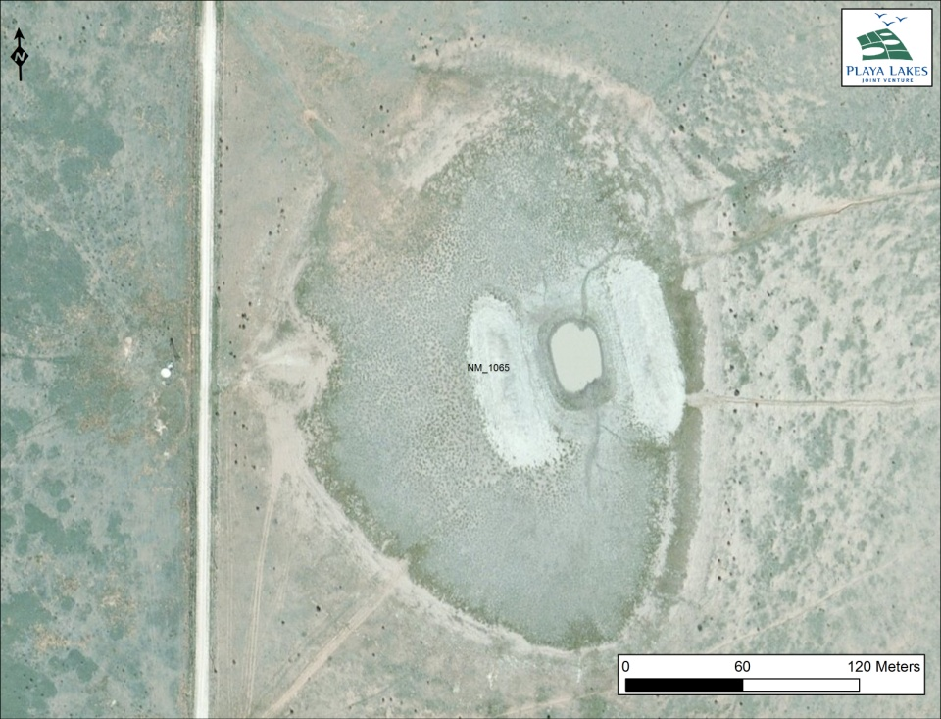
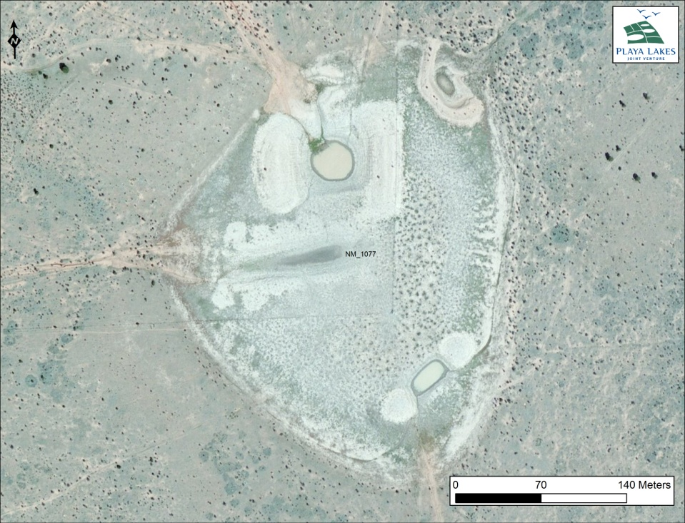
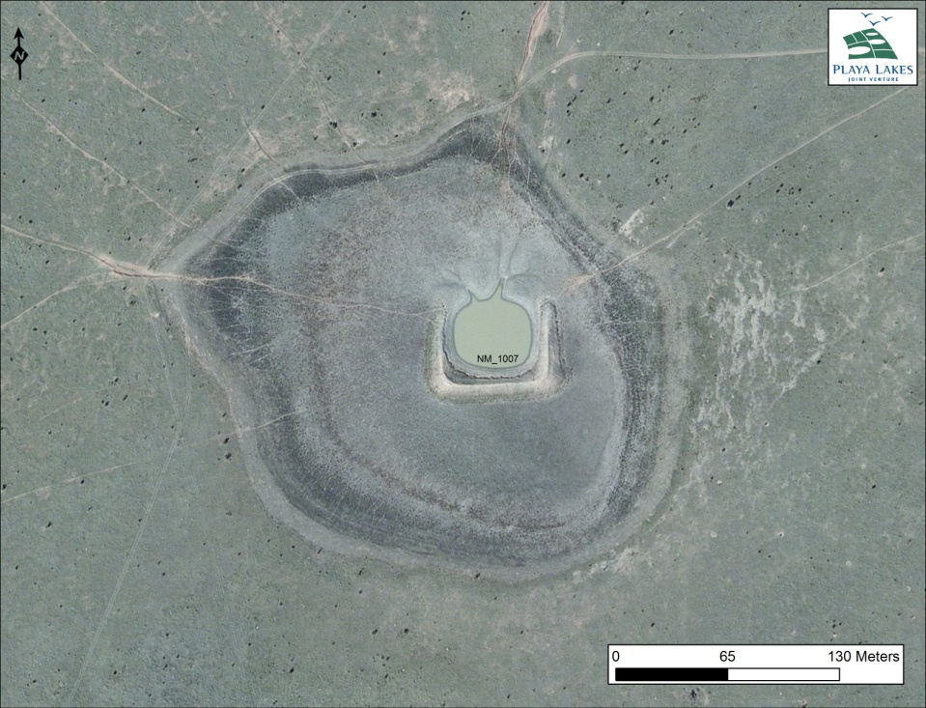
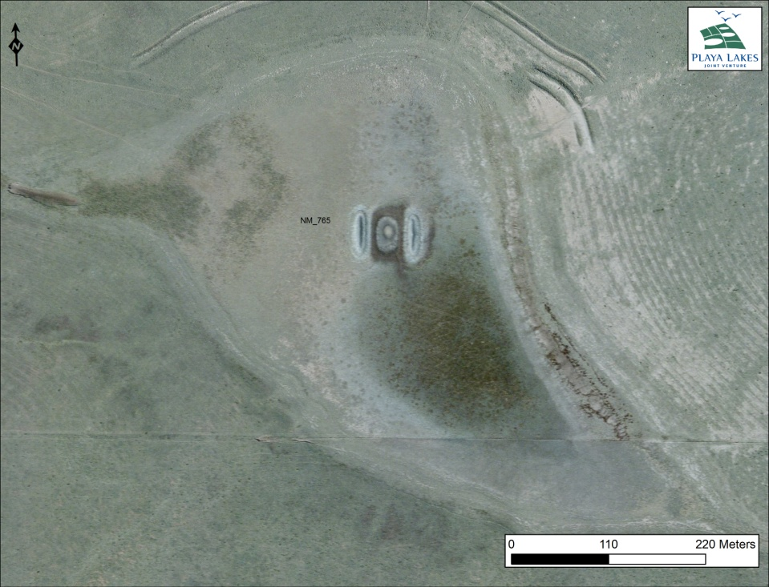

Slide 29
Clovis Playas Restoration Costs and Benefits
Playa Condition | # Playas | Acres | Restoration Cost | Average benefit (DUDs) | % of BCR 18 NM Goal
 |  |  |  |  | Wet year | “Average” Year
Functional Now, Not in 2040 | 181 | 1,411 acres | $243,000 | 189k | 5.7% | 0.57%
Grass, Pit | 83 | 1,039 acres | $415,000 | 139k | 4.2 % | 0.42%
Farmed, No Pit | 31 | 196 acres | $1,390,000* | 26k | 0.8% | 0.08%
Farmed, Pit | 12 | 149 acres | $1,100,000* | 20k | 0.6% | 0.06%
Total | 307 | 2,795 acres | $3,148,000 | 373k | 11.3% | 1.13%
* Restoration estimate for farmed playas does not include easement or offset for lost revenue

Slide 30
Great Start with this Document
You have a great start and an outstanding team
PLJV can help:
Playa expertise
Targeting and prioritization
Farm Bill Programs
Grant programs specific to wetland conservation

