Slide 1
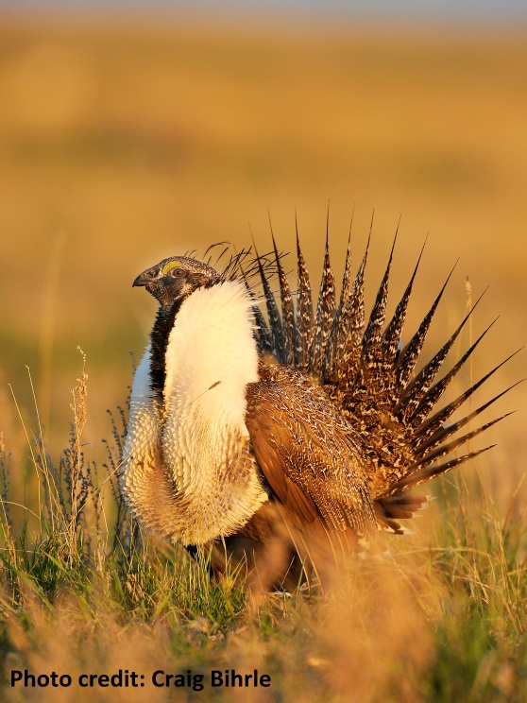
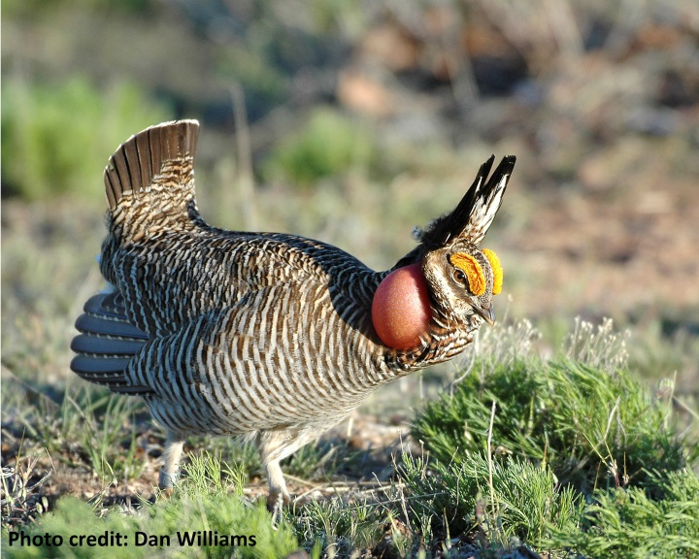
Farm Bill Conservation Programs
The voluntary conservation programs included in the Farm Bill are the primary means through which farmers, ranchers, and forest landowners improve wildlife habitat, build soil health, sequester carbon, and improve water quality on their lands. These effective programs help keep working lands productive for producers, wildlife, and local communities throughout the country.
Farm Bill Programs:
Provide cost-sharing for land management practices
Conserve environmentally sensitive lands
Protect agricultural lands and wetlands through voluntary easements
Foster proactive, locally-led conservation partnerships
In 2015, almost 9 million acres of wildlife habitat were improved through NRCS Farm Bill programs.
Rental payments, technical assistance, and landowner cost-share through the Farm Bill’s Conservation Reserve Program (CRP) have:
Increased waterfowl production by ~2 million ducks per year in the Prairie Pothole region
Restored more than two million acres of wetland systems
Reduced soil erosion by more than 300 million tons per year
Provided landowners with economic stability during shifts in agricultural markets by providing stable source of revenue for participants
Through Farm Bill’s Working Lands for Wildlife (WLFW) partnership, landowners in 35 states have enrolled over 6.7 million acres in conservation practices, such as:
Western Sagebrush Habitat Restoration
4.4 million acres of sagebrush habitat across 11 states restored and improved between 2010-2014 as part of the NRCS Sage Grouse Initiative. This effort, while focused on Sage Grouse, is also benefiting 350 wildlife species that depend on sagebrush landscape, such as two Species of Concern, Brewer’s Sparrow and Green-tailed Towhee.
Landowner-Based Conservation of Lesser Prairie Chicken Habitat
450 landowners enrolled 1+ million acres across five states (TX, NM, OK, KS, CO) between 2010-2015, benefiting both wildlife and ranchers.
North American Bird Conservation Initiative

Slide 2
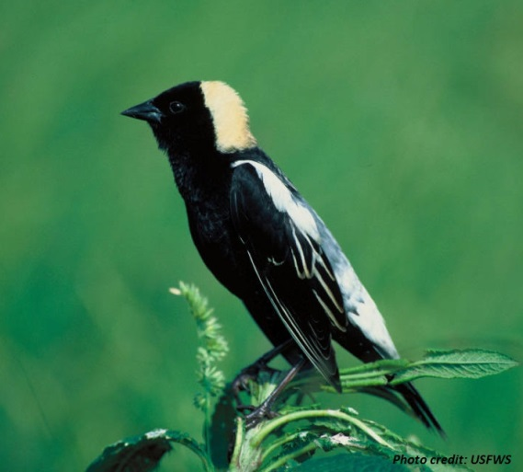
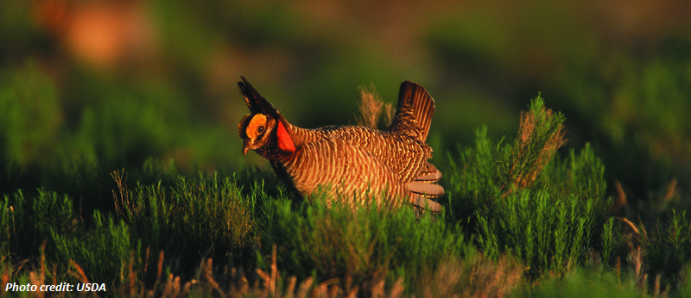
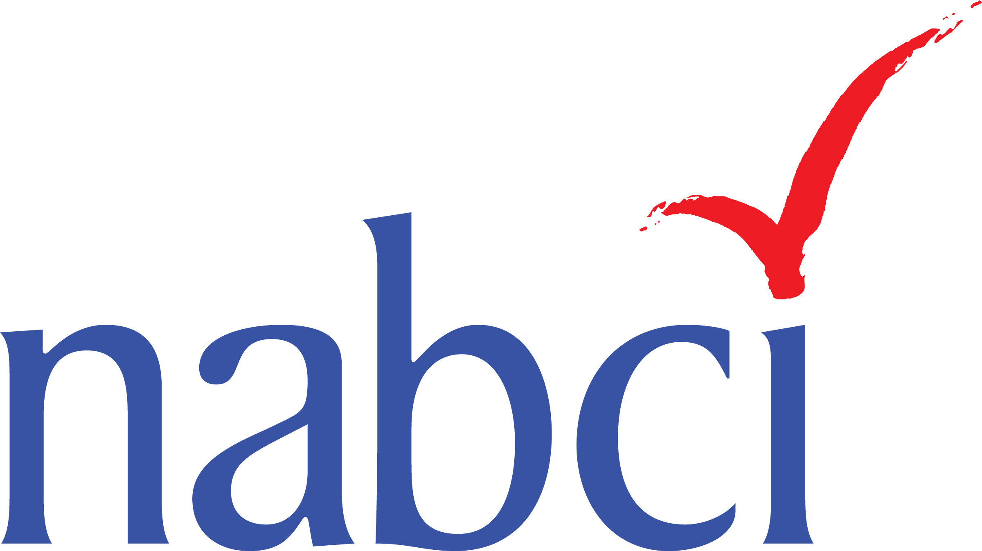
Farm Bill Conservation Programs
Farm Bill Conservation Programs
These effective programs help keep working lands productive for producers, wildlife, and local communities throughout the country.
Conservation Stewardship Program
The Conservation Stewardship Program (CSP) provides opportunities for landowners to participate in landscape-level conservation efforts that focus on priority species such as the Greater Sage Grouse, Lesser Prairie Chicken, and Monarch Butterfly. Producers enrolled
more than 14 million acres of rangeland and pasture in CSP between 2009 and 2013.
_____________
Regional Conservation Partnership Program
The U.S. North American Bird Conservation Initiative (NABCI), a partnership between government agencies, NGOs, and bird-focused partnerships, facilitates collaborative partnerships that advance biological, social, and scientific priorities for North American bird conservation.
The 2014 Farm Bill’s Regional Conservation Partnership Program (RCPP) uses partnerships to leverage conservation investments to meet regional and watershed-wide conservation goals. Partnership programs address diverse conservation needs, such as water quality, water quantity, at-risk species habitat, air quality, and soil health.
Contact: Judith Scarl
Jscarl@fishwildlife.org
www.nabci-us.org
Easements secured through the 2014 Farm Bill Agricultural Conservation Easement Program conserve key waterfowl habitats throughout the country, including the Mississippi Alluvial Valley, Gulf Coast, Chesapeake Bay watershed, Pacific Northwest, Great Lakes, Prairie Pothole Region , and Central Valley of California.
North American Bird Conservation Initiative

