Slide 1
NABCI Communications

Slide 2
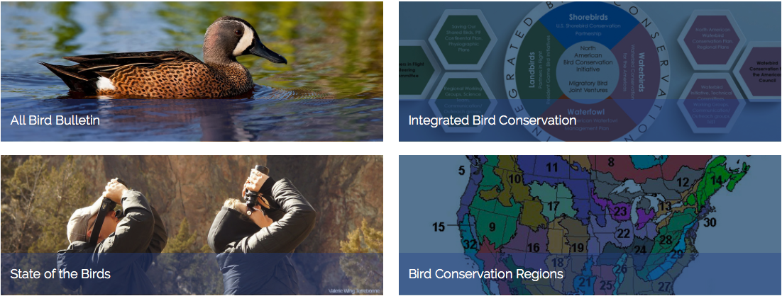
New Website
One-stop shop for bird conservation in U.S. - http://nabci-us.org
Road map for understanding bird conservation community
Online home for key NABCI and bird community documents & products
Notes:
1300 people visited first month of Website Launch.
Then received 17,000 visits the following month and over 4,000 this past month. This huge increase was due to the NAWMP Human Dimensions Survey which at the end directed survey responders to the NABCI website – audience was largely birders identified through eBird.
We know of at least 11,000 people who completed the survey and visited NABCI site from there.

Slide 3
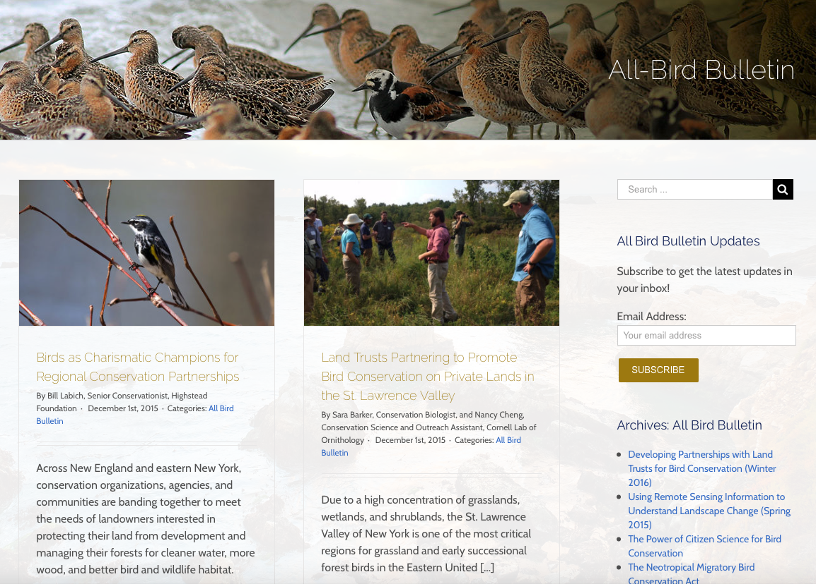
The All-Bird Bulletin Blog
Transition from PDF to blog
Release two blogs per month
One blog from all NABCI partners each year
Discussion:
Themes/Focus
Notes:
Blog resides on the NABCI Site under Committee and Resources tab. Each new blog will be released to community via MailChimp.Hope is that we can get one blog by each of the NABCI partners each year.
With the PDF All Bird Bulletin, our goal was to showcase work that was being done on a pressing and often emerging issue in the bird community. With the new blog format, what does the Committee see as the central goal? Maintain same goal? Communicate about good projects in the bird community? Show how the community is addressing subcommittee themes?
Spreadsheet: https://docs.google.com/spreadsheets/d/1UJPxMSnh8zu6lYuefsDQz5l2yPUS78lfzgjUv98s34w/edit#gid=0

Slide 4
Communication Needs: NABCI Subcommittees
Discussion: What are the major communication needs?
How can we work with you to develop key products?

Slide 5
Work this Year
Continue to update Website – News, Resources, Subcommittee Documents
Coordinating and Distributing All-Bird Bulletin blogs throughout the year from NABCI partners
Addressing NABCI Subcommittee communication needs

