Slide 1
Coordinator Introduction
Judith Scarl
Welcome to NABCI’s
Winter 2017 Meeting!
Photo copyright Rick Derevan via Flickr
Notes:
Welcome to NABCI
Thanks to everyone for being here
Thanks to USFWS for hosting and helping with the logistics

Slide 2
Overview
Highlights since last meeting
Meeting Overview
Meeting Themes
Things to Consider
Copyright Don McCullough via Flickr
Notes:
I’m going to use the next ten minutes to give you a sense for how all of the items on our agenda build into a bigger, more comprehensive picture.
I’m going to give a quick overview of some of our key accomplishments since the last NABCI meeting, which you’ll hear more about over the next few days. I’ll give a meeting overview and also mention a unifying theme that will help to highlight the direction NABCI is going in. And finally, I’ll end with some things that I hope we’ll all consider throughout our meeting to help guide our discussions, but also to help ensure that NABCI is able to advance its priorities effectively both at meetings and between them.

Slide 3
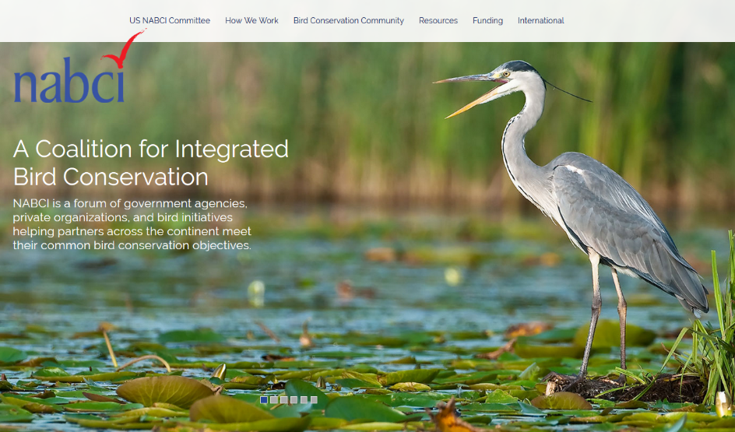
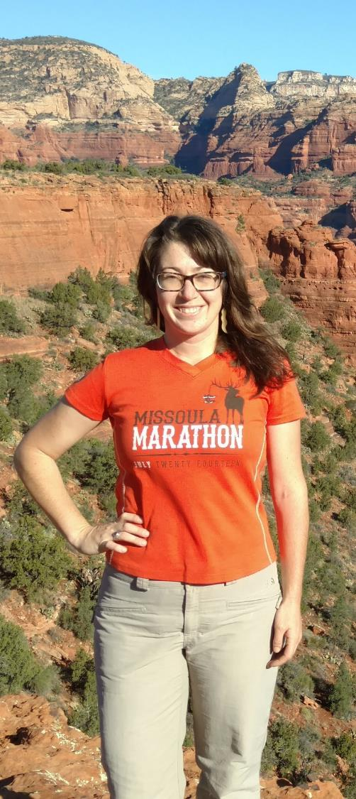
Highlights since
Last Meeting
Notes:
As always, we’ve had a lot going on in the last 6 months, and I’ll just give you a couple of teasers that you’ll hear more about throughout the day. The bird conservation community hired the first National Bird Conservation Social Science Coordinator, Ashley Gramza, who started her job at the beginning of January. This is a position that we’ve been talking about for a few years that finally came to fruition under the leadership of Tammy VerCauteren and Ashley Dayer- Tammy and Ashley will tell you more about this position and formally introduce the new Social Science coordinator during the Human Dimensions Subcommittee update. We launched a new NABCI website last October, designed to serve as a repository for national bird conservation resources, as well as a guide to the very complicated bird conservation community- Matt Cimitile and Greg Butcher will tell you about this during their Communications Subcommittee update. Canada, Mexico, and the US released a draft Hemispheric Vision for Bird Conservation, which members of our International Subcommittee played a big role in developing, and Deb Hahn and Greg Butcher will tell you more about the next steps for that Vision in the International Subcommittee update.
Over the last six months, also, each of our Subcommittees was tasked with completing a new Work Plan, if they hadn’t already done this before our last meeting. Each of our Subcommittees will present its Work Plan at this meeting and give us the opportunity to provide feedback.

Slide 4
NABCI’s New Vision
Healthy and abundant populations of North American birds are valued by future generations and sustained by habitats that benefit birds and people.
Photo copyright Alan Schmierer
Notes:
Another big highlight over the past six months is that NABCI voted to adopt a new vision for our US NABCI Committee. As you know, at our last meeting, we discussed expanding our old vision, which was “Healthy populations of North American birds that are valued for generations to come” to incorporate a habitat and a human element- to show that bird conservation has broader relevance beyond birds. The Executive Council presented Committee members with an alternate option for comment back in September, responded to feedback, and offered the new Vision text for a vote in November. All Committee members voted, and we adopted the new Vision with a vote of 24 to 4. Our new vision is “Healthy and abundant populations of North American birds are valued by future generations and sustained by habitats that benefit birds and people.”
The adoption of this new Vision I hope will reflect a broader shift in thinking for NABCI- the idea that we need to be more inclusive in bird conservation, that we need to demonstrate bird conservation’s broader relevance to both conservation, as well as more general human interests, such as health or economics, if we are to have the greatest chance of success to meet bird conservation goals. I think it also reflects an acknowledgment that it’s on us, as a bird conservation community, to make those connections- to show how our interests are aligned with others. I’m really happy that NABCI is choosing to go in this direction. Rather than diluting our efforts, I think this will actually help us to build even stronger support to work towards the goals that are most important in bird conservation.

Slide 5
Day 1
Subcommittees (morning)
Policy (afternoon)
Priorities (afternoon)
Copyright Rich L via Flickr
Notes:
This morning, each of our Subcommittees will present on their major projects and accomplishments, as well as go through their new Work Plans- Committee members received each Subcommittee’s Work Plan in the pre-meeting reading packet I sent out a few weeks ago. As we hear about the Subcommittee Work Plans, we’ll want to make sure that each Subcommittee’s Work Plan is appropriately focused and reflects work that is important to the broad bird conservation community. But it’s also our job at this meeting to think about how each Subcommittee’s goals and actions help NABCI to achieve its broader goals as laid out in our strategic plan. Several of our Subcommittees are communicating with each other to figure out where they can work together to advance common goals, and this meeting is a great opportunity to think more about how our Subcommittees fit together and can support each other.
This afternoon, we’ll talk about some of NABCI’s newer initiatives, like how to better engage in policy development and implementation, and how we can use State of the Birds data to better link to key policy decisions. We’ll also talk about priorities in two separate but related presentations. First, in the past, NABCI has had some unifying projects that the entire Committee could rally around, such as the development of Bird Conservation Regions, or the push to make all Joint Ventures all-bird. We’ll evaluate whether there is another high-priority project that all of NABCI should be working to advance. Beyond NABCI’s own priorities, we’ll also discuss whether NABCI should compile a list of the highest priorities across the bird community, what value such a list might have, and how to go about doing something like that, if we determine that this would serve as a useful resource.

Slide 6
Super
NABCI
Surprise!
? ? ? ?
Notes:
We’ll end this afternoon with a Super NABCI Surprise (although this photo makes it seem maybe scarier than it really is).

Slide 7
Day 2
Strategic Planning
Governance
Photo copyright Srikanth VK via Flickr
Notes:
Day 2
Depending on where we go with our discussions about Priorities this afternoon, we may need to take some time to revisit them tomorrow morning, and we’ve got a slot for that. Tomorrow, also, we’ll tackle our Strategic Plan. You’ve received a draft Strategic Plan in your packets, and I sent the Plan around to the NABCI distribution list. Tomorrow I’ll go through how we got from the discussions at our last meeting, to a complete strategic plan with input from the broader NABCI Community. We’ll talk about the next steps, the process of building in the more detailed work plan to support the Strategic Plan, and if anyone has any major concerns about the strategic plan, there will be the chance to voice these. We’ll end the meeting with a business meeting, where we go through some governance issues and talk about the Gary T. Myers award.

Slide 8
Think Outside of the Box
(Or the bird cage)
Notes:
One major theme of our meeting will be thinking outside of the box- or outside of the bird cage (I’ve been saving this joke for weeks). Throughout our meeting, we’ll be touching on not just the importance of building stronger connections between some of the bird conservation silos, but we’ll also come back to the idea that making connections outside of bird conservation is critical to accomplishing our goals.
-Part of the focus of the Hemispheric Vision that our Subcommittee will talk about is how, in order to advance bird conservation internationally, we may actually need to make our efforts a little less about birds.
-As I mentioned, the NABCI Committee also voted to adopt a new Vision that incorporates habitat and a human element, and again, I hope that broadening the Vision for our Committee reflects a similar sentiment nationally- an acknowledgment that bird conservation is broadly connected- connected to landscape or habitat conservation, connected to economics, to recreation, and to human health- and that it’s up to us as a bird conservation community to make those connections and build partnerships based on common interests.
-We’ll talk about linking State of the Birds reports to specific policies, and the importance of linking this messaging not just with birds, but with the economic and social benefits of bird conservation programs.
-And of course, we’ll talk about our Subcommittee’s work plans, with the ultimate goal of aligning our Subcommittees with our bigger-picture Strategic Plan, and vice versa- but also we’ll be looking for opportunities to collaborate across our Subcommittees, to make sure that our Subcommittee designations don’t inadvertently limit us.

Slide 9
Things to Consider
Leadership
Investment
Relevance
Notes:
As we go through our meetings, I hope we can keep the theme of “thinking outside of the bird cage” in mind, and think about ways to broaden our approach to bird conservation in order to be more effective. But there are three other things I hope we’ll think about throughout this meeting- things that will help make NABCI stronger and a better partnership.
First, I ask you to think about leadership. Over the last six months, we’ve had a lot of leadership transitions in our Subcommittees- we have new Chairs for our International and State of the Birds Subcommittees, as well as a new Co-Chair for our SOTB Subcommittee, will have a new chair for our Communications Subcommittee after this meeting, and are still working on a Chair for the Monitoring Subcommittee. Tomorrow we’ll talk about expanding who is eligible for Subcommittee leadership as part of our governance discussion, to make sure we get the best fit possible to lead each of our Subcommittees. But beyond our Subcommittees, each of NABCI’s projects and initiatives need leadership- whether that’s evaluating our position on policy, working on different elements of the strategic plan, or shepherding projects that don’t fit neatly into one subcommittee or another. The more we have people willing to step up and lead our initiatives, the more capacity NABCI will have to achieve our goals. I hope you’ll think about where you fit in to this- which initiatives you might be able to play a leadership role in.
Beyond leadership, I hope you’ll think about how else you can invest in NABCI to make our partnership as successful as possible. It’s fantastic that we’re all able to get together twice a year and talk about big-picture issues and make decisions, and I know that’s a big sacrifice of time and travel. I hope these meetings inspire you to do more, too. One of the challenges of the NABCI Committee is how to be truly representative- how to make sure it’s not just the 29 of us in this room, making decisions and having discussions that don’t get reflected back to the organizations we represent. I hope you’ll think about how you can engage people in your organization to work on NABCI’s subcommittees, to use NABCI’s resources, or to give you input on NABCI.
I also want to acknowledge the financial investment that several of our partners are making in NABCI. We have four federal agencies contributing financially to the general NABCI fund, which supports my position and travel, and some of NABCI’s side projects- USFWS, USFS, BLM, USGS. You’ll hear later today about other agencies that are supporting some of NABCI’s projects through Subcommittees. All of the states contribute funds to NABCI through the Flyway Council. And within the last several months, we got commitments from three of our NGOs- BCOR, TWS, and BRI to contribute financially to NABCI. Tammy and I will be approaching our other NGO partners over the next few weeks to follow up on whether you may also be able to contribute financially to NABCI.
And finally, along our theme of “thinking outside of the bird cage,” I hope we’ll think about relevance beyond the bird conservation community. Our focus is bird conservation, but who else might our goals align with, and how can we partner with them? And what actions can we take as a community to demonstrate the broader relevance of bird conservation, and to engage those non-traditional bird conservation partners?

Slide 10
Let’s go!
© Joseph Kiesecker
Notes:
The majority of NABCI’s substantive work happens in its subcommittees and ad hoc work groups, and we’ll start the morning with reports and discussion from several of NABCI’s subcommittees. I want to mention that subcommittee membership is not limited to NABCI committee members, or even Committee member organizations- we have a lot of different people helping and leading our Subcommittees, and we wouldn’t be able to accomplish what we do, without them. So, thank you to each of our Subcommittees for their hard work, and I hope that each of our NABCI Committee members can continue to think about how each of your organizations can contribute to the great work they’re doing.
So, let’s get started! We’re going to kick things off with a report from our Human Dimensions subcommittee, led by Co-Chairs Tammy VerCauteren and Ashley Dayer.

Slide 11
Highlights since
Last Meeting
National Bird Conservation Social Science Coordinator
Website Launch
Draft Hemispheric Vision
Subcommittee Work Plans
Notes:
As always, we’ve had a lot going on in the last 6 months, most of it moved forward by our Subcommittees. Just to give you a couple of highlights- The bird conservation community hired the first National Bird Conservation Social Science Coordinator, a position that we’ve been talking about for a few years that finally came to fruition under the leadership of Tammy VerCauteren and Ashley Dayer- Tammy and Ashley will tell you more about this position and formally introduce the new Social Science coordinator during the Human Dimensions Subcommittee update. We launched a new NABCI website last October, designed to serve as a repository for national bird conservation resources, as well as a guide to the very complicated bird conservation community- Matt Cimitile and Greg Butcher will tell you about during their Communications Subcommittee update. Canada, Mexico, and the US released a draft Hemispheric Vision for Bird Conservation, which members of our International Subcommittee played a big role in developing, and Deb Hahn and Greg Butcher will tell you more about the next steps for that Vision in the International Subcommittee update.
Over the last six months, also, each of our Subcommittees was tasked with completing a new Work Plan, if they hadn’t already done this before our last meeting. Each of our Subcommittees will present its Work Plan at this meeting and give us the opportunity to provide feedback.

Slide 12
-National Bird Conservation Social Science Coordinator
-NABCI Website Launch
-Hemispheric Vision for Bird Conservation
-Subcommittee Work Plans
Highlights since
Last Meeting
Notes:
As always, we’ve had a lot going on in the last 6 months, most of it moved forward by our Subcommittees. Just to give you a couple of highlights- The bird conservation community hired the first National Bird Conservation Social Science Coordinator, a position that we’ve been talking about for a few years that finally came to fruition under the leadership of Tammy VerCauteren and Ashley Dayer- Tammy and Ashley will tell you more about this position and formally introduce the new Social Science coordinator during the Human Dimensions Subcommittee update. We launched a new NABCI website last October, designed to serve as a repository for national bird conservation resources, as well as a guide to the very complicated bird conservation community- Matt Cimitile and Greg Butcher will tell you about during their Communications Subcommittee update. Canada, Mexico, and the US released a draft Hemispheric Vision for Bird Conservation, which members of our International Subcommittee played a big role in developing, and Deb Hahn and Greg Butcher will tell you more about the next steps for that Vision in the International Subcommittee update.
Over the last six months, also, each of our Subcommittees was tasked with completing a new Work Plan, if they hadn’t already done this before our last meeting. Each of our Subcommittees will present its Work Plan at this meeting and give us the opportunity to provide feedback.
National Bird Conservation Social Science Coordinator
Website Launch
Draft Hemispheric Vision
Subcommittee Work Plans

Slide 13
Super
NABCI
Surprise
? ? ? ?
Notes:
We’ll end this afternoon with a Super NABCI Surprise.

