Slide 1
Human Dimensions Subcommittee
Notes:
A rem,m

Slide 2
Topics
The HD Landscape
Review of Work Plan
National Social Science Coordinator
Welcome Ashley Gramza
First Quarter Work
Role of Advisory Team
National Survey Update
Social Science One-pager
Notes:
I think it is impressive to at least mention how many members of our subcommittee we have and the diverse representation, it has grown since August, could also highlight HD capacity and interest are growing across the nation- Southeast Group, others? Our committee will work to stay engaged, avoid duplication and share resources.

Slide 3
The HD Landscape
Vibrant subcommittee
20+ active members
HD interest growing
JV Coordinators meeting
SEAFWA
New SS positions
2 National Parks; More in USFWS; 15+ TNC; etc.

Slide 4
HD Work Plan
Enable bird conservation partners to integrate human dimensions science and tools into bird conservation efforts.
Contribute to NAWMP HD efforts
Strengthen the social science capacity for bird organizations through sharing relevant research and offering trainings and/or workshops.
Understand how to support birdwatchers and natural resource managers and other key audiences interested in conservation.
Notes:
A reminder that in August we presented our updated work plan and achievements. A copy of that report is in your packet. We continue to do work in three main areas.
Today we will talk about our work with NAWMP on the national survey
Capacity – today we will talk about a one-pager that is part of this work
We are beginning work on a private lands study in PL region with FSA. You will hear more about this at the next NABCI meeting.
Our subcommittee anticipates revising our workplan again later this spring after our new Coordinator has incorporated feedback from all of our subcommittee members and others.
Should we remind folks 50% of Ashley’s time advancing social science capacity and 50% advancing social science research?

Slide 5
National Social Science Coordinator
Funding Partners
USDA Farm Service Agency
USDA Forest Service
North Carolina Wildlife Resources Commission
Virginia Tech
2 years secured
Notes:
As you’ve seen in emails since our last in person meeting, we are very pleased to announce that we raised over $165,000 for the National – not including in-kind support from Virginia Tech and additional funding support for a private lands incentive program research project with FSA.
Ashley is sorry she is not here to join me in thanking the partners who stepped up to support this position and those NABCI members who helped us connect with them. (Ashley will be at NAOC but was unable to make it to NABCI).
Thanks to FSA – Rich Iovanna and David Hoge.
USDA Forest Service – Wilhelmina Bratton and Greg Butcher for the connection (?)
North Carolina Wildlife Resources Commission – Gordon Myers and Scott Anderson.
Virginia Tech – Ashley for using her start-up funds to support this position, providing in-kind support through her time, and securing office space and administrative support.
[Ask everyone to clap]
Please note that only 2 years of funding are secured. Our original goal was 3 years, but we decided to move forward with just 2 years of funding.

Slide 6
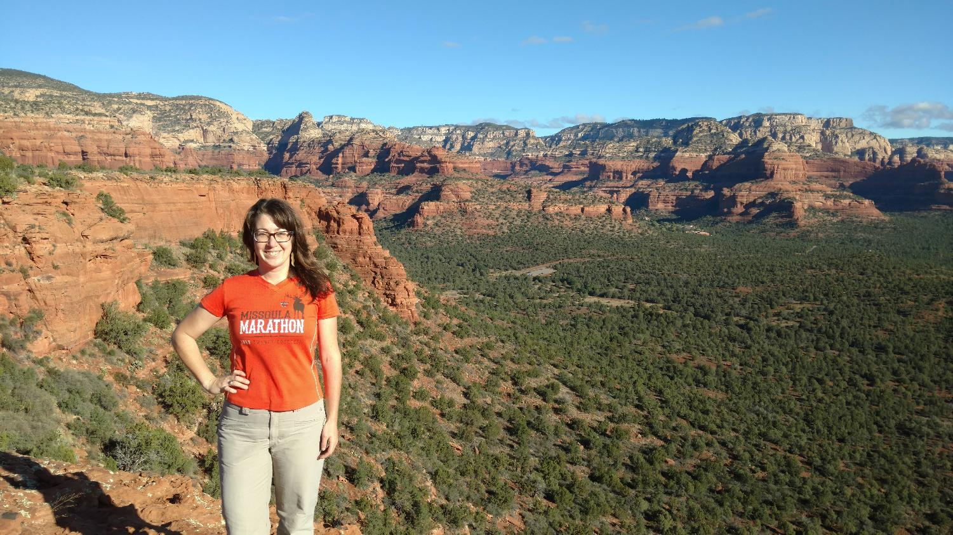
Welcome Ashley Gramza
Notes:
Gramza (as we will call her to avoid the confusion of two Ashley’s) will bring an ideal mix of social science and wildlife science background, with a B.S. in Wildlife Ecology from University of Wisconsin-Madison; an M.S. in Human Dimensions of Natural Resources from Colorado State University, and a nearly complete Ph.D. in Fish, Wildlife, and Conservation Biology from Colorado State University. Her dissertation research focused on a topic of great relevance to bird conservation: "Integrating biological and social science data to understand the ecological role of free-ranging domestic cats.”
Gramza has a great deal of experience studying applied human dimensions issues with local, state, and federal natural resource agencies, most recently leading human-wildlife interaction research with the National Park Service. She additionally brings on-the-ground private lands experience, having worked as a Private Lands Wildlife Habitat Specialist in Iowa.

Slide 7
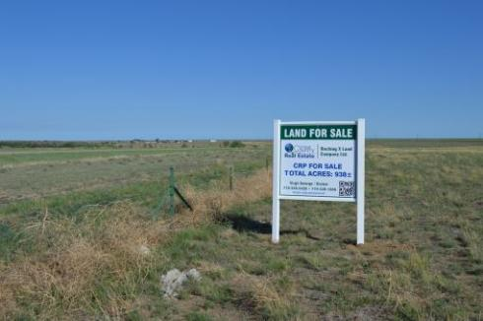
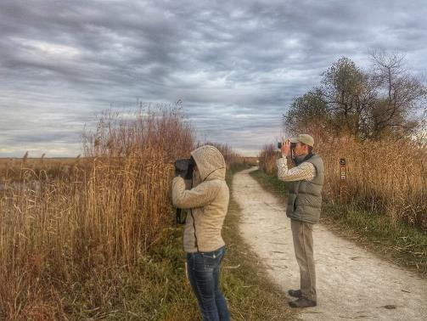
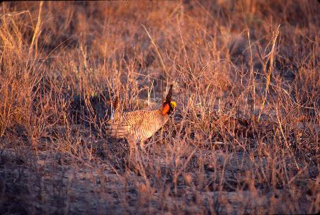
First Quarter
Make connections and start to understand HD needs within the bird conservation community
Update HD subcommittee workplan
Draft HD factsheet specific to bird conservation
Begin work on CRP private lands research project
Notes:
Working with the Advisory team, I’ve been working on the following tasks for my first quarter in this position
This month and next, Gramza will be working on understanding where people are within the bird conservation community with regards to human dimensions and assessing the great needs for capacity building within the community and charting the most strategic next steps for this position.
Focus of the first 2 months will be getting up to speed with organizations and people within the bird conservation community and introducing herself with the goal of better understanding partners, players, and social science needs.
For the next 2 years, her research will focus on motivations for enrollment in Conservation Reserve Program within the Playa Lakes Joint Venture area and understanding what farmers and ranchers do once their CRP contracts are up.
Should we summarize feedback from HD subcommittee on high level priorities they are interested in?
Suggest quick summary of what you’re up to this first quarter. Mention that the Advisory Team created this charge for you. Mention where you expect you’ll be at the end (new Work plan for subcommittee and personal work plan; connections made; private lands project underway; and initial product of the factsheet complete).

Slide 8
What We’ve Been Hearing
Research on engaging stakeholders
Explain need & purpose of HD
Success stories of HD and birds
Connect bird folks with HD folks
Partner with others to advance needs

Slide 9
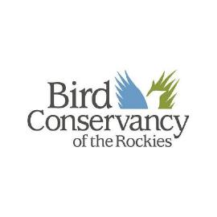
Advisory Team
Members
Ashley Dayer, Supervisor at Virginia Tech
Tammy Vercauteren
Natalie Sexton
Todd Fearer
Scott Anderson
Judith Scarl

Slide 10
Role of Advisory Team
Developed position description & hiring team
Strategic advice on direction & priorities
Ensure Gramza has appropriate workload
Champions & mentors for position
Connections to bird conservation community
Evaluation on an annual basis

Slide 11
The Position
Notes:
Job Description
50% leadership and capacity building including the following:
Serve as the Co-Chair of the NABCI Human Dimensions Subcommittee
Engage with the North American Waterfowl Management Plan’s Human Dimensions Working Group, the Unified Science Team (including Tri-Initiative Science Team and the North American Waterfowl Management Plan’s Science Team) bird conservation communications teams (e.g., the Joint Venture Communications, Education, and Outreach Team and NABCI’s Communications Subcommittee), and other agencies’ and organizations human dimensions specialists (e.g., the USFWS National Wildlife Refuge System’s Human Dimensions Branch)
Connect bird conservation partners needing social science support with those with social science skills and research background
Collaborate with other social scientists (e.g., US Fish and Wildlife Service Branch of Human Dimensions) to develop resources and tools for conservation professionals
Deliver social science resources and tools (e.g., written, web, webinars, trainings) to bird conservation professionals
Develop and maintain a repository of bird conservation research tools (e.g., surveys) and studies
Communicate results of relevant social science research to bird conservation partners and aid them in understanding how to apply results
Cultivate a network of champions for bird conservation social science
Foster a shared understanding of how social science contributes to bird conservation
50% social science research and research coordination activities including the following:
Pursue research collaborations with bird conservation partners
Identify top research needs of the bird conservation community
Contribute to proposal writing and fundraising efforts to support top research needs
Participate in bird conservation study teams and serve as a liaison between social science researchers and bird conservation professionals
Provide expert review of bird conservation-related social science surveys
Research project design
Literature reviews
Survey design and implementation
Focus group and interview design and implementation
Data analysis (qualitative and quantitative)
Peer-reviewed report and manuscript writing
Other communications products to transfer social information to bird conservation professionals to facilitate application of information to management and decisions

Slide 12
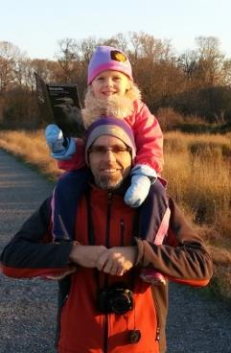
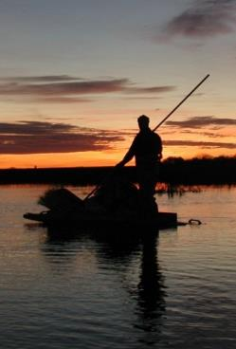
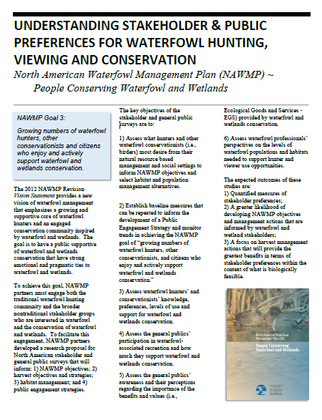
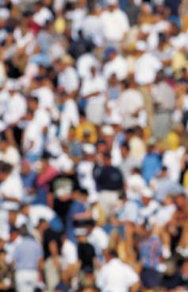
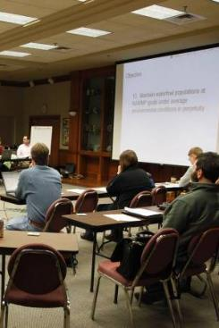
National Survey
Viewer Survey
Hunter Survey
Public Survey
Professional Workshops
Notes:
Now I want to talk about two of our projects….the first is with NAWMP and the Flyways....led by USGS.
Highlight …first of it’s kind in several ways:
Continental in scope
Like NAWMP…looking across the range of stakeholder groups…
Tremendous partner support and engagement in funding, developing, and implementing project…a big thank you….
Provide reminder still a little ways to go on the Canadian front…as Howie mentioned yesterday.

Slide 13
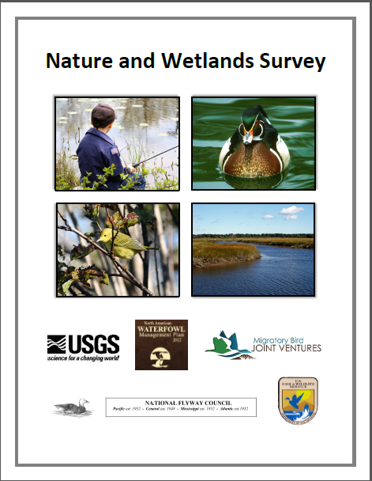
General Public Survey
Jan 30 - Begin mailing surveys
End of March - Finish survey administration
Early May - Provide basic preliminary results
May - Continue analysis
June - Produce draft findings document

Slide 14
Bird Viewer Survey
Contacted eBird members 5 times in Nov. – Dec.
33,230 responses (~26% response rate)
88% completed survey that started it
Median survey time = 20 min.
Non-response mail survey –early Feb.
Report – late Mar.
Notes:
We contacted eBird membership 5 times between early November and mid-December. A total of almost 30,000 surveys were completed. I have closed the survey to data collection and will be implementing a short non-response survey by mail in late January or early November to assess reasons for non-response and identify any potential demographic or experience differences between non-respondents and respondents. We contacted 128,000 valid e-mail address, so the response rate is about 23%. Because our sample is so large and response flow so uniform over time (% on essentially all questions remained stable from the first few days throughout the data collection period), I do not anticipate any issues with non-response. I will be circling back to eBird folks to determine what data they have for the eBird population, but I'm not sure how much information they have collected over the years. For those starting the survey, 88% completed it. Based on the completion rate among hunters, about 5-6% of incompletes were likely due to server crashes at Sawtooth during high volume response times. These very likely represent random incompletes not directly caused by survey length or respondent characteristics.

Slide 15
Hunter Survey
2 mail contacts 35,000+ waterfowl - mid. Nov. –Jan.
~5,300 online surveys (~15% response rate)
~92% completed survey that started it
Final contact to be made in states with low RR
Non-response mail survey – Feb.
Report – late Mar.
Notes:
2) We contacted 35,000+ waterfowl hunters twice in mid-November and again in December. We have received a total of ~4200 useable surveys (completed questions through the choice questions). The overall response rate is standing at about 12% but it varies from about 18% in the upper midwest, Utah and few other states to below 10% in some of the southern states. The completiong rate among those who start the survey is 92-3% so survey length does not appear to be an issues. Getting them to log into the web site is. I will be implementing an incentive for all respondents in states with less than 11% response rates, and a random proportion of respondents in states with less than a 13% response rate. We are sending this third contact out over the next week. I think the incentive will lift our overall response rate to 20%, but I might need to implement addtional strategies in Florida, Arkansas and North Carolina to assure that we hit our target of ~400 in those states. We started with an initial sample of 2000 in each of the oversample states, but have 1000 in reserve from the HIP data base that we could contact with an incentive to lift the response if we see that we need to. We might also be able to match e-mails to respondents in those states and lift response by a few % points that way. I've been in discussion with the services and have confidence in their processes. It would be a last resort that we will likely not take. The goal is to have all data collected by mid-February. A shortened non-response check would follow immediately after that.

Slide 16
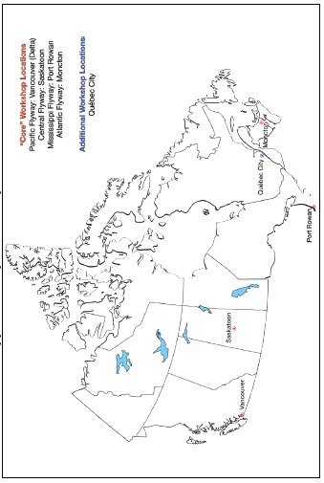
Canada Update
Surveys in March
Working on funding
Notes:
2) We contacted 35,000+ waterfowl hunters twice in mid-November and again in December. We have received a total of ~4200 useable surveys (completed questions through the choice questions). The overall response rate is standing at about 12% but it varies from about 18% in the upper midwest, Utah and few other states to below 10% in some of the southern states. The completiong rate among those who start the survey is 92-3% so survey length does not appear to be an issues. Getting them to log into the web site is. I will be implementing an incentive for all respondents in states with less than 11% response rates, and a random proportion of respondents in states with less than a 13% response rate. We are sending this third contact out over the next week. I think the incentive will lift our overall response rate to 20%, but I might need to implement addtional strategies in Florida, Arkansas and North Carolina to assure that we hit our target of ~400 in those states. We started with an initial sample of 2000 in each of the oversample states, but have 1000 in reserve from the HIP data base that we could contact with an incentive to lift the response if we see that we need to. We might also be able to match e-mails to respondents in those states and lift response by a few % points that way. I've been in discussion with the services and have confidence in their processes. It would be a last resort that we will likely not take. The goal is to have all data collected by mid-February. A shortened non-response check would follow immediately after that.

Slide 17
Save The Date

Slide 18
Social Science One-pager
How will you (or others) use it?
With what goal/purpose?
With what audience?
→ Your answers will inform content, messaging, and distribution (but let’s not talk about those details today).
Notes:
Give a little background that this was requested by multiple folks on the committee. We want to ensure we develop a useful product that meets goals and outcomes we want to achieve.

