Slide 1
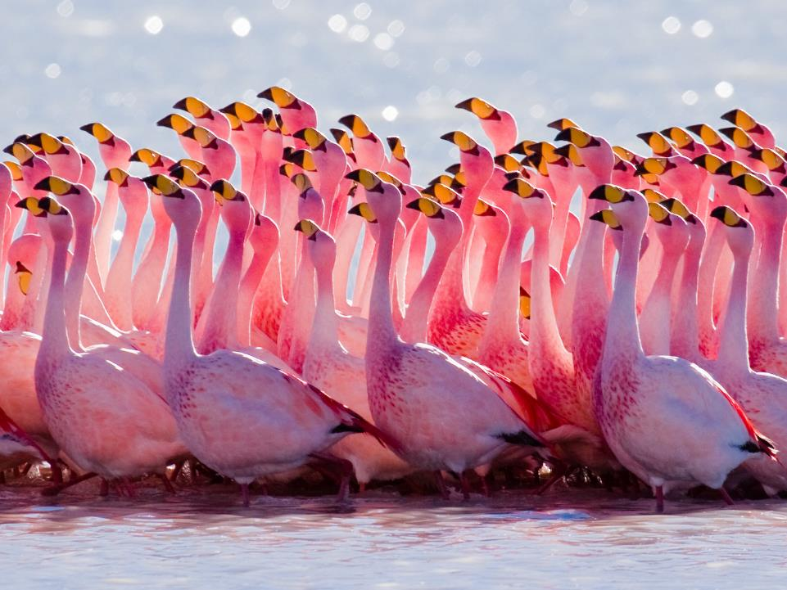
2017-2021 NABCI Strategic Planning Process
Looking Forward for Bird Conservation
© Pedro Szekely
Notes:
We’ve made great progress in our strategic planning efforts since our last meeting, and all Committee members received a draft Strategic Plan in your pre-meeting reading packets. I really want to thank everyone who was a part of the strategic planning effort- we really tried to have very broad outreach and engagement in this process, which means that a lot of people helped in a lot of different ways.

Slide 2
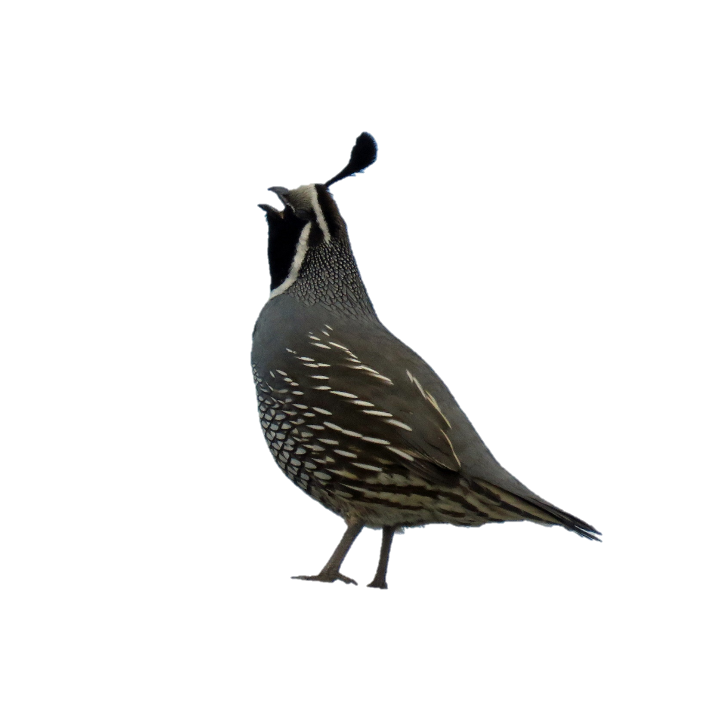
Benefits of NABCI Strategic Plan
Defines NABCI’s scope, focus, and goals
Focuses NABCI meetings to maximize productivity
Helps answer the age-old question:
What is NABCI, anyway??
California Quail © Alexandra MacKenzie via Flickr
Notes:
Before I talk about the strategic planning process, I want to emphasize the benefits of NABCI’s 2014-2016 strategic plan that we will continue to see with our next strategic plan. Our strategic plan helps to define NABCI’s scope, focus, and goals- it helps to focus our efforts on a unique niche in the bird conservation community, and it gives us clear goals that we can align our actions with. It also really helps to focus our meetings- since we started organizing our meetings around our strategic plan two years ago, our meetings have had clear purpose, been outcome-focused, and all of our presentations and discussions clearly aligned with what we are trying to achieve. We’ve gotten an enormous amount of positive feedback about how productive our meetings have been over the last couple of years, and how aligning meetings with the strategic plan has helped enormously and even served to re-engage some of our partners who were questioning the value of NABCI. And our strategic plan has really gone a long way to answering that age-old question that I know we all get (and ask sometimes): “What is NABCI, anyway?” as well as Why NABCI? Why do we need NABCI? So I know that strategic planning isn’t always everyone’s favorite activity, but the benefits we get from it are well worth it, and I appreciate all of your efforts to make NABCI as effective as possible.

Slide 3
Today’s Presentation
Progress and Process
Building the Work Plan
Next Steps
Preferred Outcome: Committee is comfortable with draft Strategic Plan;
identify team and process to build Work Plan
Photo copyright Ken Slade via Flickr
Notes:
Today we’re going to move forward the strategic planning process. I’ll go through the progress we’ve made and explain the process we’ve used so far, as well as the process we’ll use to build in a work plan. There were a lot of questions last time on the strategic planning process, so I want to make sure this is transparent. We’ll also solidify the next steps for building in the work plan. The preferred outcome of today’s discussion is that the Committee is comfortable with the draft Strategic Plan, and that we have a clear strategy for how we’ll build a Work Plan over the next six months, and who will be engaged in that process at each step.

Slide 4
Progress and Process
Six rounds of comment and revision, starting in August 2016
Step 1: NABCI Committee Member survey and NABCI meeting discussion
Photo copyright Ken Slade via Flickr
Notes:
So to walk you through the process of getting to where we are now, we’ve had six rounds of comment and revision of the Plan over the last six months.
The first step was the survey we asked NABCI Committee members to participate in before our last meeting, and the discussion we had during our August meeting. Based on the survey and discussion, people felt like we generally had the right elements in our 2014-2016 Plan, but for the next Plan we needed to better define how NABCI would engage in policy, we wanted to re-evaluate our Vision, and we needed to re-think our Plan’s language to better clarify what we were trying to achieve, and what we are trying to do. We formed three teams to address each of these elements. Keith and I talked about the Policy Team and its recommendations yesterday, so I’ll skip to the work we did on the Vision.

Slide 5
Step 2: Vision Revision
Healthy and abundant populations of North American birds are valued by future generations and sustained by habitats that benefit birds and people.
Vote: 24 to 4 in favor
Photo copyright Joseph Kiesecker via Flickr
Notes:
In our Committee member survey last summer, people expressed general satisfaction with NABCI’s vision, but several people mentioned that it might be improved by incorporating a habitat or human element- that is, making it clear that bird conservation has benefits far beyond birds. Again, as I mentioned yesterday, this is a bit of a mindset-shift, and reflects the increasing acknowledgment that it is essential for us to find areas of alignment between bird conservation goals and broader conservation goals, or even broader human interests- so that we have maximal chance of bird conservation success.
Our original vision was Healthy populations of North American birds that are valued for generations to come.
NABCI Executive Council, which consists of Gordon, Jerome, Tammy, Greg, David W, and me, developed alternate Vision language and sent to Committee members via email for feedback in September 2016.
EC incorporated Committee feedback and sought additional input from 3 Communications staff. Alternative vision put to online vote by NABCI Committee in November, and new Vision was adopted by a vote of 24-4 in December 2016. again, I hope this reflects somewhat of an expansion of how we think about bird conservation and how we work with broader communities to support bird conservation and shared goals.

Slide 6
Step 2: Plan Language Team
Photo copyright Ken Slade via Flickr
Goal: Improve language of Plan to clearly represent what we want to achieve (goals) and what we want to do (actions)
Members: Ken Williams, John Alexander,
Tammy VerCauteren, Todd Fearer, Geoff Walsh, David Hoge, Judith Scarl
Notes:
At the same time the Executive Council was working on the Vision, we had a Plan Language Team tasked with structural rearranging of existing Plan to more clearly represent what we want to achieve (goals) and what we want to do (actions/tasks). Team met twice in late 2016 and restructured Goals 1 and 2, with sub-goals to accompany each of these. While the substance of what NABCI is trying to accomplish didn’t change, this language team helped to clarify what NABCI is looking to accomplish, and also to a certain extent, better defined the potential scope of those accomplishments.

Slide 7
Step 3: Executive Council
Feedback: Goals and Sub-Goals good, recommend building in high-level actions
(October 2016)
Executive Council approves draft Actions: November 2016
Photo copyright Ken Slade via Flickr
Notes:
Draft high-level Strategic Plan presented to Executive Council in October 2016; Council asked for actions to be incorporated into Strategic Plan, to better evaluate whether our plan was realistic to accomplish. Coordinator incorporated draft Actions and sent Plan to small team for feedback. By November, the Executive Council felt like we had a solid draft and could move forward with broader community feedback.

Slide 8
Step 4: Close Partner Feedback
Subcommittees
BCPP Coordinators and JV Coordinators (phone call)
JV Coordinators (phone call)
Photo copyright Omar Bariffi via Flickr
Notes:
Next Step: : Plan distributed to Subcommittee Leadership and feedback requested from Subcommittees by December 12.
-No feedback received from Subcommittees at that time, although we did receive some later.
-Received and considered feedback from Bird Conservation Plan Partnership Coordinators and JV Coordinator on a one-hour phone call
-Received and considered feedback from JV Coordinators from Todd Fearer’s compilation of 1 hour phone call and additional feedback submitted in writing
Unlike in the previous steps in this process, due to time constraints, I was the only one who saw all of the feedback and incorporated it, so that’s a potential bottleneck; when we develop the work plan, we’ll build in a mechanism to make sure that there is a team that sees the feedback and works to incorporate it at each step of the process.

Slide 9
Step 5: Broader Community Feedback- NABCI Organizations and Partnerships
Photo copyright Diana Robinson via Flickr
Notes:
The next step was to distribute the Plan to NABCI Committee members and the NABCI Community via Coordinator’s distribution list. Committee members asked to provide feedback on behalf of the organizations they represent, and it was suggested that partnership representatives convene calls with their Partnerships to offer opportunity to provide feedback.
Feedback Received:
-US Shorebird Conservation Partnership
-Dave Mehlman, TNC
-Ducks Unlimited
Coordinator considered feedback and distributed this Plan to the Committee for consideration today.

Slide 10
Where we are now
Complete Strategic Plan with well-defined goals, sub-goals, and high-level actions
Photo copyright Ken Slade via Flickr
Notes:
So, where we are now is that we have a complete strategic plan with well-defined goals, sub-goals, and high-level actions.

Slide 11
Goal 1: Maintain a well-coordinated bird conservation community to achieve strategic conservation.
1A. Support, develop, integrate, and promote priorities of (regional), national and international bird conservation partnerships.
1B. Strengthen communication within the bird conservation community.
Notes:
The first goal is our coordination and communication goal. Given that the bird conservation community is so complicated, with so many different NGOs, agencies, partnerships, and states working on different aspects of bird conservation, NABCI’s coordination function is really key to make sure we’re maximizing opportunities to identify highest-priority goals across the bird community and support work to advance these goals.
Maintain a well-coordinated bird conservation community to achieve strategic conservation. Under Subgoal 1A, this is where we have most of our explicit partnership work and support, nationally, internationally, and internal to NABCI. High-level actions here include:
1Ai. Work collaboratively across countries to support partnership development that will advance full annual cycle conservation of migratory birds and their habitats.
1Aii. Identify and support common priorities among Joint Ventures and between Bird Conservation Plan Partnerships.
1Aiii. Facilitate and promote the development of novel partnerships between conservation and non-traditional organizations (e.g., industry, urban planning associations, etc.) that provide new resources and avenues for addressing bird conservation priorities.
1Aiv. Maintain an effective US NABCI Committee.
Again, with such a complicated bird conservation community, making sure that communication channels are strong throughout the bird community is one of the best ways to facilitate coordination and collaboration. Under our second subgoal, we have actions that include
1Bi. Facilitate effective promotion, distribution, and communication of NABCI products to target audiences.
1Bii. Develop and maintain strong communication channels between the NABCI Committee members and the broader NABCI partnership.
1Biii. Recognize leadership within the bird conservation community.

Slide 12
Goal 2: Facilitate science-based conservation efforts that support healthy bird populations
2A. Promote and advance the use of ecological and social science in design and evaluation of bird conservation practices.
Notes:
Goal 2 is where most of our science-content Subcommittees and affiliated teams would fall- big picture work that we do to support the on-the-ground implementation that is carried out by our partners.
2Ai. Promote and advance bird monitoring that is integrated into strategic habitat conservation. (Monitoring Subcommittee)
2Aii. Enable bird conservation partners to integrate human dimensions science and tools into bird conservation efforts. (HD Subcommittee)
2Aiii. Support efforts to coordinate and unify science capacity among national bird conservation partnerships to more effectively address shared ecological science challenges and needs. (Incorporates NABCI’s role in relation to a unified science team that is coming out of our affiliated partnerships)
2Aiv. Develop and promote effective communications that identify national and international bird conservation needs and inform actions to advance bird conservation. (State of the Birds, Policy)
2Av. Promote and advance bird conservation objectives on both private and public lands. (Private Lands Subcommittee).

Slide 13
Goal 3: Inform and support effective policy to advance bird conservation
3A. Facilitate coordinated communication with government leadership about highest priority programs, initiatives, and needs of bird conservation.
3B. Support partners in the creation and implementation of science-based policies that support bird conservation.
Notes:
And finally, Goal 3 addresses NABCI’s role in policy, which is primarily focused on communication at multiple levels- communication targeted at Congressmen and women as well as agency leadership. Some of the actions here include:
3Ai. Annually compile or develop messaging demonstrating the importance of key bird conservation programs (NAWCA, NMBCA, SWG, Farm Bill, JVs) and promote use of coordinated messaging within the bird community
3Aii. NABCI non-federal partners will develop or compile messaging that communicates how emerging legislation or funding could impact bird conservation.
This relates to what Keith talked about yesterday- that providing this unified messaging about specific programs is one of the most important things NABCI can do in relation to policy. But as Keith mentioned yesterday, NABCI is looking to engage in policy at not just the Congressional level, but also at the agency level- supporting our partners to create and implement strong policies that support bird conservation.
3Bi. Conduct regular outreach to leadership of Committee member organizations to discuss NABCI priorities and solicit feedback on how NABCI can support the development and implementation of policy favorable to bird conservation.
3Bii. Demonstrate bird conservation’s strong ties to healthy land, water, and people in order to communicate relevance beyond birds.

Slide 14
Preferred Outcome: Committee is comfortable with draft Strategic Plan; identify team and process to build Work Plan
Photo copyright Ken Slade via Flickr
Questions
Have we missed anything MAJOR in this strategic plan?
Notes:
So just to remind you of the preferred outcome for today, the Executive Council and I are hoping that the Committee is comfortable with the strategic plan as is, and we’re also hoping to have some discussion on the process of building a work plan. We recommend not having extensive discussion on the content of the strategic plan at this point, since we’ve had so many rounds of feedback and revisions, and now we need to move forward to start accomplishing what we say we’ll accomplish. We do want to take five minutes to ask one big picture question- is there anything MAJOR that we’ve missed in this strategic plan?

Slide 15
Goal 1: Maintain a well-coordinated bird conservation community to achieve strategic conservation.
1A. Support, develop, integrate, and promote priorities of (regional), national and international bird conservation partnerships.
1B. Strengthen communication within the bird conservation community.
Goal 2: Facilitate science-based conservation efforts that support healthy bird populations
2A. Promote and advance the use of ecological and social science in design and evaluation of bird conservation practices.
Goal 3: Inform and support effective policy to advance bird conservation
3A. Facilitate coordinated communication with government leadership about highest priority programs, initiatives, and needs of bird conservation.
3B. Support partners in the creation and implementation of science-based policies that support bird conservation.
Notes:
Here are the Goals and Sub-Goals, to help us think about whether we have missed anything major in this high-level strategic plan (you also have the full version in your handouts).
(Speak now if you have major concerns about moving forward to build a work plan based on this outline.)
The Executive Council suggests that we don’t need to have a formal vote to approve the Plan at this time, but we’d like an informal verbal approval to move forward to build in a more detailed work plan to this higher-level strategic plan.
Are there any MAJOR objections to moving forward with building in the work plan over the next six months?

Slide 16
Building the Work Plan
Step 1: Coordinator works with Subcommittee leadership to incorporate high-level elements from Subcommittee Work Plans
1A. Coordinator meets individually with each Subcommittee’s leads to draft Actions related to that Subcommittee and assign Tasks to leads
1B. Coordinator drafts language for additional Tasks not associated with Subcommittee (e.g. Coordinator tasks, all-Committee tasks)
1C. All Subcommittee leads convene to discuss NABCI Work Plan
Step 2: Executive Council reviews Plan and vets actions and tasks
Step 3: Feedback requested from NABCI Community via NABCI Committee members; incorporated by Coordinator and Executive Council
Final Step: Bring to NABCI Committee for final approval at August 2017 meeting
Goal: Be Inclusive, but Realistic!
Photo copyright Brian Garrett via Flickr
Notes:
So let’s move on to talk about the process of building the work plan. Here are the next steps I’ve proposed in order to present a complete Work Plan at our August 2017 meeting.
What we’ll do first is work with Subcommittees to incorporate Subcommittee goals into the NABCI Work Plan.
The first step is to meet individually with each Subcommittee’s leads to draft actions related to that Subcommittee, and make sure that we understand who is responsible for advancing each of those tasks.
There are some tasks that don’t fall within the purview of an existing Subcommittee- for example, tasks that are primarily the responsibility of the Coordinator, or tasks that are assigned to the entire NABCI Committee. I can go through and draft language for these additional tasks, and associate them with the appropriate Goals and high-level actions.
The next step is to bring a bigger, but still focused team together to go through the draft Work Plan. I suggest the Subcommittee Leads, since we’ll want to verify that we’ve incorporated their goals accurately, but also this will help to identify any opportunities for collaboration between subcommittees that might not have been addressed during individual Subcommittee goal incorporation. The Subcommittee Leads can run the draft by their Subcommittees in advance and bring feedback to the Subcommittee Lead discussion.
Once the Subcommittee Leads are comfortable with the draft plan, we’ll run the plan by the Executive Council. And third, we’ll distribute Plan to the NABCI Community, and request that feedback be submitted through NABCI Committee representatives.
It would be good to have a team vet this feedback and work with me on how to incorporate it. Executive Council?
And finally, we’ll bring the Plan to the NABCI Committee for final and formal approval at our August 2017 meeting.
We want to be inclusive, to make sure we are taking the right steps to achieve our goals- but we also want to be realistic- the more rounds of feedback we get, the more difficult it is to handle, and the more feedback we get at the end may contradict feedback we get at the beginning. Also, focusing a lot of the process around our Subcommittees means that NABCI will have a clear team to move forward the tasks that go into the Work Plan.
Question: What additional partners, beyond our Subcommittee leads, should provide feedback on the Work Plan before asking for feedback from entire community?

Slide 17
Building the Work Plan
Step 1: Coordinator works with Subcommittee leadership to incorporate high-level elements from Subcommittee Work Plans
Step 2: Executive Council reviews Plan and vets actions and tasks
Step 3: Feedback requested from NABCI Community via NABCI Committee members
Final Step: Bring to NABCI Committee for final approval at August 2017 meeting
Is this proposed process appropriately inclusive?
Any additional feedback on how to strengthen process to build the work plan?
Photo copyright Brian Garrett via Flickr
Notes:
So I want to ask a very basic question to the Committee- do you feel that this proposed process is appropriately inclusive? And do you have any additional feedback on how to strengthen the process to build the work plan?

Slide 18
Next Goal: Complete Strategic Plan and Work Plan presented to Committee and approved at August 2017 NABCI meeting
Onward!
Photo copyright Brian Garrett via Flickr
Notes:
So, we’ll aim to have a complete strategic plan and work plan presented to the Committee and approved at our August 2017 NABCI meeting. Thanks for your help. Onward!

Slide 19
Next Steps: Building the Work Plan
Step 1: Coordinator works with Subcommittee leadership to incorporate high-level elements from Subcommittee Work Plans
-Coordinator meets individually with each Subcommittee’s leads to draft Actions related to that Subcommittee and assign Tasks to leads
-All Subcommittee leads (plus Plan Language Revision team?) convene to discuss NABCI Work Plan
Step 2: Engage additional partners (who?) in developing work plan and vetting tasks
Final Step: Bring to NABCI Committee for final approval at August 2017 meeting
Photo copyright Brian Garrett via Flickr
Notes:
Once we’ve built in a Work Plan that identifies tasks and specific actions we can take to achieve our goals, we’ll have a vote to approve the full Strategic and Work Plan at the next NABCI meeting.
We’ve done the bulk of the work already- we just need to think about how the Subcommittee Work Plan goals that we approved yesterday fit under our Plan, and then see if we’re missing any actions and tasks to support our goals and figure out how to get those done as well..

Slide 20
Preferred Outcome: Committee is comfortable with draft Strategic Plan; identify team and process to build Work Plan
Photo copyright Ken Slade via Flickr
Questions
What are the next steps in building a complete work plan?
Notes:
The second question has to do with the process for building the Work Plan. A complete Work Plan will flesh out our actions and identify tasks, and it will assign each task to a Subcommittee, an individual person, or an ad hoc team.

