Slide 1
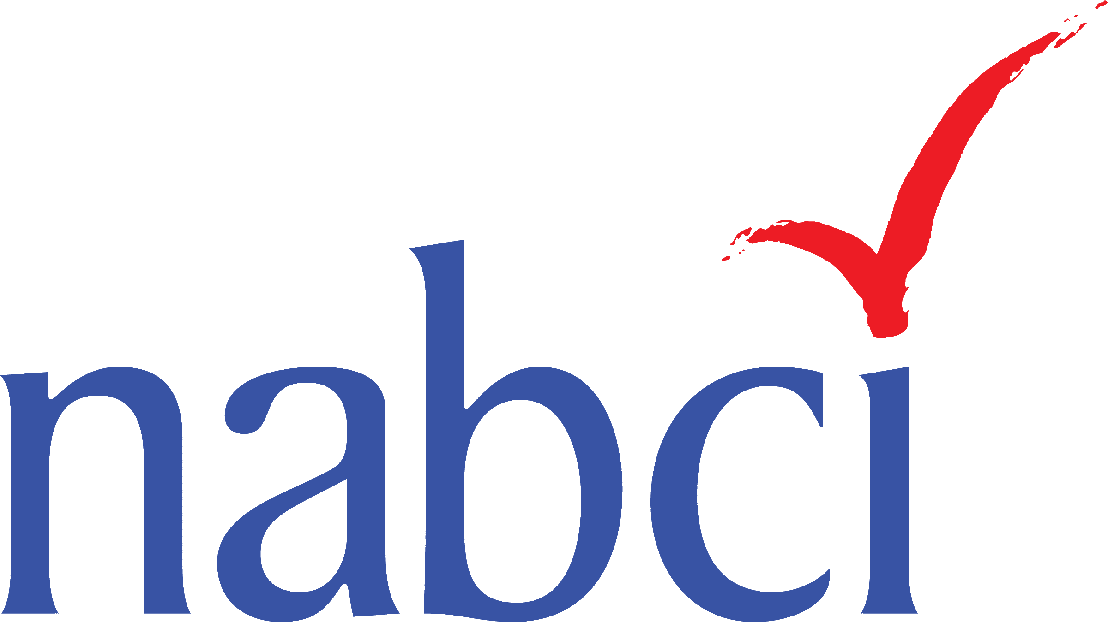
Coordinator Introduction
8 August 2017
Judith Scarl
Coordinator, North American Bird Conservation Initiative, US Committee
© Ken Slade
Notes:
-Give Coordinator introduction to set the stage for the meeting, give us a sense of what we’re hoping to accomplish throughout this meeting, and provide a bigger picture for some of the topics we’re going to be diving more deeply into.
-Also share some of what has been happening behind the scenes that maybe we won’t get into at this meeting.

Slide 2
Highlights since February
NABCI 2017-2021 Strategic Plan and 2017-2018 Work Plans Finalized
© Don McCullough
Notes:
As many of you know, in the past there have been a lot of questions about What is NABCI, and What does NABCI do, and How does NABCI add value to the bird community. Over the last two years, I’ve been really proud to see how much progress we’ve made towards answering those questions- better defining NABCI and also building the bird community’s trust in NABCI.
One of the challenges to demonstrating NABCI’s value to the bird community is that NABCI has many projects that don’t necessarily result in products- we work to build partnerships, or increase communication, or set direction- all of which are very valuable but can be difficult to measure. One of the nice things about the last six months, though, is that we’ve made a tremendous amount of progress since our February meeting with a lot of tangible products, so I want to open this meeting by sharing some highlights from the last six months with you. You’ll hear more about most of these throughout the meeting.
First, we finalized our five-year strategic plan, and built into this a comprehensive work plan that rolls up Subcommittee work plans, projects and initiatives we’ve committed to as a group, and my own work plan into a comprehensive, ambitious document that will guide us into the future. Our Strategic Plan is for five years, while our work plan represents one or two years of work that we have committed to, that will move us towards our strategic goals. I’ll be working with the Subcommittee Chairs to track progress on the work plan, and once a year I’ll provide a report to the NABCI Committee that shows what we’ve accomplished as well as where we might need to spend some extra effort.
One of the things we’ve been working towards over the last few years is having our meeting agendas built around these strategic and work plans, and this has been really successful in helping NABCI make sure that what we do at our meetings directly advances our strategic plans and that NABCI is focused and purposeful. You’ll see that each item in our agenda is linked to at least one action or task in our work plan, which should help us think about what we want to get out of each discussion.

Slide 3
Highlights since February
NABCI 2017-2021 Strategic Plan and 2017-2018 Work Plans Finalized
State of the Birds Report: Farm Bill- Released
© Don McCullough
Notes:
As you know, we’ve also discussed tying our State of the Birds reports to specific goals- and in particular, linking the reports to specific policies that NABCI wants to communicate about. At our last meeting just six months ago, NABCI committed to creating a State of the Birds report focused on Farm Bill conservation programs. And thanks to the leadership of Ken Rosenberg and Tom Moorman, NABCI pulled together a team and completed and released a State of the Birds report in under six months, which has to be some kind of record. Not only that, but this was a situation where most of NABCI came together around a common goal- this report engaged at least five of our Subcommittees and dozens of our colleagues in dozens of organizations.

Slide 4
Highlights since February
NABCI 2017-2021 Strategic Plan and 2017-2018 Work Plans Finalized
State of the Birds Report: Farm Bill- Released
Human Dimensions One-Pager
© Don McCullough
Notes:
At our last meeting, our new National Social Science Coordinator Ashley Gramza had only been in her job for about five weeks, but now she’s been with us for about seven months, and she’s made really good progress on a few key projects. One big highlight that we’ve been really needing for a while is a Human Dimensions one-pager, which is meant to be a foundational document that helps the bird community understand exactly what human dimensions is and how to apply it to their own work. And behind this one-pager is really a whole community of HD expertise- this Subcommittee has really rallied a diverse community to bring new perspectives to bird conservation, and the HD one pager is really reflective of this.

Slide 5
Highlights since February
NABCI 2017-2021 Strategic Plan and 2017-2018 Work Plans Finalized
State of the Birds Report: Farm Bill- Released
Human Dimensions One-Pager
Bird Conservation Relevancy Messaging Developed
© Don McCullough
Notes:
At our last meeting, we started talking about thinking outside of the box, or thinking outside of the bird cage- we talked about how to make the bird conservation community more relevant, and showing how bird conservation has benefits far beyond birds. We’ve had a small team working on developing some bird conservation relevancy messaging, which we can use as a jumping off point for conversations beyond the bird community. Steve Albert has really taken the lead on pulling this together, along with Matt Cimitile and John Alexander, and Steve will be walking us through that this afternoon.

Slide 6
Highlights since February
NABCI 2017-2021 Strategic Plan and 2017-2018 Work Plans Finalized
State of the Birds Report: Farm Bill- Released
Human Dimensions One-Pager
Bird Conservation Relevancy Messaging Developed
Debut of bi-monthly All-Bird Bulletin Blog
© Don McCullough
Notes:
And another big accomplishment since our last meeting was the debut of our bi-monthly All-Bird Bulletin blog! Since March, we’ve been sending out two blogs per month, which means we’ve had about ten partner organizations contribute blogs. Matt Cimitile, who has been our Communications Subcommittee Co-Chair for about two years, was really the driving force behind this and gets a lot of credit for pulling off this transition pretty seamlessly. EJ will be talking more about these and how we’ll move forward with these.

Slide 7
Highlights since February
NABCI 2017-2021 Strategic Plan and 2017-2018 Work Plans Finalized
State of the Birds Report: Farm Bill- Released
Human Dimensions One-Pager
Bird Conservation Relevancy Messaging Developed
Debut of bi-monthly All-Bird Bulletin Blog
North American Vision for Hemispheric Bird Conservation Finalized
© Don McCullough
Notes:
And finally, between meetings, the tri-national Vision team, consisting of representatives from the US, Canada, and Mexico, incorporated our Committee’s comments into the draft Hemispheric Vision for Bird Conservation and balanced some comments from the other NABCI Committees and the general bird conservation communities, and now we have a finalized vision which has been endorsed by at least two of the three NABCI Committees. This Vision is meant to guide our cooperative work- both domestically and internationally- for the next 100 years. We’ll be hearing more about the future for this Vision and its implementation through our International Subcommittee.
I know we’ll talk about these things in more depth throughout the day, but for me, seeing some of these highlights here in one place really exemplifies how far NABCI has come, how much capacity we have to get things done, and how diverse our reach is- but although we do have a diverse focus, I also think these highlights show how all of our work is moving in a unified direction, and helping the bird community better coordinate and communicate to achieve our shared goals. One of the exciting things to see here is that most of these products are really foundational- they will be used to set direction for NABCI or partners, and to build on to move forward with some pretty visionary goals. And it’s really inspirational to me to see so many different people and groups that are so willing to engage in NABCI’s projects and goals- it really shows that NABCI is doing a good job building trust and credibility within our partnership.

Slide 8
Looking at the Big Picture
Relevance
Priorities
Opportunities
© sandeepachetan via Flickr
Notes:
Now as you know, much of NABCI’s tangible work happens through its subcommittees, and our subcommittees are centered around topic areas that we think are of key importance to bird conservation. So when we look at our strategic plan, many of the actions we have committed to are really tied to specific subcommittees. But we also have some big-picture needs and goals in our strategic plan that are applicable across subcommittees, and that really would benefit from being addressed by a broad and diverse group. So this afternoon and tomorrow we’re going to have some bigger picture discussions that are focused around three topic areas- relevance, bird conservation priorities, and opportunities.

Slide 9
Looking at the Big Picture
Relevance
Demonstrate bird conservation’s strong ties to healthy land, water, and people in order to communicate relevance beyond birds;
Develop initial talking points supporting bird conservation relevancy for meetings with agency leadership, funding organizations, and non-traditional partners
© sandeepachetan via Flickr
Notes:
The idea of relevance comes up in our strategic and work plans several times. We talk about being able to communicate how bird conservation links to healthy land, water, and people, and how we need to communicate those messages to agency leadership, funding organizations, and non-traditional partners.

Slide 10
Looking at the Big Picture
Relevance
Facilitate and promote the development of novel partnerships between conservation and non-traditional organizations (e.g., industry, urban planning associations, etc.) that provide new resources and avenues for addressing bird conservation priorities.
© sandeepachetan via Flickr
Notes:
And we explicitly mention the need to reach outside of the bird community and develop those non-traditional partnerships, because partners outside of the bird community may provide us with new resources and avenues for ultimately reaching our bird conservation goals.
So we will have a few sessions this afternoon that focus on relevance. Over the last six months, I’ve asked each of our Subcommittees to think about their partnerships- what non-traditional partners are they engaging with, and what new partners outside of the bird community might share some goals with that Subcommittee? Through the morning, as part of their presentations, each Subcommittee will report back on their new and potential partnerships, and then after lunch, Mike Carter from the Playa Lakes JV, who is representing the JVs, will lead a discussion on how NABCI can move forward with engaging new partners.
And Steve Albert will talk about a project NABCI has undertaken to develop some messaging on bird conservation’s ties to economics, human health, and ecosystem services, and how we can use this messaging to build connections outside of the bird conservation.

Slide 11
Looking at the Big Picture
Priorities
Support, develop, integrate, and promote priorities of regional, national, and international bird conservation partnerships.
Facilitate coordinated communication with government leadership about highest priority programs, initiatives, and needs of bird conservation.
© sandeepachetan via Flickr
Notes:
The idea of priorities comes up a few times in NABCI’s strategic plan, as well. NABCI has committed to supporting, developing, integrating, and promoting priorities of regional, national, and international bird conservation partnerships, and facilitate coordinated communication with government leadership about highest priority programs, initiatives, and needs of bird conservation. And in order to communicate about priorities, or support and promote priorities, first we have to identify these priorities. This afternoon we’ll talk about a process we’ve undertaken to identify the top priorities in bird conservation and how we can use the products we’ll develop as the result of this process.

Slide 12
Looking at the Big Picture
Opportunities
National Geographic: Year of the Bird
International Ornithological Congress 2018
© sandeepachetan via Flickr
Notes:
And finally, over the last six months, we’ve been presented with two opportunities that may help NABCI further its goals. We’ll talk about a Year of the Birds campaign that National Geographic is staging in 2018 and ways that NABCI may want to get involved, and we’ll talk about a “new and improved” International Ornithological Congress and International Bird Festival that will be held in 2018, and whether NABCI has a role to play with this opportunity.

Slide 13
THANK
YOU
Notes:
So I want to end my introduction, and start this meeting, by saying thank you- thanks for all of your work over the past six months, thanks for being here now, and thanks for your partnership.
Does anyone have any questions?
Now I’m going to hand things over to our Human Dimensions Subcommittee Chair, Tammy VerCauteren.

