Slide 1
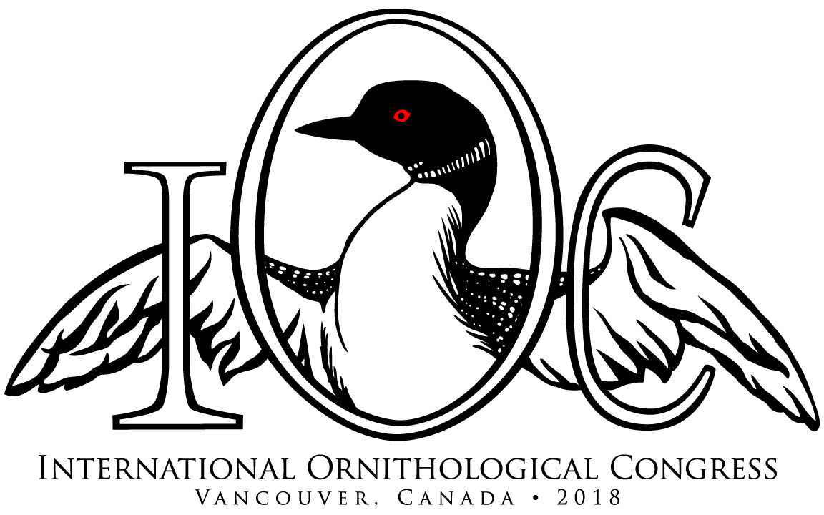

Slide 2
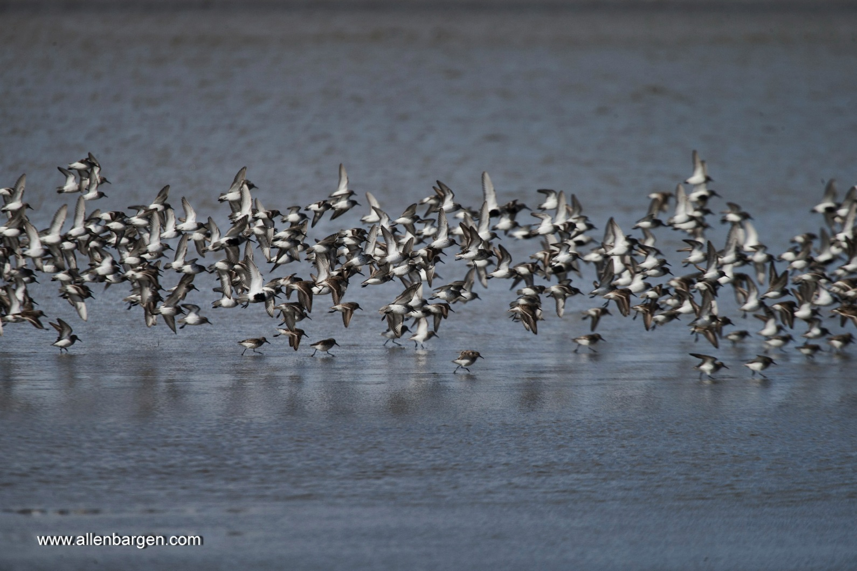
International Ornithologists' Union Congresses have occurred (well almost, 2 World Wars permitting) every 4-years since they were founded in 1884
considered the oldest, largest and most prestigious of meetings for bird scientists worldwide
Canada has hosted only once, Ottawa in 1986
Vancouver will be the first time the Congress has been on the Pacific Coast of the Americas

Slide 3
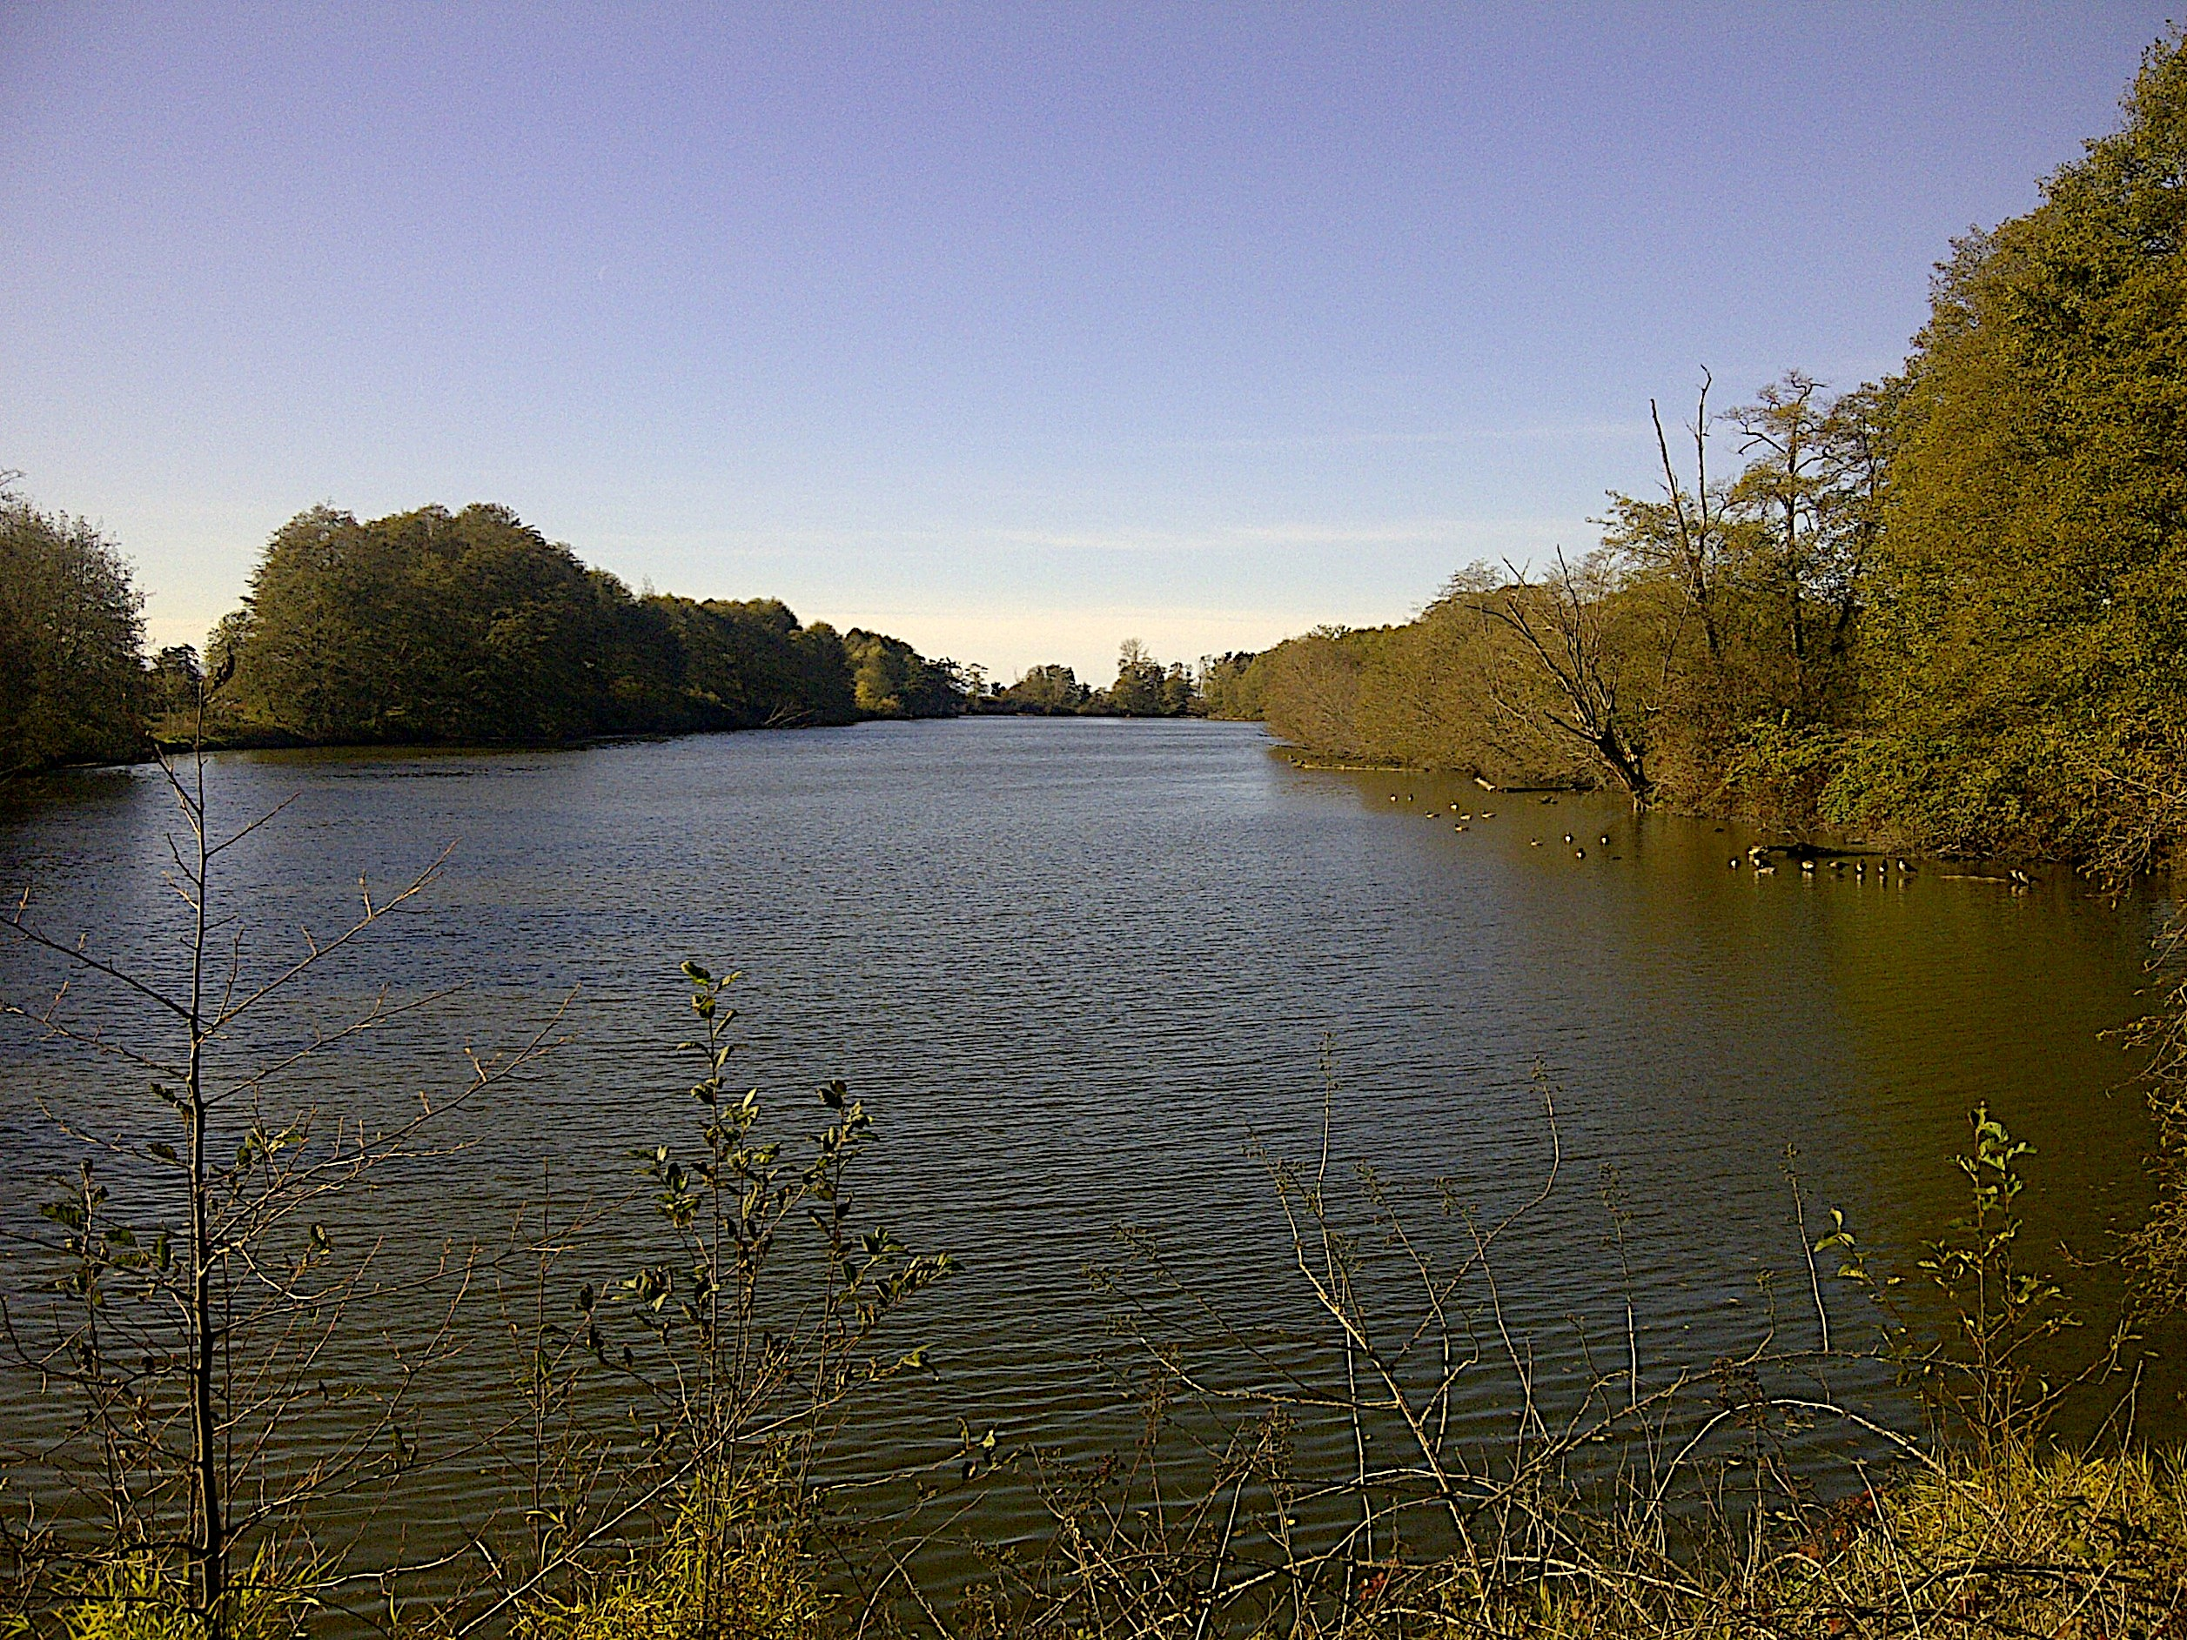
Vancouver won the bid to host the 27th International Ornithological Congress at the 26th International Ornithological Congress, held in Tokyo, Japan, 2014
planning has been intense since 2013
One year out, we have high-profile recognition and attention from the national press as well as national and international agencies and buy-in from major partners
intent on using the unique opportunity of hosting a Congress as the nucleus for staging the biggest and most diverse bird meeting ever

Slide 4
Vancouver Convention Centre – West Wing

Slide 5
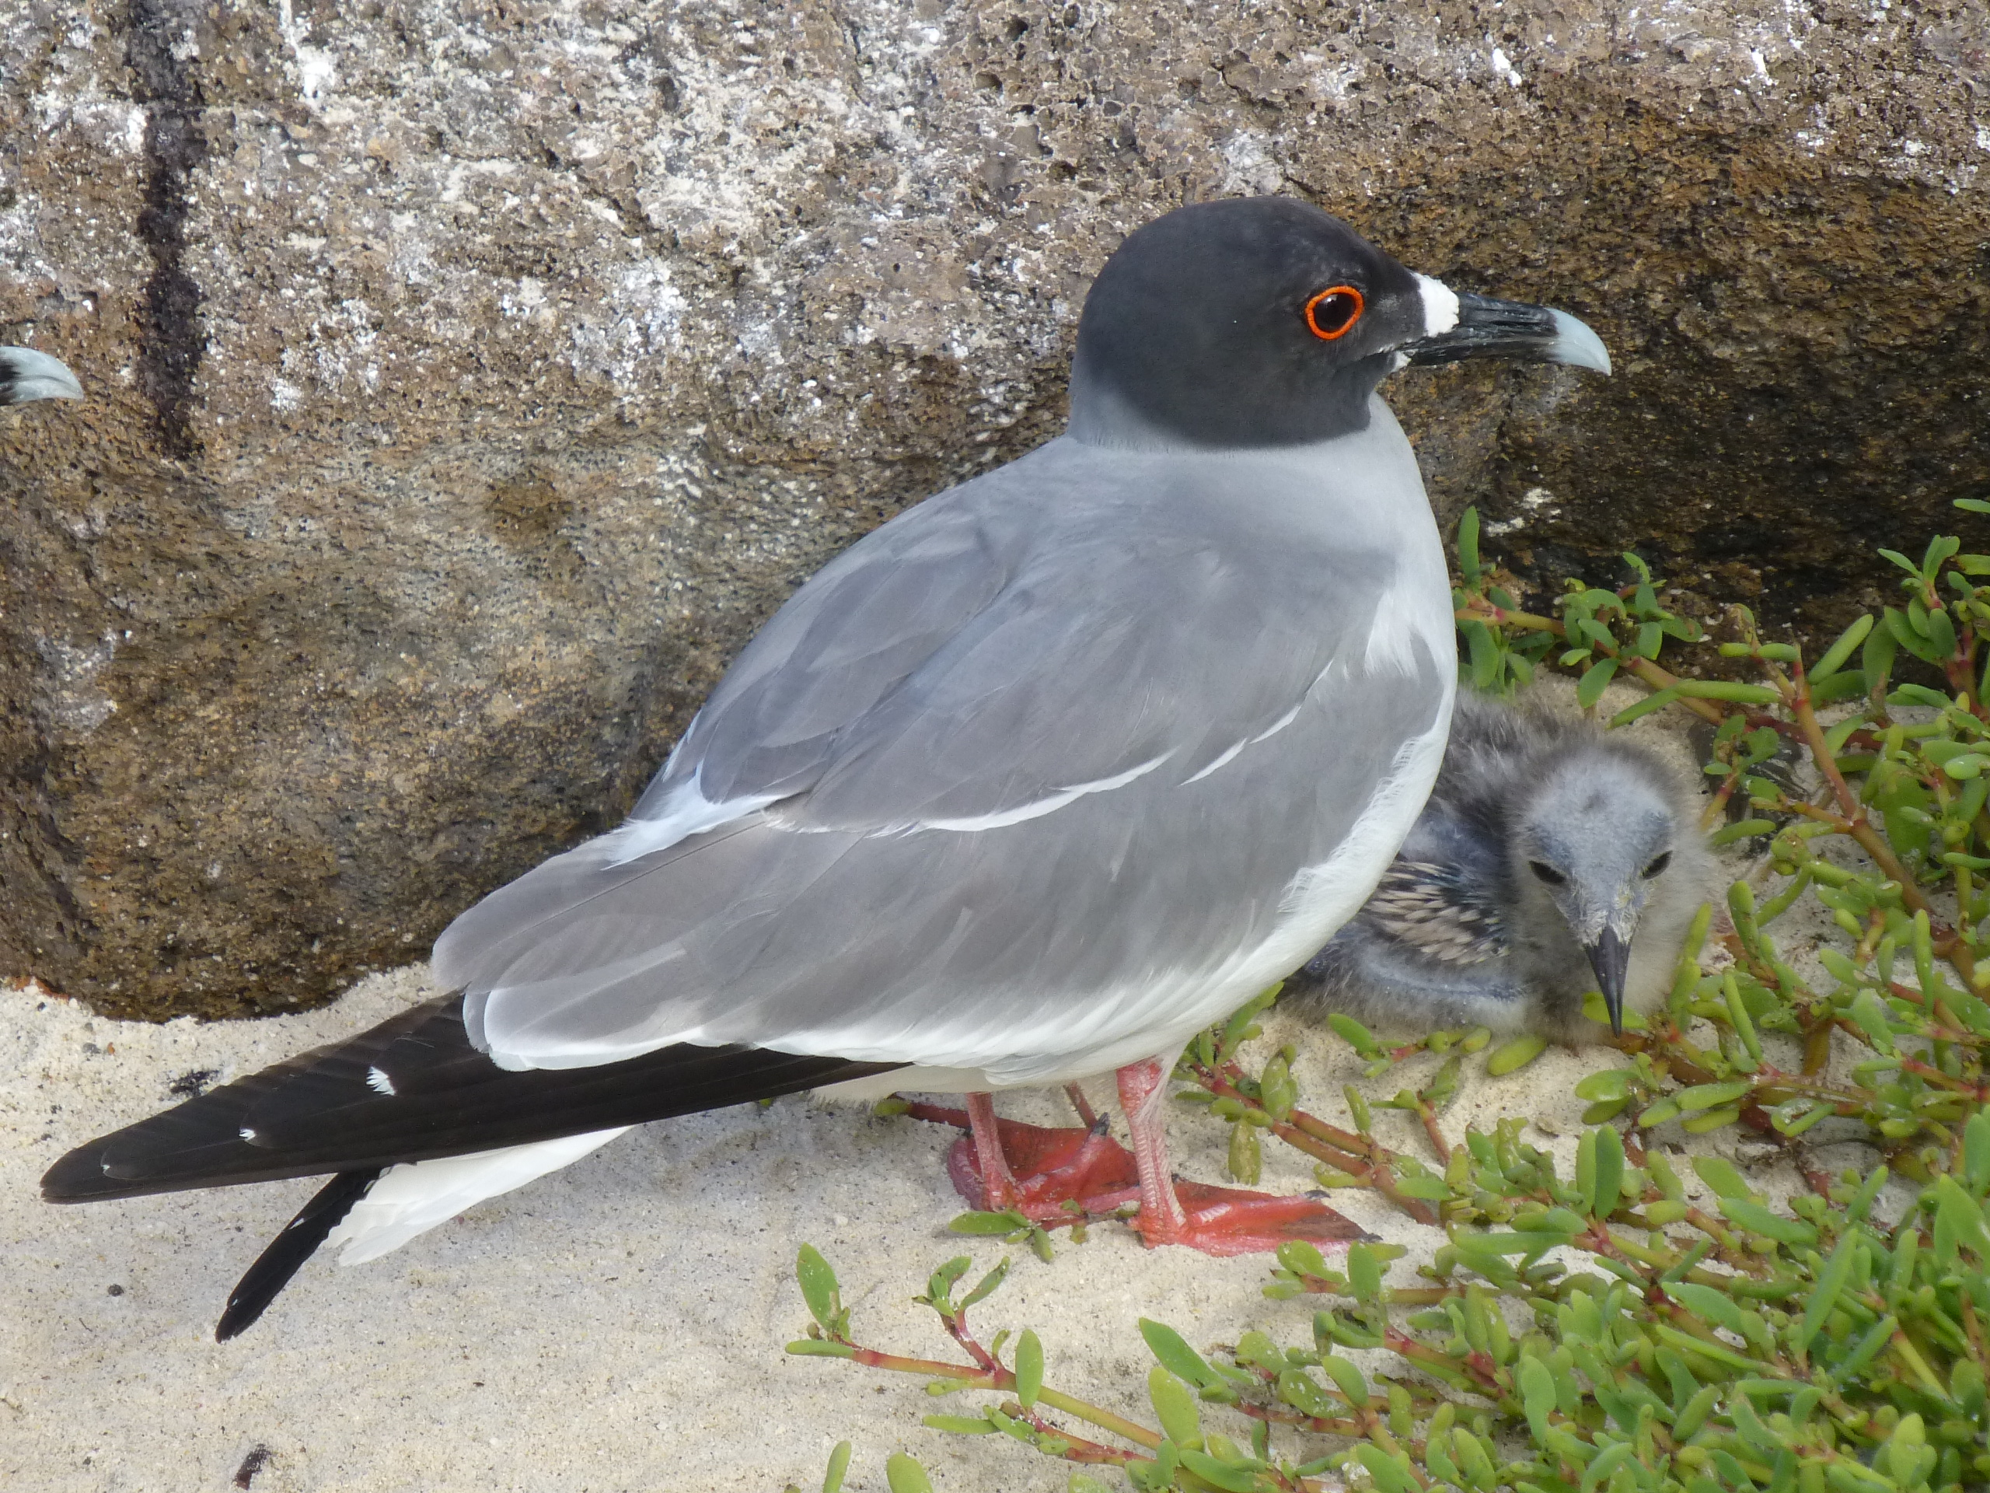
Bring in the Public, Bring in the Sponsors…..
Vancouver’s Bird Week moved and transformed
Notes:
MCI, AFC, IUCN Birds, VSO,

Slide 6
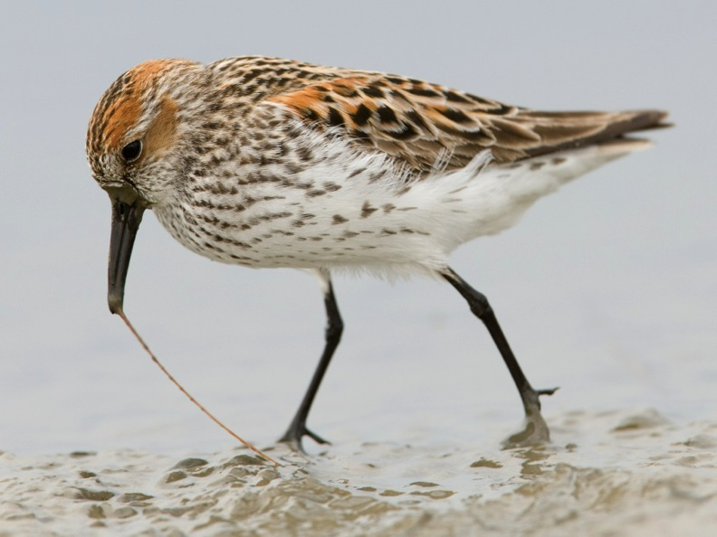
NABCI OPPORTUNITIES
Staging YOTB events to public and delegates on a World Stage
Joining with other international bird conservation
Complimentary meeting and symposium space
Exhibitions and Workshops
Notes:
Early bird gets the worm

Slide 7
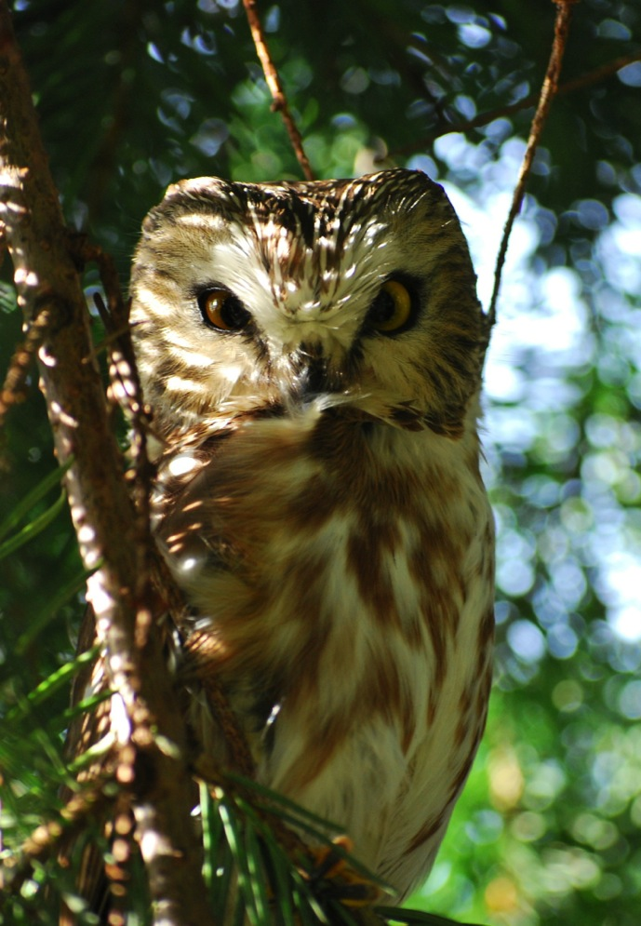
QUESTIONS?
Checkout:
www.iocongress2018.com
Convener: rwelner@sfu.ca

