Slide 1
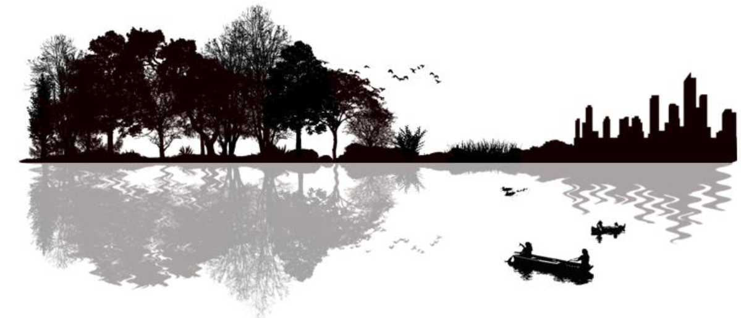
Partnering for People and Birds: Success Stories
Collating stories of non-traditional partnerships forged in order to generate benefits for both human communities and birds
Productive working lands, sustainable water resources, and healthy urban communities

Slide 2
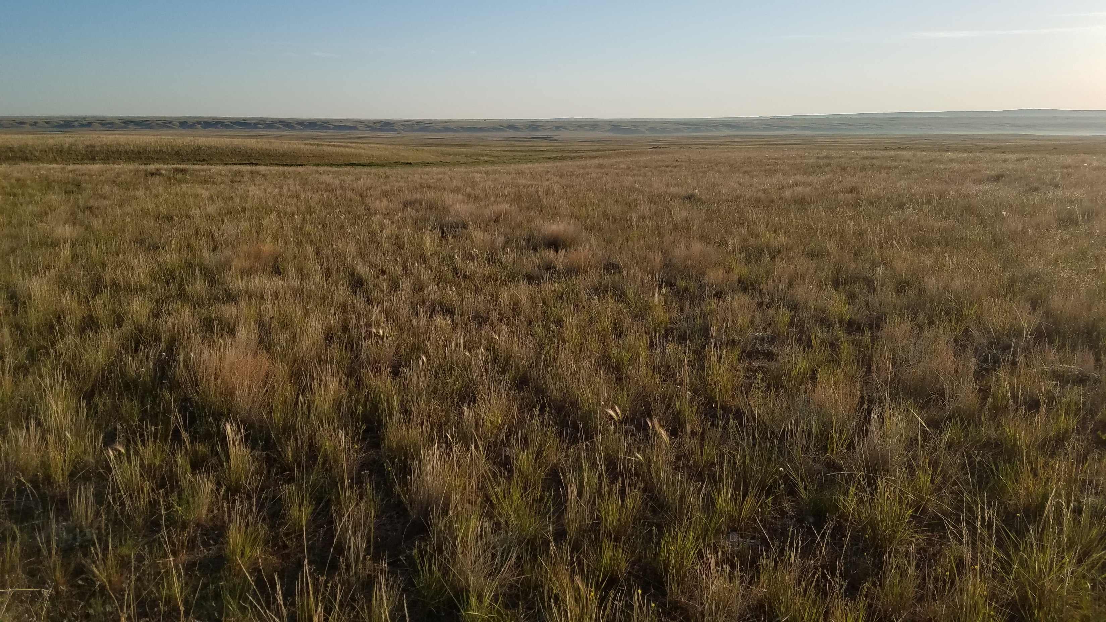
Combatting Cheatgrass on Wyoming’s Private Ranchlands Benefits Sagebrush Birds

Slide 3
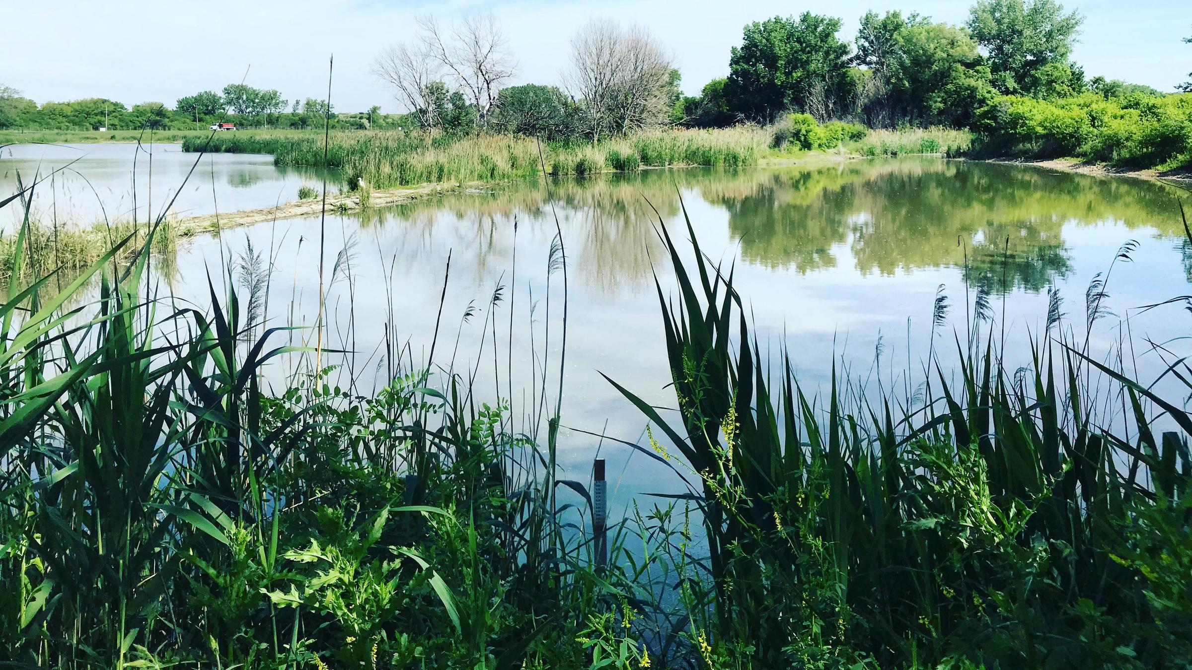
Collaborative Wetland Conservation for Birds and People in Calumet

Slide 4
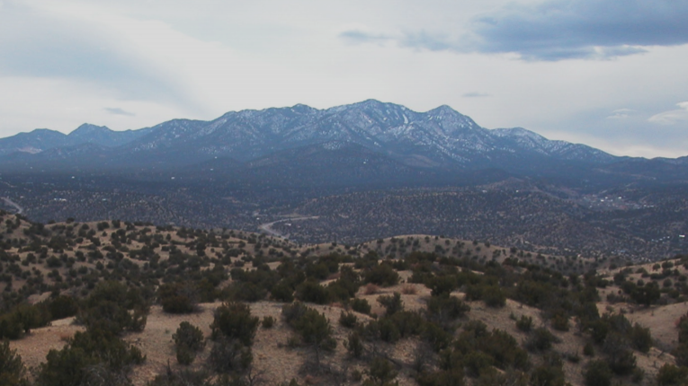
Birds, Water, and Fire: Balancing Needs in
Northern New Mexico

Slide 5
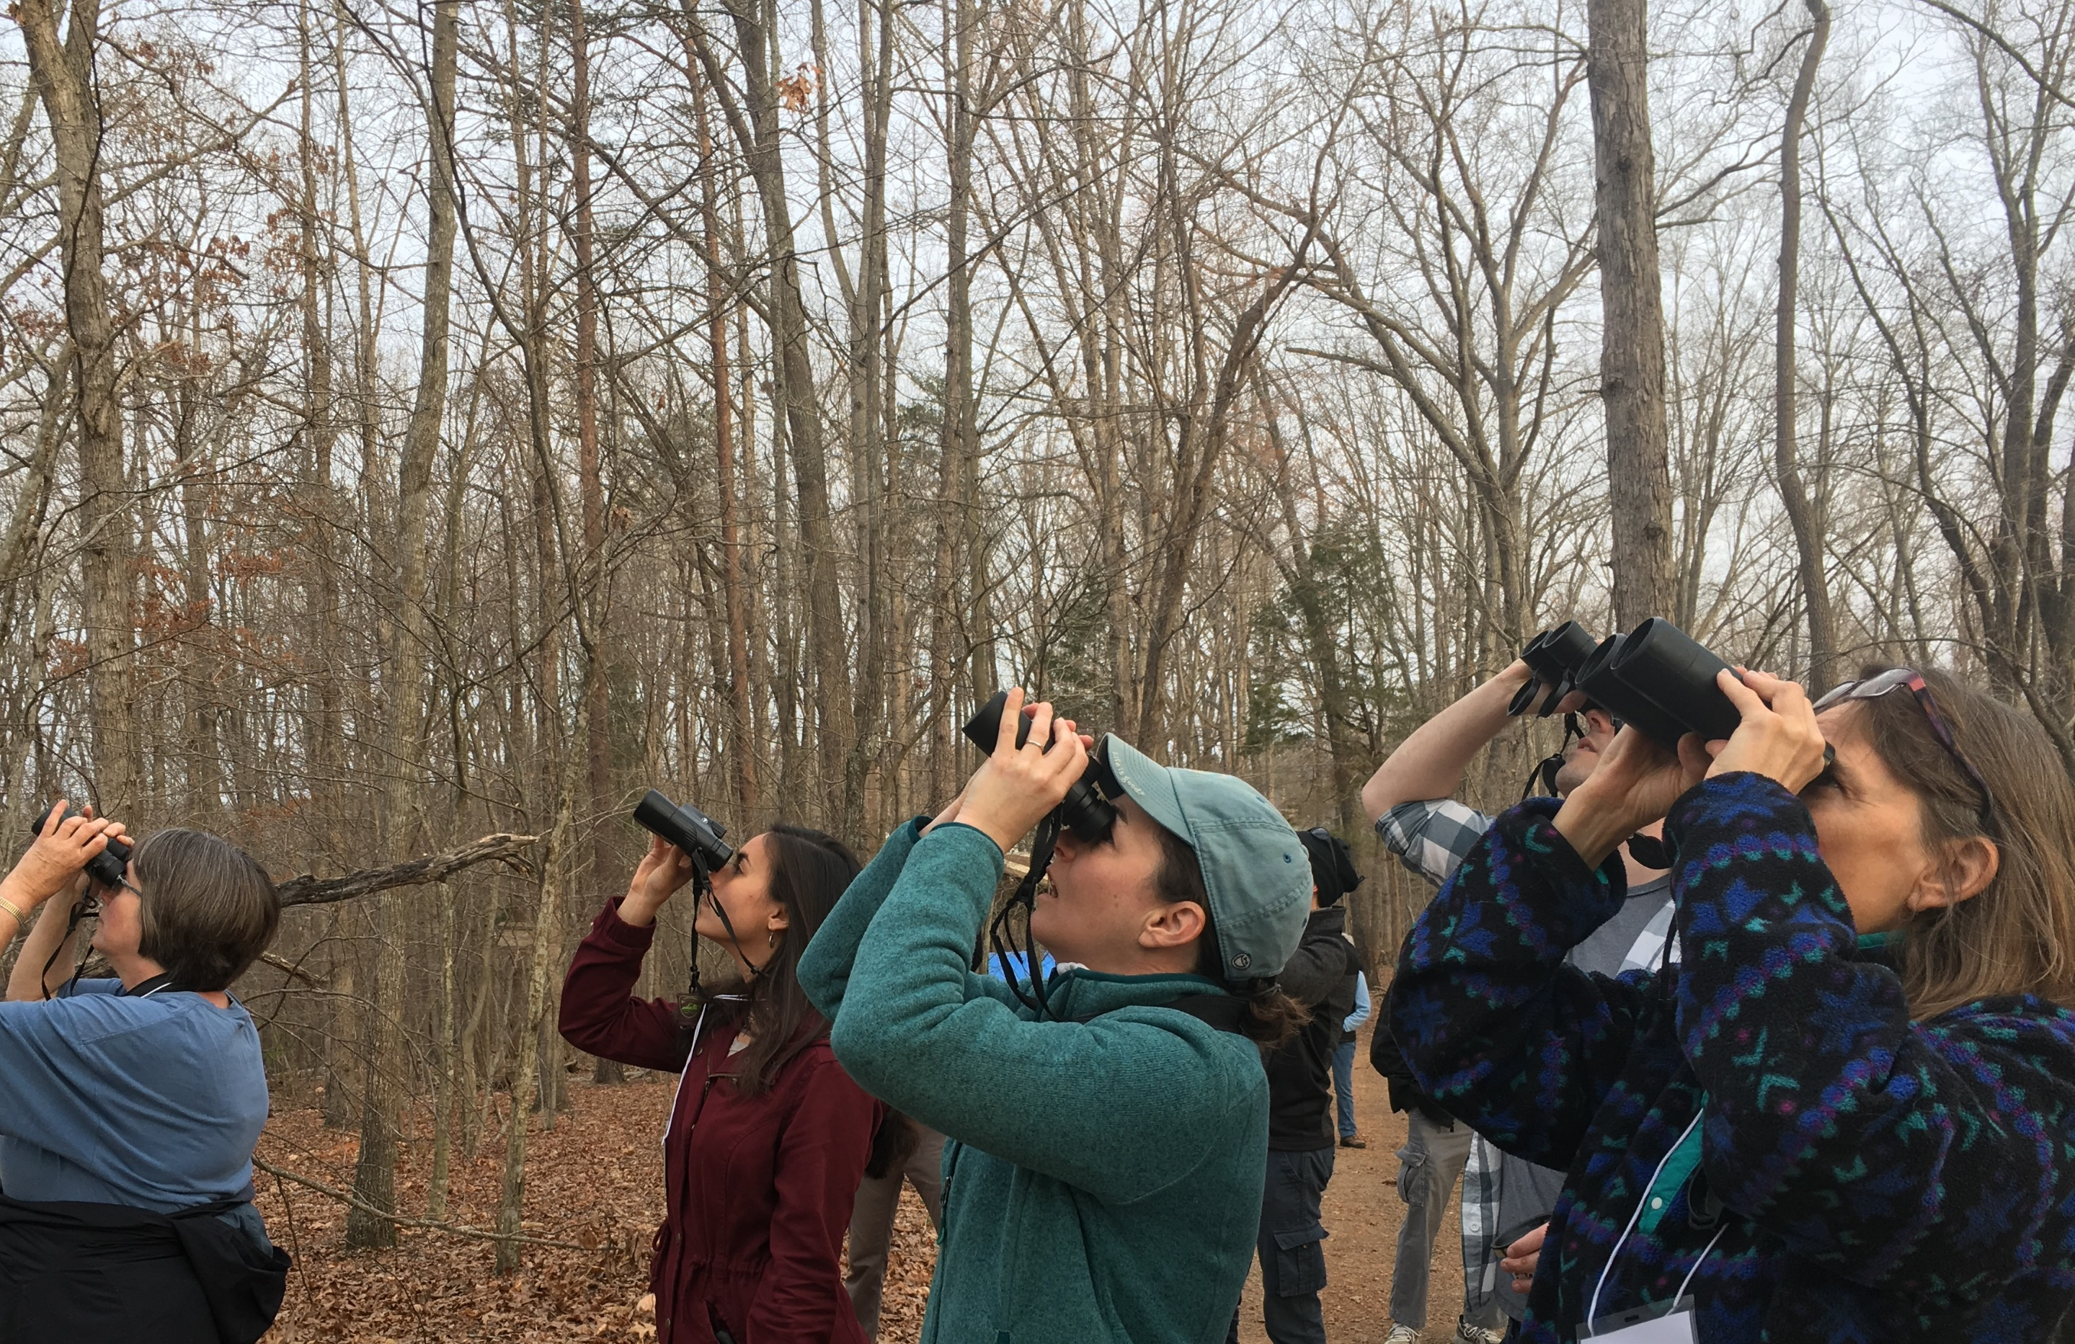
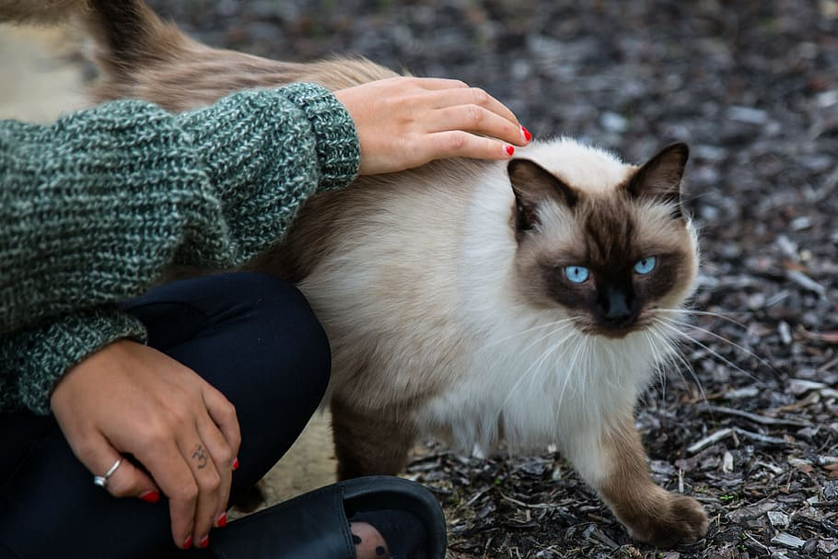
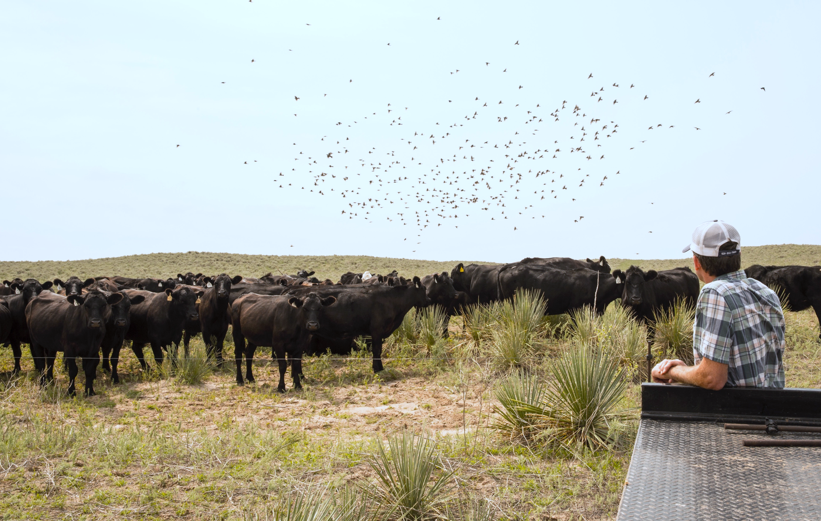
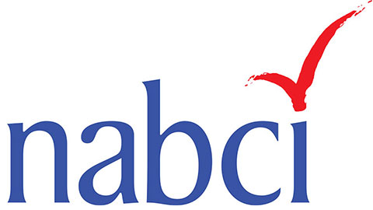
North American Bird Conservation Initiative Human Dimensions Subcommittee
Tammy VerCauteren (Chair)
Executive Director, Bird Conservancy
of the Rockies
tammy.vercauteren@birdconservancy.org
Jessica Cavin Barnes (Co-chair)
National Bird Conservation Social Science Coordinator/Virginia Tech
jcbarnes@vt.edu
February 2020

Slide 6
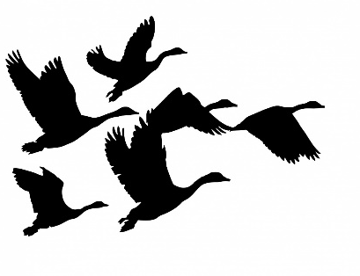
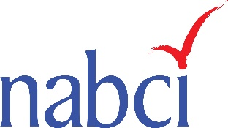
NABCI’s Vision: Healthy and abundant populations of North American birds that are valued by future generations and sustained by habitats that benefit birds and people.
HD Subcommittee Goal:
Enable bird conservation partners to integrate human dimensions science and tools into bird conservation efforts
Notes:
The activities of the Human Dimensions (or HD) Subcommittee address key parts of NABCI’s Vision for healthy and abundant populations of North American birds that are valued by future generations and sustained by habitats that benefit birds and people. Achieving this vision requires understanding what people value and how appreciation for birds might be shaped across generations. It also requires understanding what people need and how bird conservation might impact human livelihoods and well-being. The activities of the Subcommittee are oriented towards generating this kind of knowledge and translating it into conservation practice.
Components of the Work Plan of the HD Subcommittee reflect each of the three goals of the NABCI Strategic Plan, but it adopts Goal II (Facilitate science-based conservation efforts that support healthy bird populations), Sub-goal 1 (Promote and advance the use of ecological and social science in design and evaluation of bird conservation practices), Action b (Enable bird conservation partners to integrate human dimensions science and tools into bird conservation efforts) as the overarching Goal for the activities of the Subcommittee.

Slide 7
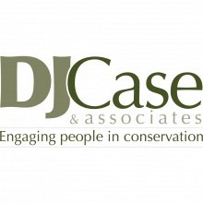
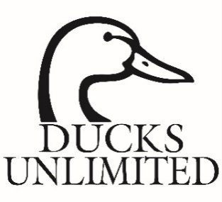
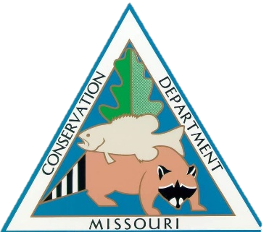
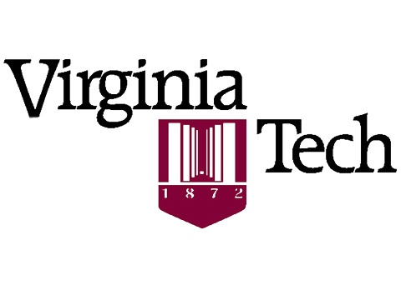
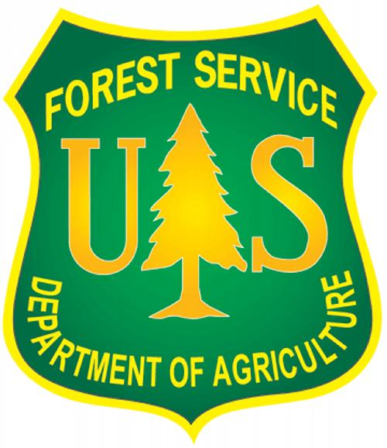
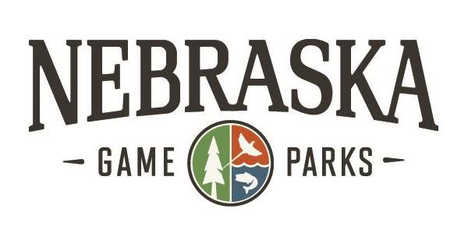
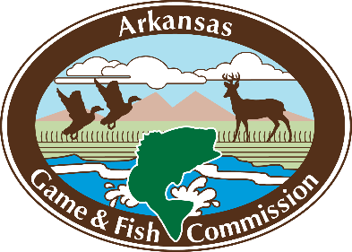
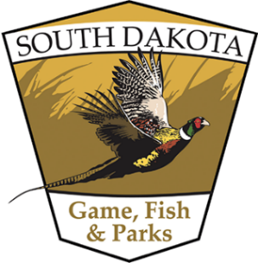
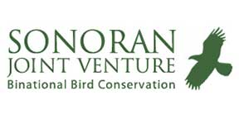
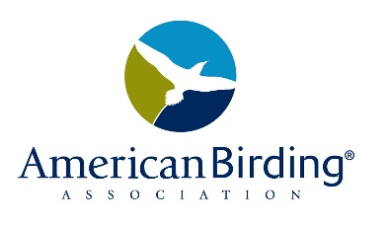
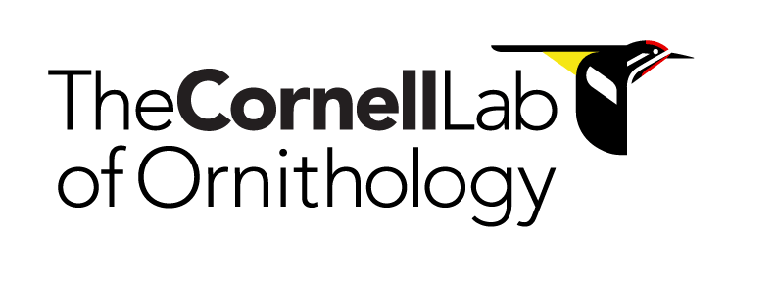
HD Subcommittee Membership
Notes:
The Human Dimensions Subcommittee held its first meeting in April 2015, with members recruited by founding Subcommittee Chair, Tammy VerCauteren, and Co-chair, Ashley Dayer.
4 years later, Subcommittee membership now spans the country and the bird conservation community, with representatives from a variety of NABCI partner organizations, including state and federal wildlife and natural resource agencies, Migratory Bird Joint Ventures, as well as university faculty and graduate students, private consultants, and nonprofit organizations. Membership is intentionally broad and inclusive, in order to maximize the diversity of resources and expertise available to the Subcommittee and NABCI. We now have about 40 people on our Subcommittee list; they each participate in calls and contribute to our efforts as they are able.

Slide 8
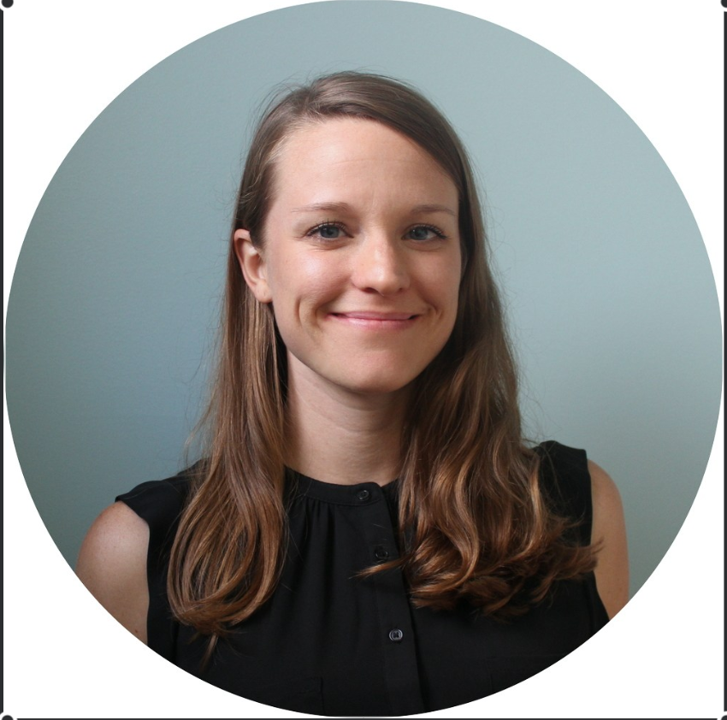
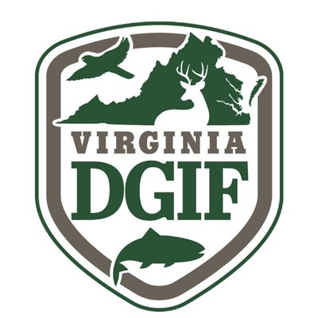
National Bird Conservation Social Science Coordinator
Ashley Gramza
2017-2018
Jessica Barnes
2018-present
Notes:
The HD Subcommittee is Co-chaired by the National Bird Conservation Social Science Coordinator. This full-time position is housed at Virginia Tech and supported financially by the university and state and federal NABCI partners, including the State and Private Forestry/Cooperative Forestry Unit of the US Forest Service, Farm Service Agency, Virginia Department of Game and Inland Fisheries, and North Carolina Wildlife Resources Commission.
From February 2017 – August 2018, Ashley Gramza served as the first National Bird Conservation Social Science Coordinator and Co-chair of the HD Subcommittee. She made important progress towards establishing an understanding of Human Dimensions and the value of social science research within the bird conservation community. She also forged or strengthened connections between NABCI and a variety of state and federal agencies and NGOs. Ashley is now a conservation social scientist in the Research, Evaluation, and Compliance Division of the Arkansas Game & Fish Commission, where she leads social science research that informs wildlife conservation in the state.
In October 2018, Jessica Barnes was hired as the new National Bird Conservation Social Science Coordinator and assumed the role of Co-chair of the HD Subcommittee. I want to take a minute to officially introduce her to the NABCI Committee, and then Jessica will take over to walk you through our new 2019-2020 Work Plan and some of our key projects.
Jessica completed a PhD at North Carolina State University in August 2018 in Forestry and Environmental Resources. At NC State, she was a National Science Foundation fellow in an interdisciplinary program on Genetic Engineering and Society. Her doctoral research broadly focused on integrating and translating perspectives from the critical social sciences to improve the social and ecological outcomes of biodiversity conservation.
Specifically, she studied efforts to restore populations of the functionally extinct American chestnut throughout the Appalachian region of the U.S. using hybrid and transgenic trees - some of the first engineered organisms designed to spread freely in the environment. Jessica drew on theory from a wide range of fields and collaborated with ecologists, economists, geneticists, geographers, and anthropologists to consider the long-term social and biological impacts of conservation actions around American chestnut restoration. Additionally, she worked to understand how public groups can shape conservation projects through citizen science, community dialogues, and interdisciplinary research and to engage diverse stakeholders in the governance of this conservation challenge. Jessica has also studied sea level rise in coastal North Carolina; leatherback sea turtle conservation in Trinidad; agricultural pests in Mexico; and non-native plants in Georgia and across the globe. All of these experiences have had direct relevance for bird conservation.
Since starting in the Social Science Coordinator position, Jessica has been busy learning the ins and outs of the complex world of bird conservation; liaising with a broad range of bird conservation partners to ensure that the position’s focus remains on social science needs of greatest importance; developing resources that communicate the meaning and value of human dimensions to bird conservation; coordinating a number of research projects (which you will hear more about later); and organizing or contributing to multiple conference sessions to share social science research findings with the broader wildlife conservation community.

Slide 9
HD Subcommittee 2019-2020 Work Plan
Our 3 Actions focus on:
Liaising to support and connect HD efforts across the bird conservation community
Developing and sharing resources and trainings to improve the integration of social science into bird conservation
Conducting and translating social science research for bird conservation practice
Notes:
As Tammy said, our Subcommittee is guided by an overarching goal to “Enable bird conservation partners to integrate human dimensions science and tools into bird conservation efforts”
We have three Actions that will help us move towards this goal, and these actions are supported by specific Tasks that will guide the activities of the Subcommittee and its members over the next two years. First, we will look at these three Actions, then look more closely at the specific Tasks that our Subcommittee has been and will be involved in.

Slide 10
Action 1:
Liaise to support and connect HD efforts across the bird conservation community

Slide 11
Audience Research and Interpretive Content, CZA
Visitor Survey
13 zoos & aquariums participated
1,127 responses; majority: 35-54 year-old females
Data analysis and reporting still in progress
Preliminary Findings
46% of respondents strongly agreed that individual actions impact conservation (positive or negative)
Interest level is most important in adopting an action into everyday lifestyle; direct benefit was least important
Average interest level in birds, bird conservation, and threats to migratory birds = ~5; over 50% rated their interest level at 5+
Average knowledge about birds, birds conservation, and threats to migratory birds = ~3.5
zooantwerp.be

Slide 12
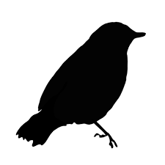
Audience Research and Interpretive Content, CZA
Preliminary Findings
Most difficult actions: keeping cats indoors, joining organizations, and doing citizen science
Easiest actions: not releasing helium balloons, learning about birds, and creating backyard habitat
The most people felt that habitat loss/alteration, pesticides, and climate change are the most significant threats to migratory birds; the fewest people indicated that wind turbines and starvation were significant threats
NEXT: explore the best ways for visitors to learn about and adopt conservation actions
zooantwerp.be

Slide 13
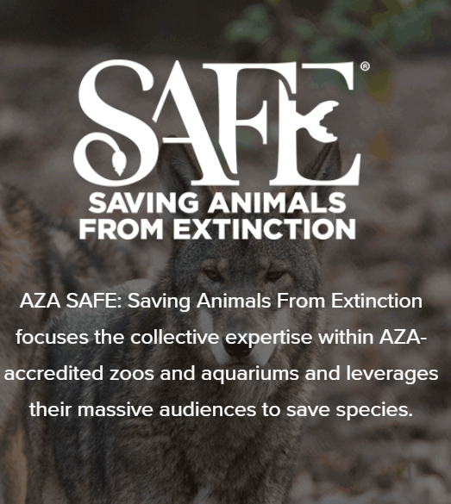
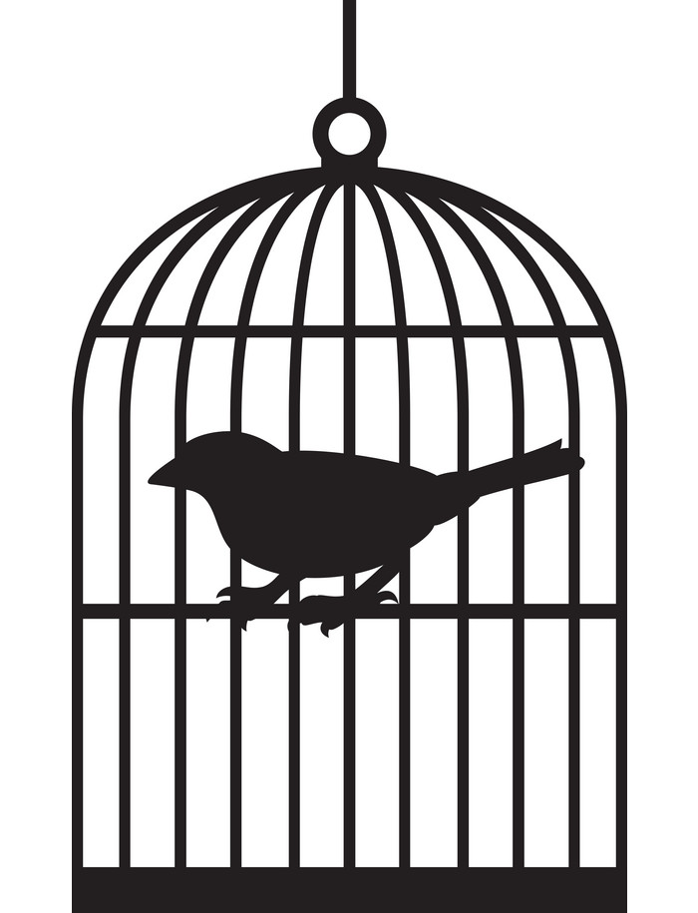
AZA North American Songbird SAFE Program
3-yr Action Plan in final stages
20 participating zoo and aquariums + many advisors
State of the Birds and contributions from NABCI members provided background and informed the draft plan
Reduce collisions
Reduce mortality from cats
Save habitat
Reduce contaminants
Promote bird-friendly products
Participate in citizen science
Reduce songbird trafficking
Increase empathy & awareness
Plan Actions
Notes:
Crosswalk SotB and Visitor Survey
Reach a broader network
Will visit more in August

Slide 14
Unified Science Team
Theme Team 3: Integrating social and biological objectives
→ Building on NABCI HD
→ Collaborating with NAWMP HDWG/PET Habitat Team
Scope of Work
Part 1: Pilot a process for evaluating HD capacity and needs
Part 2: Develop guidance for and pilot a process for establishing, implementing, and evaluating social objectives that are integrated with biological objectives
→ Ongoing need for access to NAWMP and other national-level survey data at usable scales
Other ideas for liaising with and supporting the Unified Science Team?
Notes:
NABCI Work Plan
Larger conversation at UST meeting about relationship with NABCI, serving as NABCI’s Science Subcommittee, updating NABCI website, regular UST updates at NABCI meetings
Trying to figure out if SSC can help fill JV need for access to NAWMP data – several usability of data for JVs

Slide 15
Action 2:
Develop and share resources and trainings to improve social science integration in bird conservation

Slide 16
Human Dimensions of Bird Conservation webinar series
Future topics may include:
National-level survey results
Private lands (grassland) conservation
Engaging under-represented groups
HD of Neotropical bird conservation
Livelihood impacts and relevancy
Conservation psychology and effective messaging (with CommComm)
Which webinar topics would be particularly valuable in the next year?
Find previous webinars at: NCTC Human Dimensions Webinars
https://nctc.fws.gov/resources/knowledge-resources/video-gallery/human-dimensions.html
Notes:
Committee can offer ideas on priority

Slide 17
Expanding access to bird-specific HD resources
Notes:
Also Relevancy Success Stories, Webinar recordings, abstracts from organized symposia and conference sessions, reading or reference list
Considering ways to expand access to bird-specific HD resources

Slide 18
Action 3:
Conduct and translate social science research for bird conservation practice

Slide 19
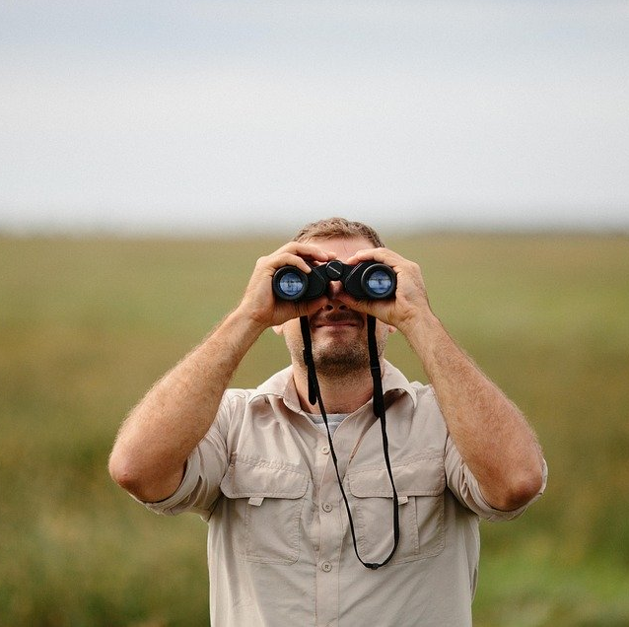
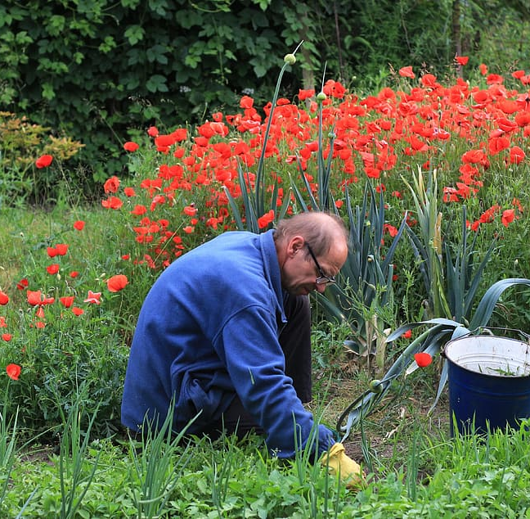
Survey: Relationships between Birder Attributes and their Bird Conservation Actions
Terry Rich, dissertation research
Goal: Discover how to engage birders in bird conservation; identify values, interests, and skills that predict conservation actions
Sample: 5,502 responses; individuals from all 50 states, 1,000+ from each AFWA region; broad spectrum of expertise levels
Selected results:
60-70% of respondents had some level of familiarity with NABCI, PIF, State of the Birds, and other national-level initiatives
Websites were the most important source of information for 64% of respondents
Bird conservation organizations were the first choice for information for 90% of respondents; state wildlife agencies and US FWS were a distant 2nd and 3rd
All threats to birds (cats, collisions, illegal shooting, etc.) were ranked as extremely important
Among 18 conservation actions, making individual property more desirable
for birds was most important (83%)

Slide 20
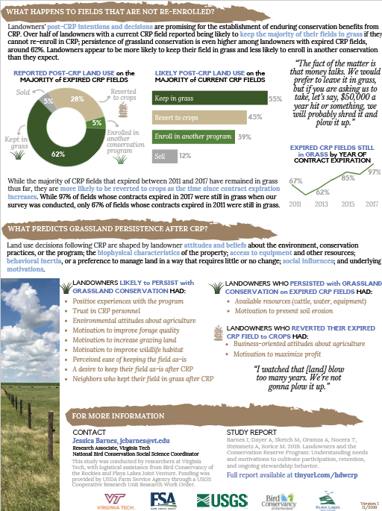
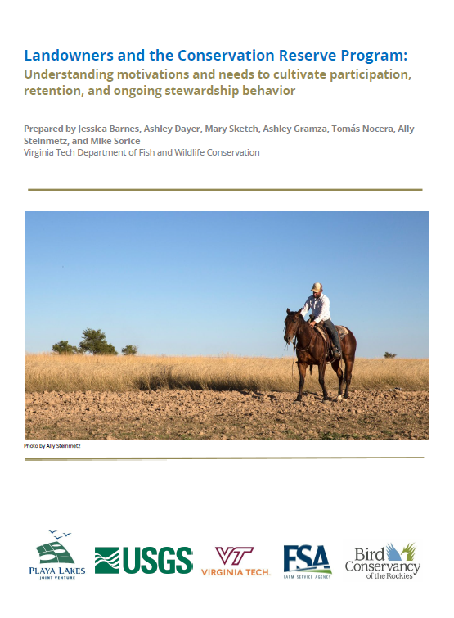
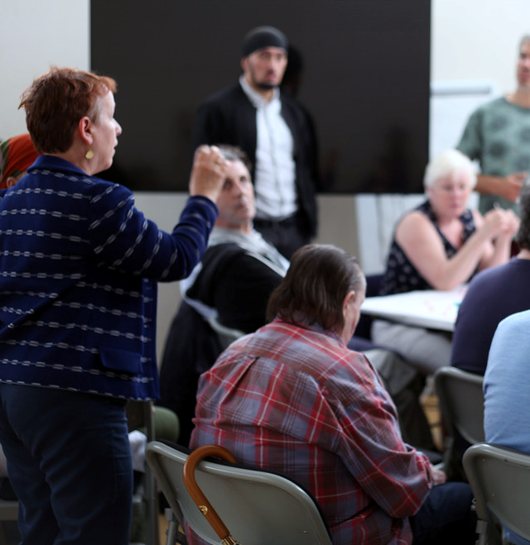
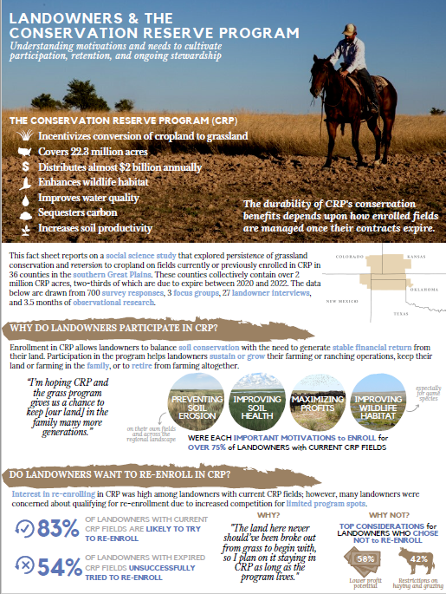
Landowners and the Conservation Reserve Program
Translating and implementing results
Study Report
Meetings in study states
Fact sheet
Full report and fact sheet available at tinyurl.com/hdwcrp

Slide 21
Coming soon:
An HD survey for the NABCI network
Notes:
Suggestions for what we need to know?

