Slide 1

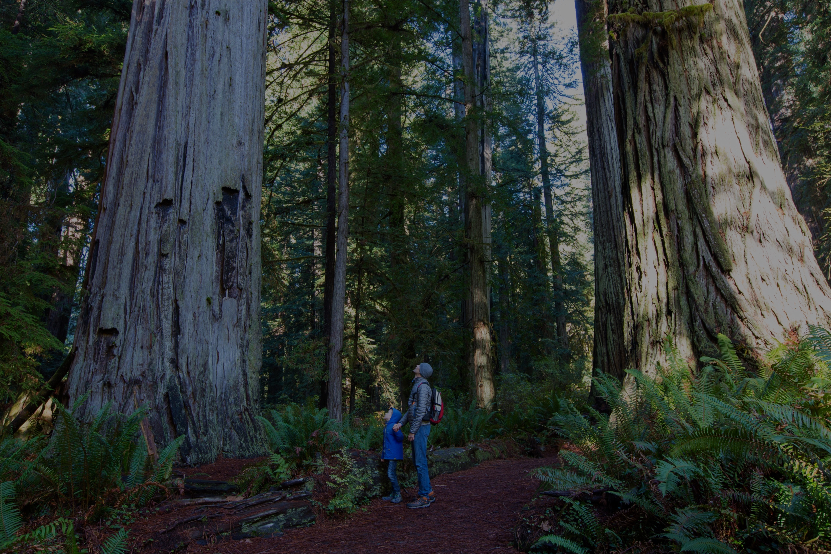
Our Nature. Our Nation. Our Future.
The nation behaves well if it treats the natural resources
as assets that it must turn over to the next generation increased, and not impaired, in value.
TEDDY ROOSEVELT
Notes:
I’m Sean Saville…AFWA’s Manager for the Alliance for America’s Fish & Wildlife Campaign…whose goal is to pass the Recovering America’s Wildlife Act.

Slide 2
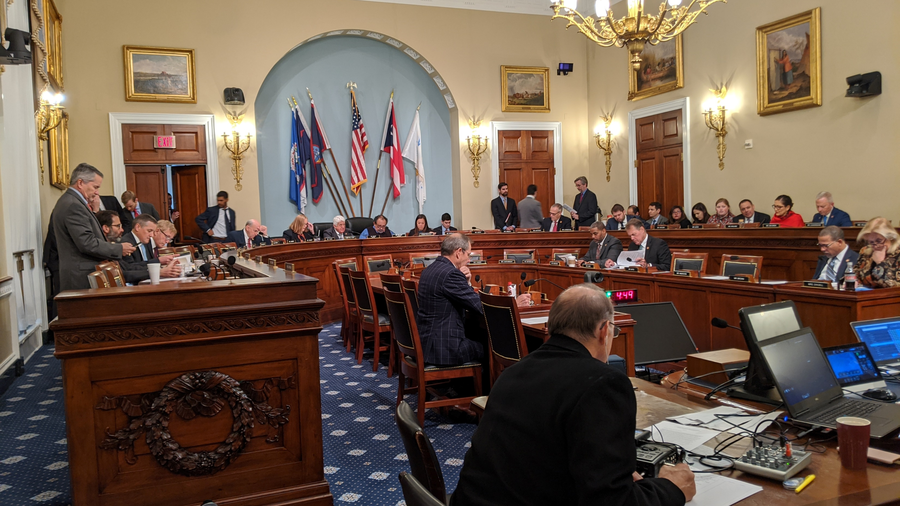
Notes:
HNR Cmte markup December 5, 2019—successful bipartisan vote for final passage (next slide vote count)
Insights:
Bishop, Graves, Westerman want to play and be helpful
Majority players helped negotiating language/politics—Huffman, Lowenthal, Grijalva
Major milestone and accomplishment for the campaign--furthest the bill has ever gotten in the legislative process…THANK YOU!
Sends strong message to Senate—bipartisan support is there…enough juice to get through House and move to Senate

Slide 3
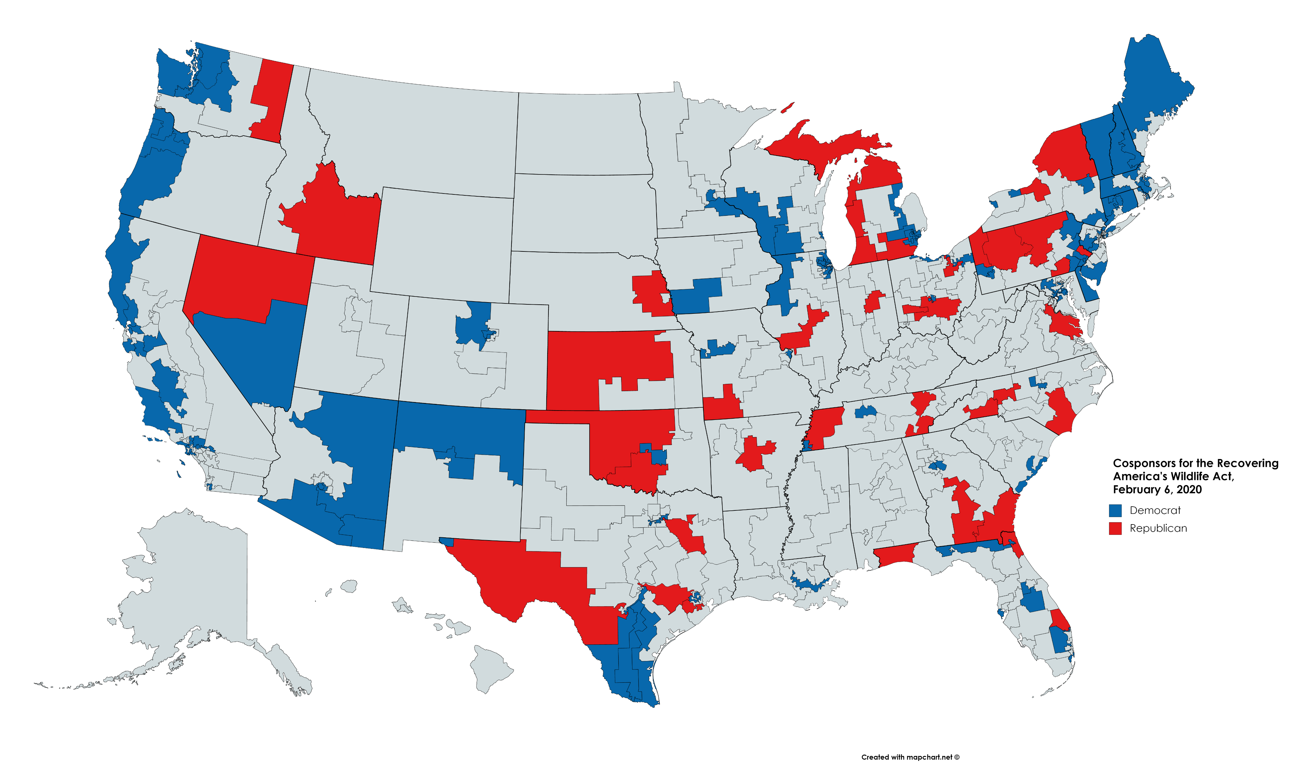

Slide 4
Changes to Funding Provisions
Dropped all findings
Changed the current formula of 50:50 (land: people) to 50% proportion of land and water in a state, 25% proportion of human population, and 25% proportion of T/E vertebrates and invertebrates in the state.
At least 15% to recover state and federally listed species (an average over 5 yrs)
Changed the amount apportioned to the US territories from ¼% each to 1/3% each, except Puerto Rico which would be no less than 1%.
Added preference under the Innovation Grants Program to the recovery of species that are “identified as priorities through regional scientific assessments of species of greatest conservation need.”
Dropped from bill the term “nuisance” that referred to certain species (e.g., nutria) that are a threat to SGCNs. States would identify “risks” to SGCNs in their SWAP and the “risks,” whatever they are and which can include certain species, would be eligible for RAWA funding/projects.
Notes:
Dropped findings to reduce the chances and number of undesirable amendments that would be ruled germane to the bill.
Changes to apportionment formula will increase funding to states with higher numbers of T/E species and decrease the amount of funding to a state based on the proportion of human population. We will share and a new estimated state apportionment table as soon as it is available
Increase % to T & E:
States would be able to spend 15% of their apportioned funds on species that are candidates for listing or petitioned for listing under the ESA, as well as already listed as threatened or endangered under the federal ESA, and those species under State law;
The 15% is an average over 5 years; and
The Secretary may reduce the minimum requirement spent on an annual basis if the Secretary determines that the State, territory, or the District of Columbia is meeting the conservation and recovery needs of these species.
Territories—negotiated with Bordallo to remove bill that would attempt to pull $$ from PR—more flexibility and funding for territories to do conservation—politics (HNR markup vote count)
Incentivize regional assn participation
Nuisance species—internal battle for years
Also changed the 5-year reporting period to every 3 years and include in the reporting requirements the submission of a three-year work plan and a three-year expected budget with results from the previous three-year period. This will be submitted to the House NR and Senate EPW Committees and to the FWS.

Slide 5
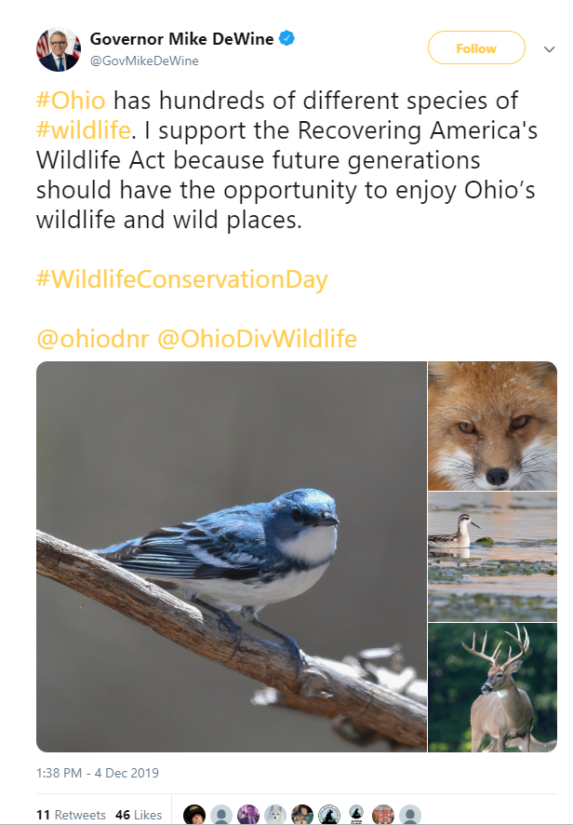
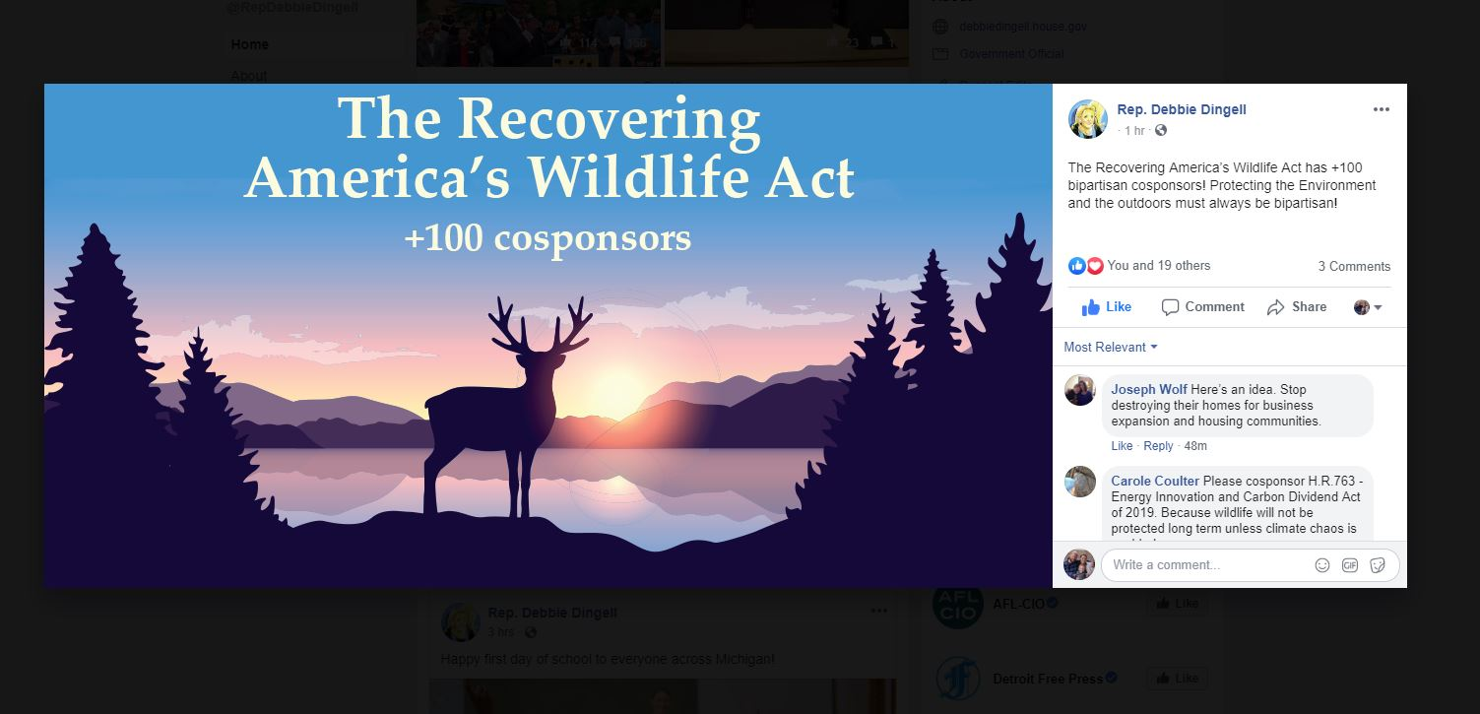
#RecoverWildlife
Notes:
Key Messages:
Social media continues to be an effective engagement tool--wildlife Imagery in posts captivates audiences of all demographics, but especially our audience
Some examples of social media posts from two milestones in the campaign last year—crossing 100 cosponsor mark again, and garnering a majority of Governors’ support
Working with partners to create engaging social content
Use the campaign hashtag to link posts to national campaign and follow up on social media
#RecoverWildlife is official hashtag of campaign—please use in social media posts about the legislation—follow the campaign on FB @OurNatureUSA

Slide 6
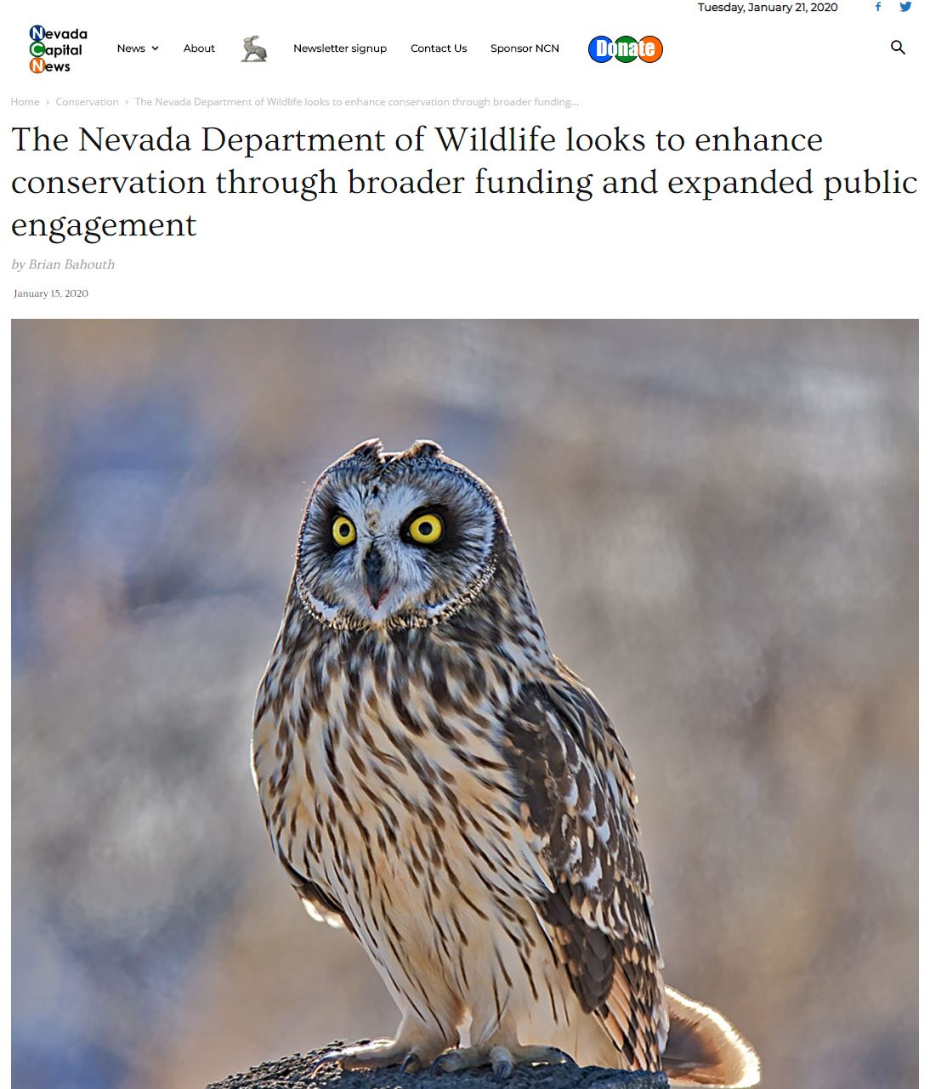
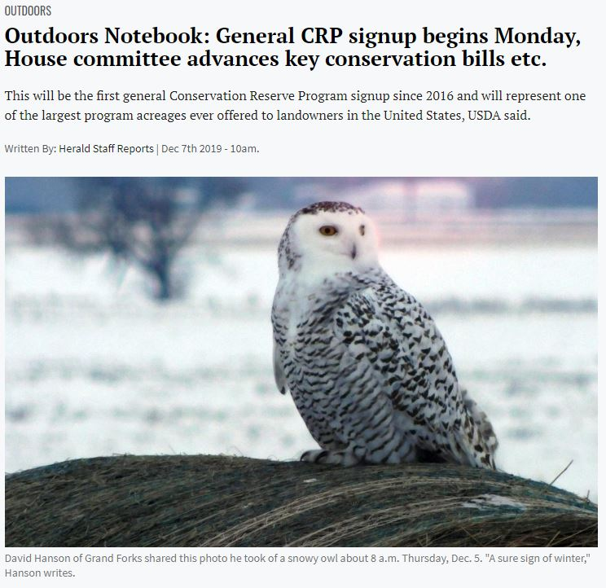
Notes:
Working on High-visibility media placements to help leverage congressional support—House leadership targets in their districts and in DC, and potential Senate leads
Recent examples of RAWA in the media—Interesting the allure of owls as messengers—birds are popular and captivating

Slide 7
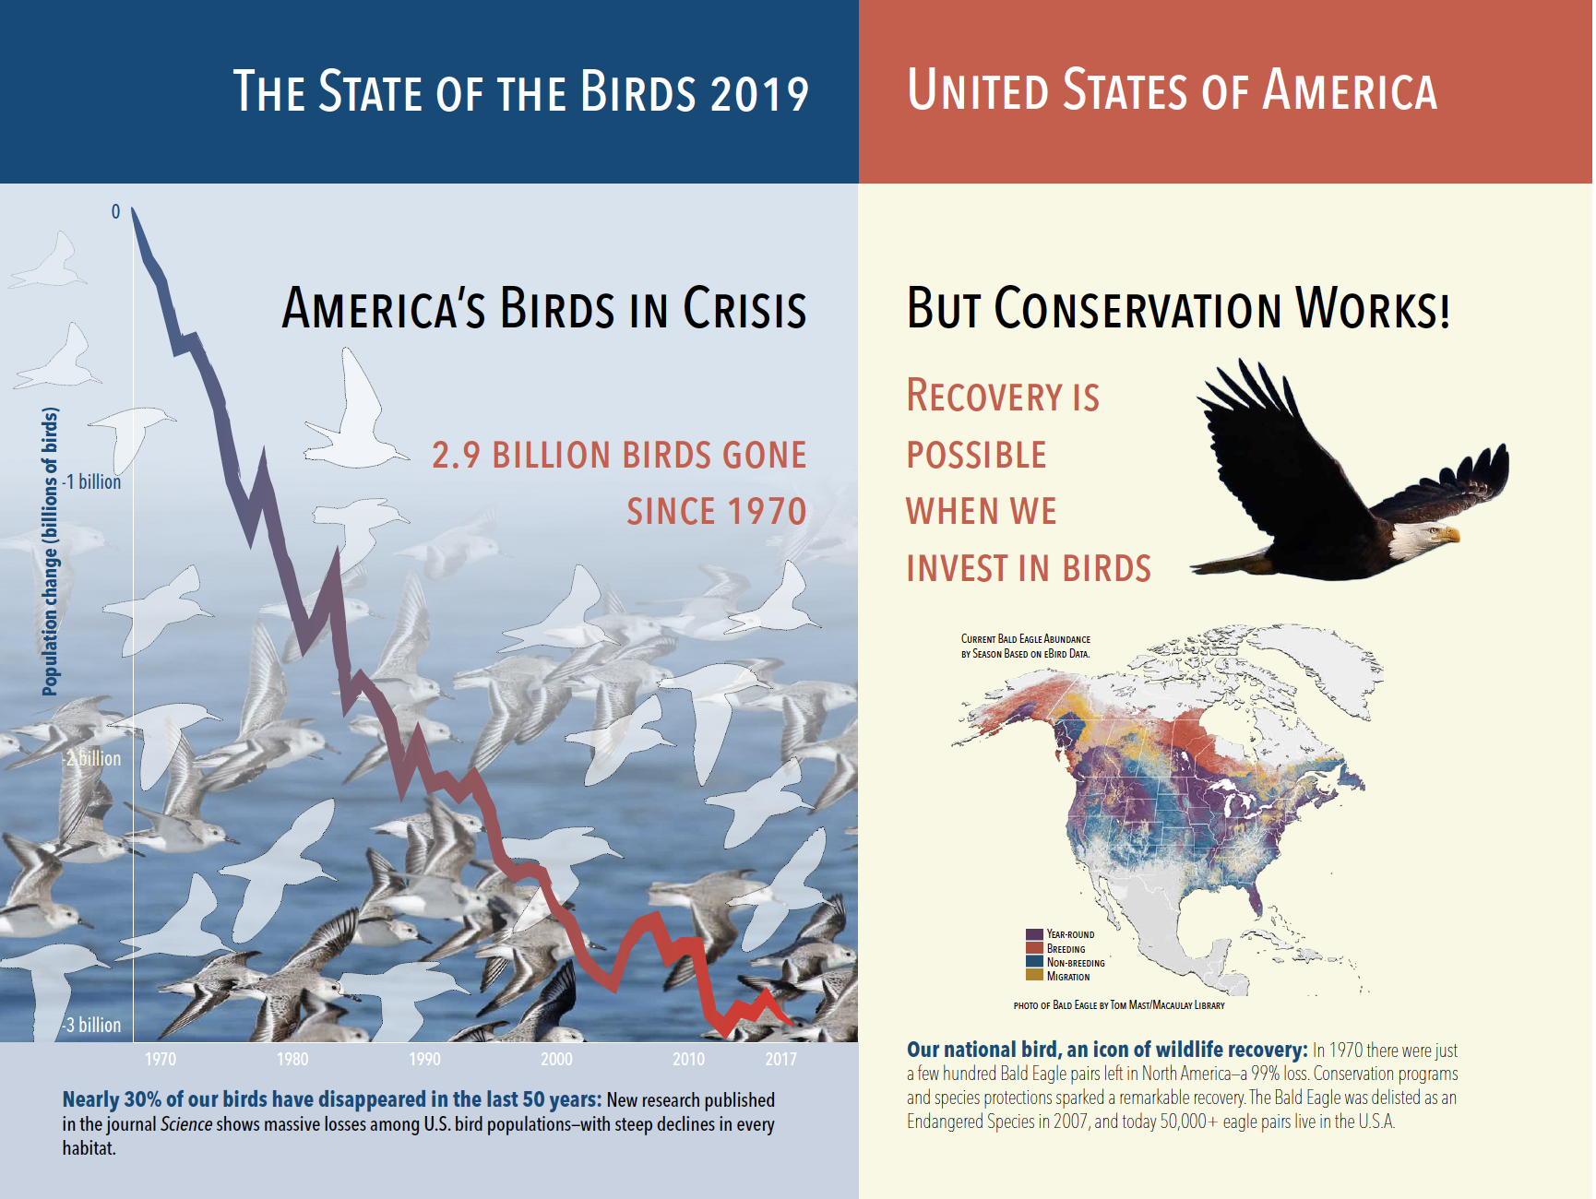
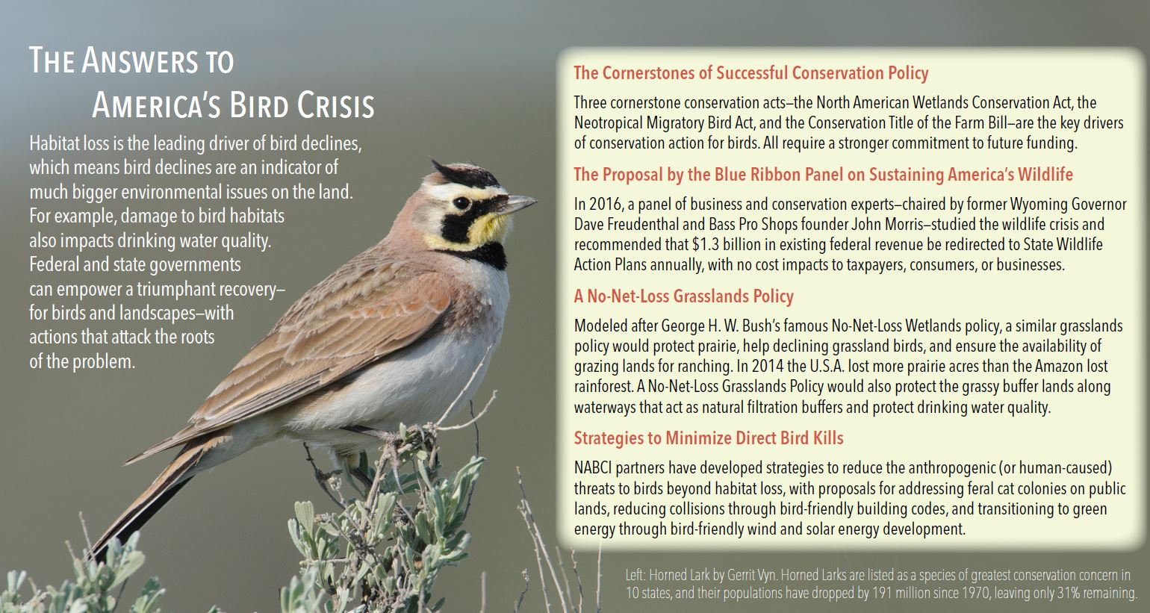

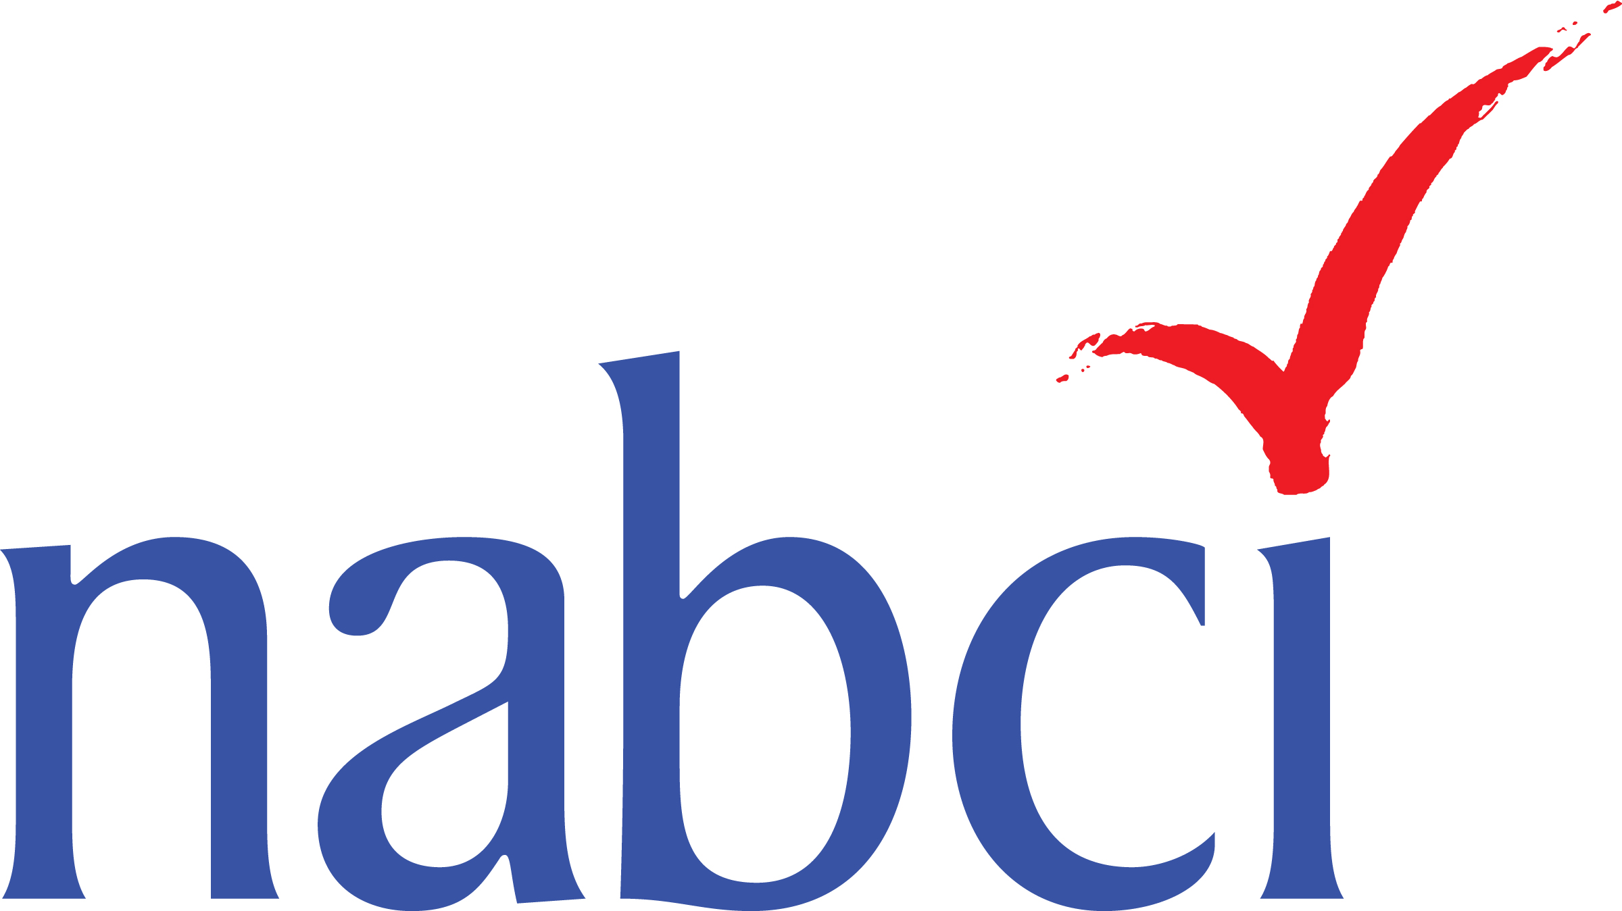
2019 State of the Birds Report
A Call to Action to Reverse Bird Declines and Prevent Wildlife from Becoming Endangered
3BillionBirds.org
Notes:
Key Message:
-New science points to massive bird loss, states are key to successful recovery, dedicated funding through Recovering America’s Wildlife Act is the solution.
SOTB report launched at AFWA annual meeting—following high profile release of journal in Science
Audubon hosted reception at AFWA annual mtg w/report launch (over 150 attendees)
Major media hits: WaPo, NYTimes same day—mentions of RAWA—and over 1700 hits since (reach of over 3.4 billion people worldwide)
Hill briefing—authors of science journal and report presented to hill staff
Comms campaign—3 billion birds
Mentioned in multiple congressional hearings/markups (HNR/RAWA/MBTA/NAWCA)
Useful in outreach to cosponsors and helped frame need for dedicated funding/successes of dedicated funding for markup
Will continue to be valuable in this year’s legislative campaign

Slide 8
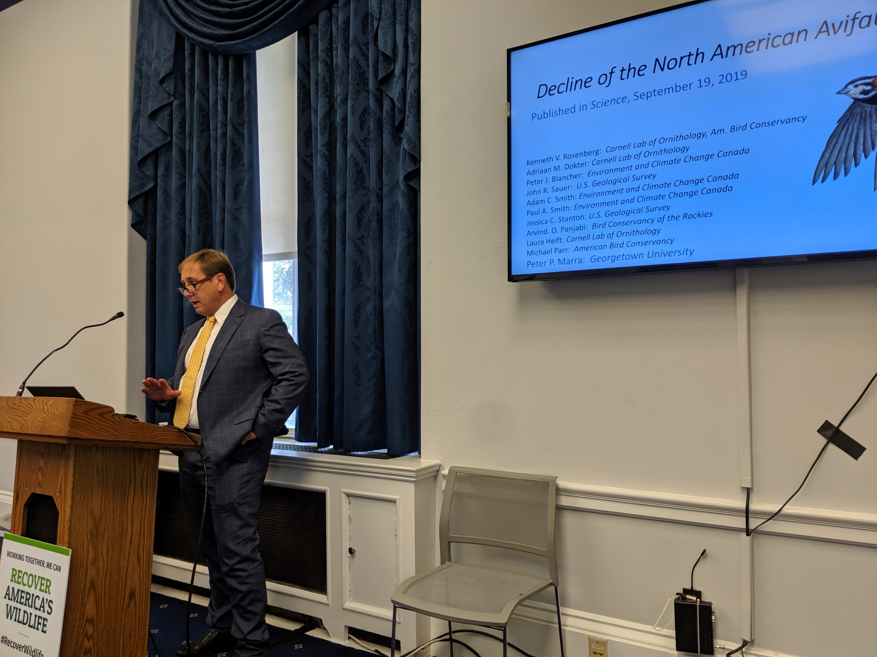
On October 7, 2019– Authors of the Science publication and co-authors of the SOTB report presented to congressional staff and partners on the scientific findings, highlighting 3 billion birds lost since 1970, and the Recovering America’s Wildlife Act as a critical part of the solution to stemming these species declines and providing dedicated funding for their conservation.
Notes:
Highlight bird crisis—losses
Successful conservation programs like NAWCA—waterfowl big winners (Tom-DU)
Policy solutions
Dedicated funding-RAWA

Slide 9
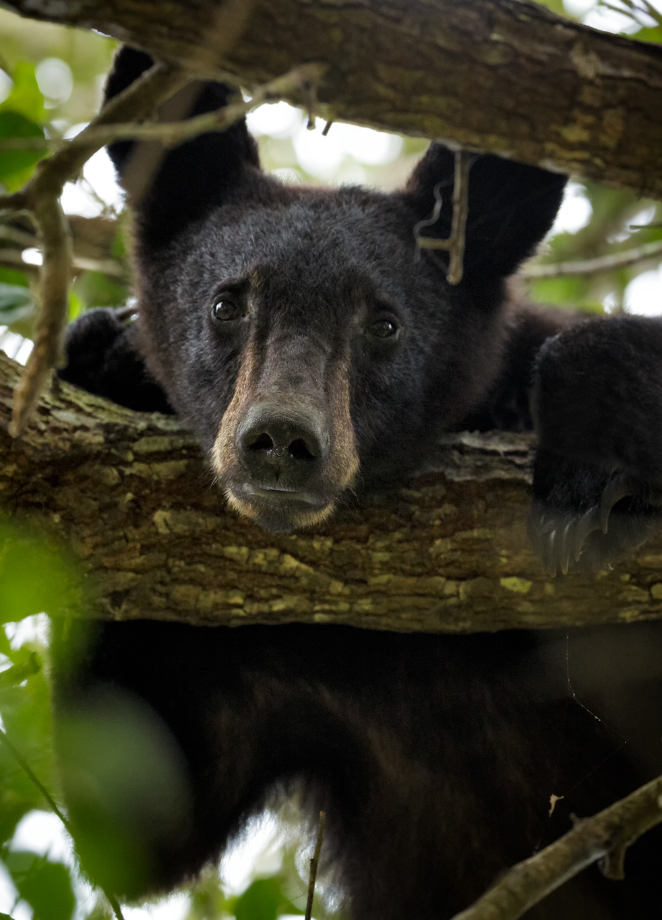









New Partners
Notes:
Key Messages:
The Alliance for America’s Fish & Wildlife represents the continued partnership of organizations and businesses committed to implementing a dedicated funding solution for the conservation of our fish and wildlife.
New partners—some strategic, influential stakeholder groups, including Intl Raptor and Falconry Center, NWF’s WA affiliate, Oregon Zoo has been a great partner, Forest groups, State agency foundations, and land trust partners

Slide 10
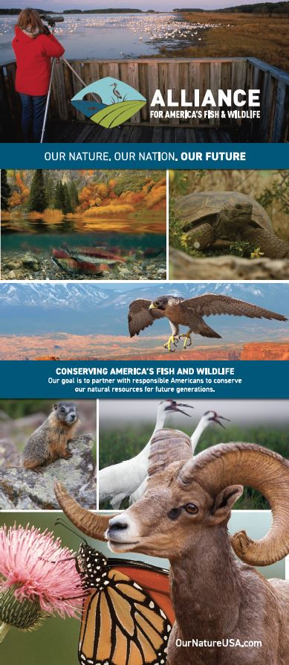
Next Steps for early 2020
Get bill to the floor for vote in full House
Introduce in Senate; get hearing in EPW
Continue to develop strategic partnerships to advocate
Fly-ins, targeted briefings, and letters of support
Opportunistic media placement of Op-eds, LTEs, social media campaign
Notes:
Key Messages:
Cosponsors are key to advancing the bill toward passage
The goal of the campaign is to pass the legislation, so to that end…we need cosponsors to advance the bill to the floor in the House, and create the political will to unlock the secret black box of offsets to address the payfor issue to get through the Senate also…
The campaign team has a draft plan that we’re working to refine and continue to build upon, including tactics: Coalition letter to House, Op-eds, fly-ins, briefings, visits to House leadership, Senate office education (JV fly-in in late Feb.)
These priority actions are all designed to build and demonstrate broad support for the bill, raise the visibility of the campaign and utilize strategic partnerships to leverage additional support.
Success relies on us all working together
If we can work together to execute these actions in a timely manner, and garner maximum support on the bill, we will be successful in passing the bill.
Resources are available
We will distribute resources--Alliance toolkit also.

Slide 11
Sean Saville
Campaign Manager
Alliance for America's Fish & Wildlife
Association of Fish & Wildlife Agencies
202-838-2561
ssaville@fishwildlife.org

