Slide 1
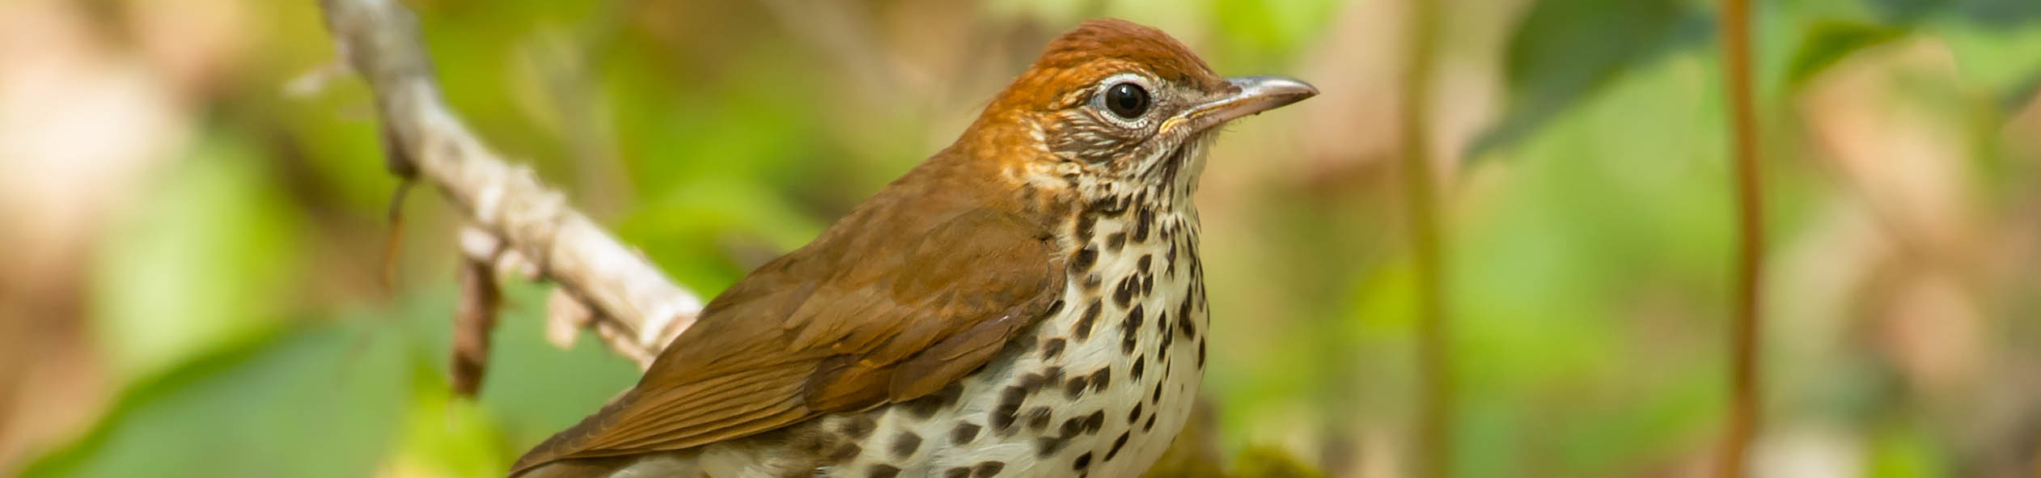



Increasing Awareness of the Relevance of Bird Conservation to Broader Conservation and Sustainability Development Efforts
Paul Reeves Photography
February 5, 2020
Greg Butcher, Amy Upgren, Andrés Anchondo, Andrew Rothman

Slide 2
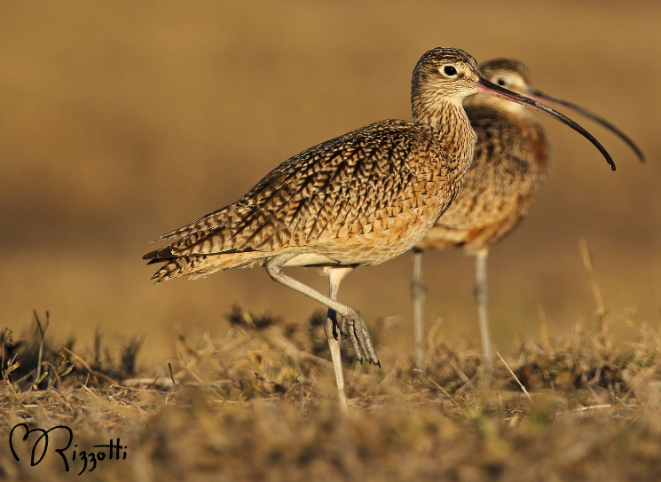
Project Goals
  Demonstrate the relevance of bird conservation to broader conservation
  Emphasize how bird conservation and sustainable development advance complementary goals
Based on the recommendations of the International Sub-committee, and the relevancy toolkit, which inspired the subcommittee

Slide 3
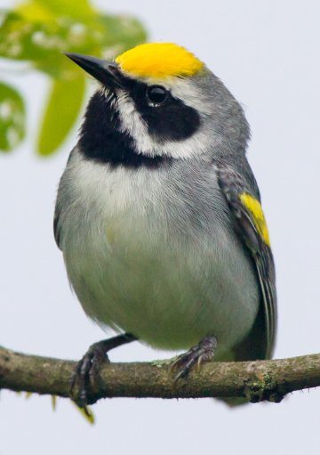
Project Goals
How?
Engage with conservation and sustainable development efforts in Latin American and the Caribbean:
  Governments
  Multilateral agencies
  Development banks
  Non-government entities
  Private investors
Frode Jacobsen

Slide 4
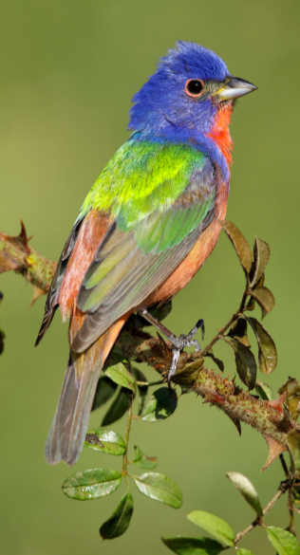
Proposed Activities
1) Prepare an informational document for outreach to the conservation and sustainable development community in Ecuador
2) Outreach to the Fondo Mexicano para la Conservacion de la Naturaleza (FMCN) to discuss common interests in Mexican bird conservation
3) Create and maintain a list of key contacts in South America for the Convention on Migratory Species (CMS), Americas Flyways Framework (AFF), and Global Environment Fund (GEF)

Slide 5
Proposed Activities (cont.)
4) Work with EcoAgriculture Partners and others to host a workshop in DC on bird conservation, sustainable development, and integrated landscape management
5) Promote birds as indicators of habitat restoration success and biodiversity value
6) Produce blogs from examples where bird conservation is already working with multilateral conservation and development efforts

Slide 6
Proposed NAOC Symposium
The Relevance of Bird Conservation in Broader Land Use, Conservation and Sustainable Development Efforts
Proposed Speakers: Tom Lovejoy, Humberto Berlanga, Rene Zamora-Cristales (WRI), Becky Stewart (CWS), Ruth Bennett, Amy Upgren and Andres Anchondo, and me

Slide 7

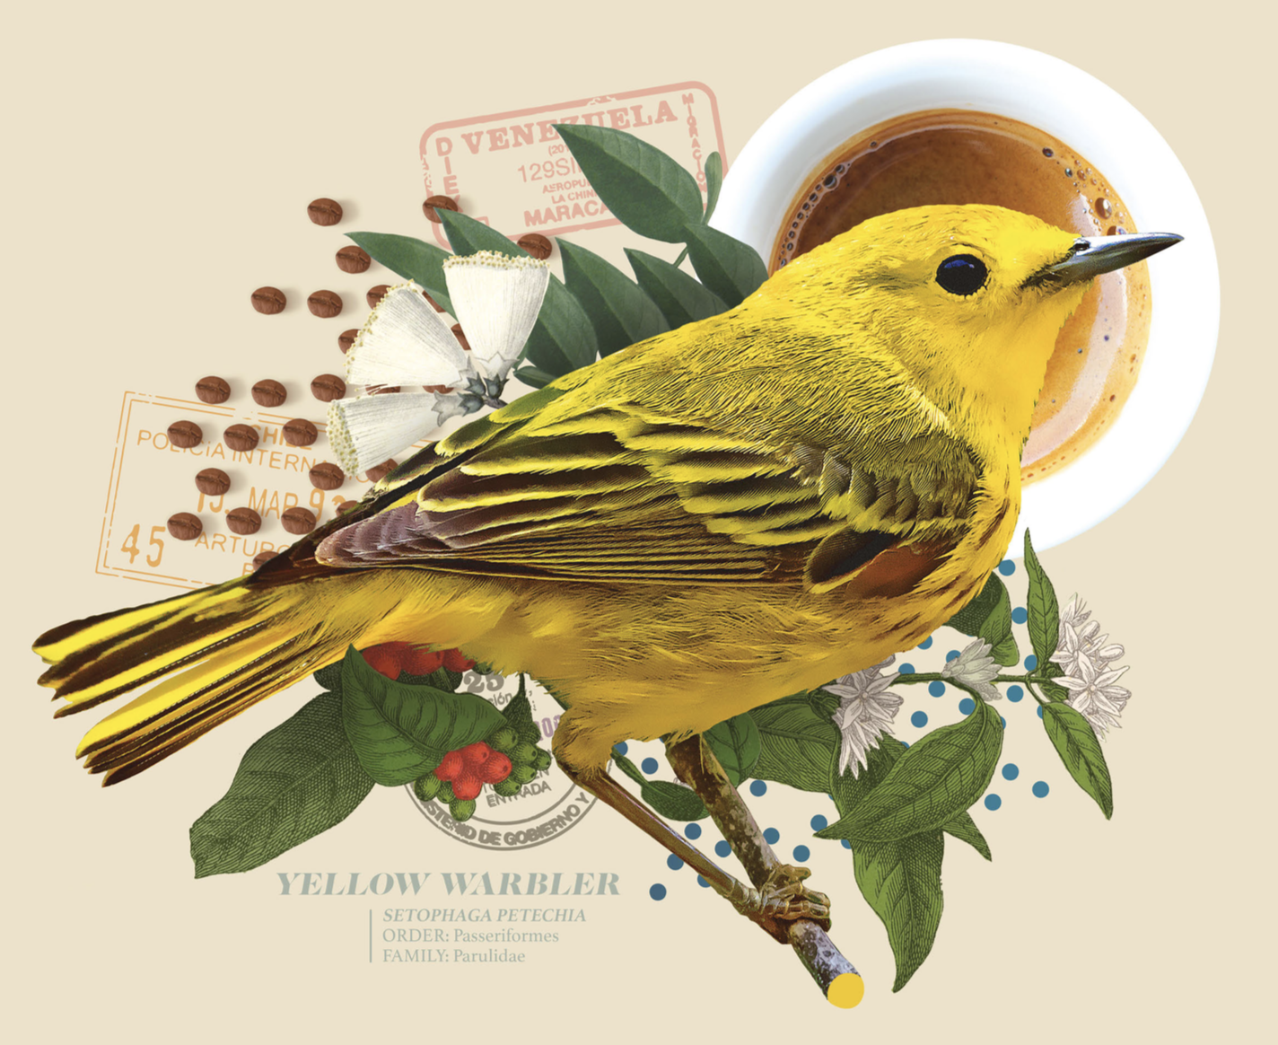
NAOC Roundtable (90 min)
Bird Friendly Agriculture and Development
SMBC, NABCI International, Audubon
Ruth Bennett: BennettR@si.edu
Goal: Establish broad scientific standards, consolidate public awareness campaigns, and champion a universal vision and framework for “Bird Friendly” agriculture and development
Audience:
Bird Friendly, Agriculture, Development researchers/stakeholders
Conservation partners in coffee, cacao, cardamom,
  forest products, cattle, shrimp, salt, etc.
Kickstart a Bird Friendly Coalition:
Define Bird Friendly goals and standards
Promote a network of Bird Friendly products
  and lifestyle choices

Slide 8
Expected Outcomes
Medium- and long-term
Integrate bird conservation into multilateral environmental agreements
Promote the role of bird conservation in sustainable development initiatives in Latin America and the Caribbean
Develop collaborative projects on bird conservation with businesses and impact investing

Slide 9


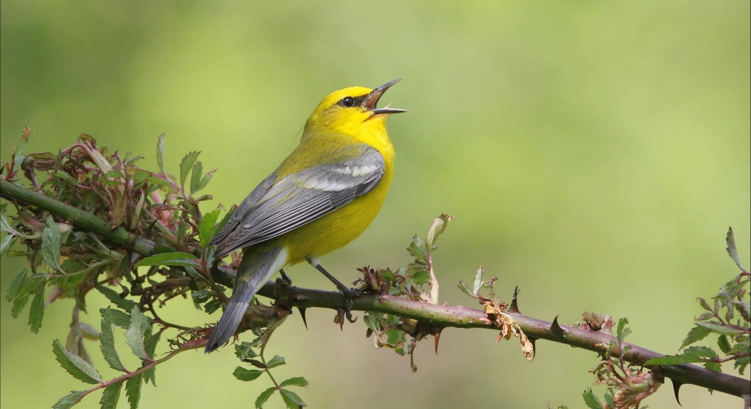
Feedback and questions?
Thank you!

