Slide 1
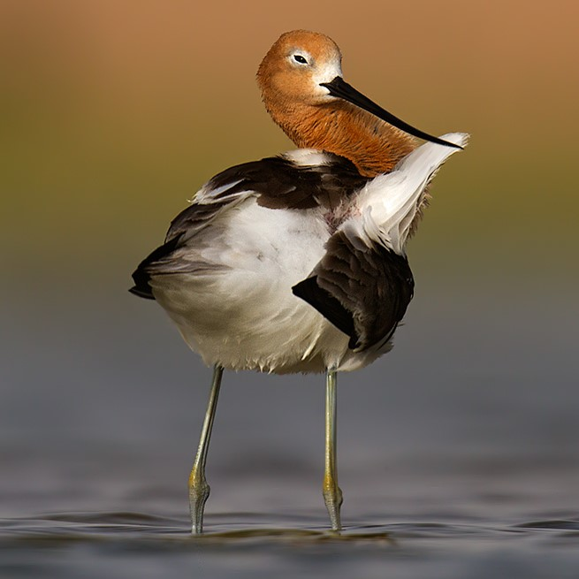
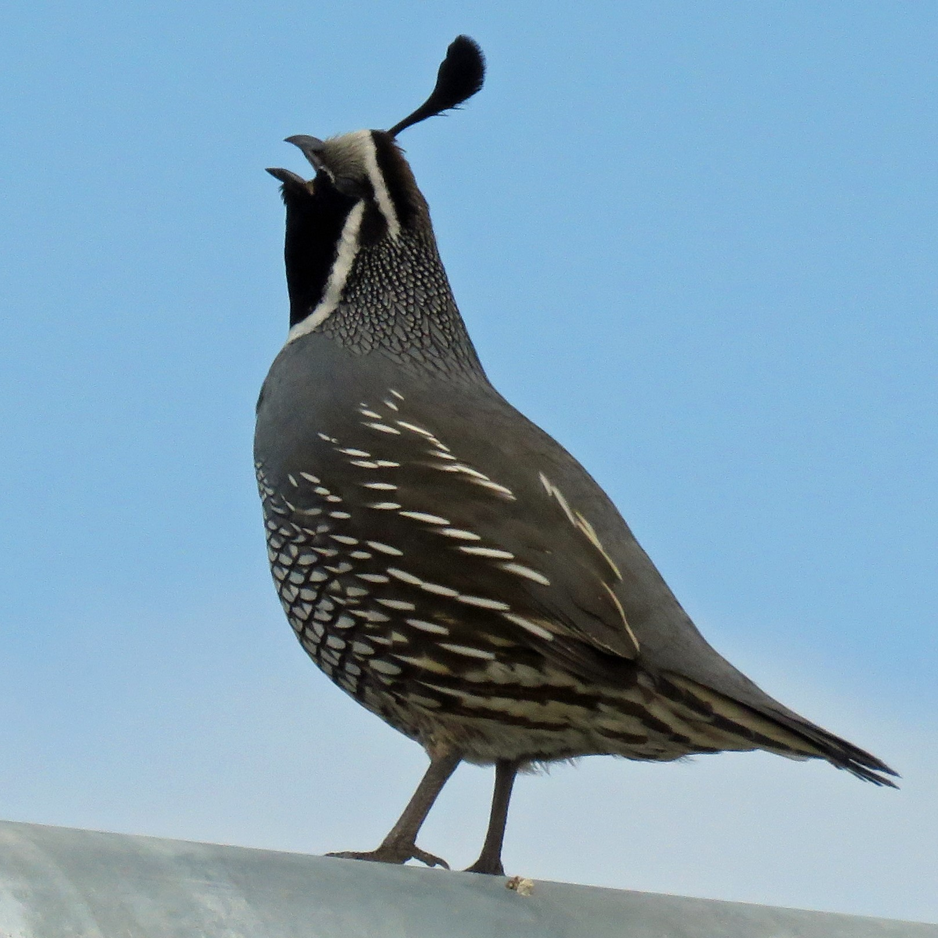
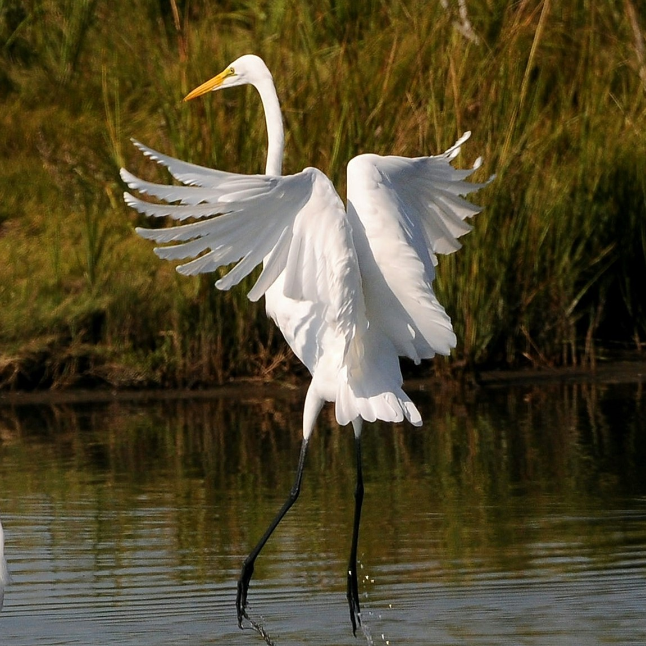
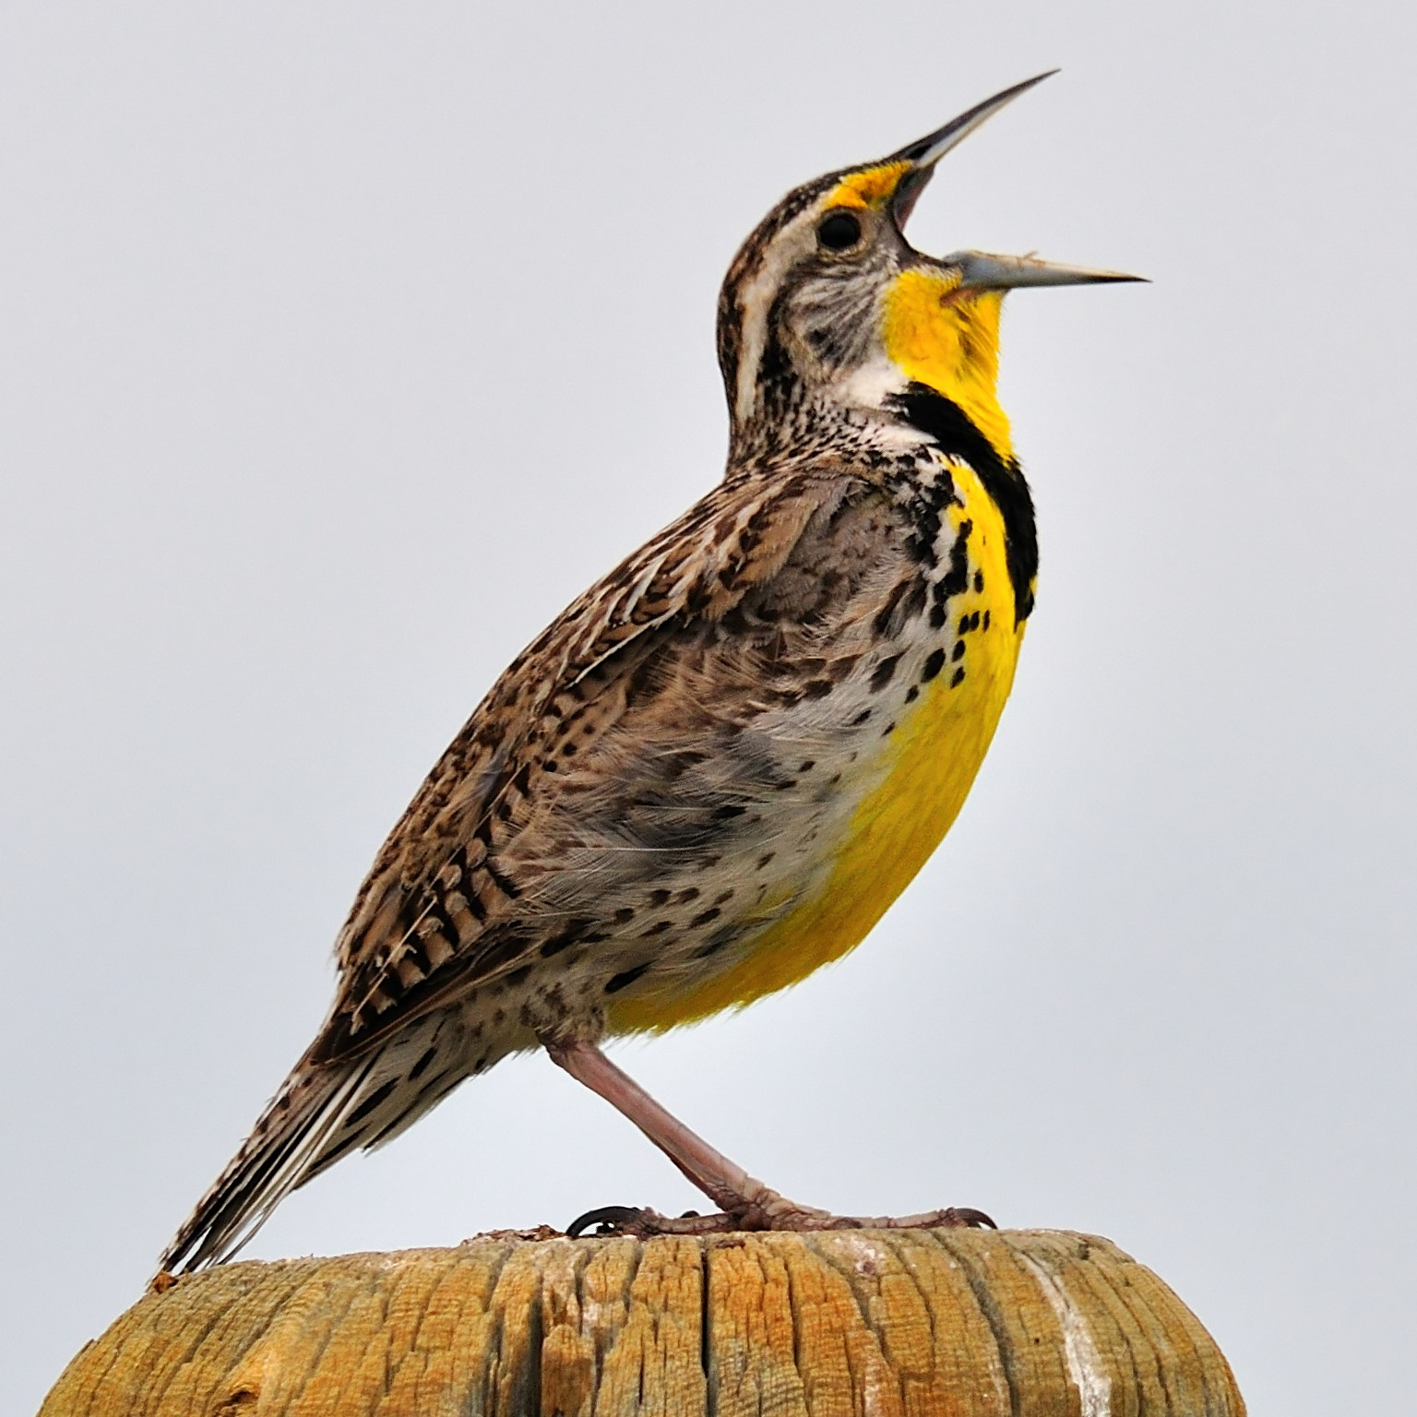
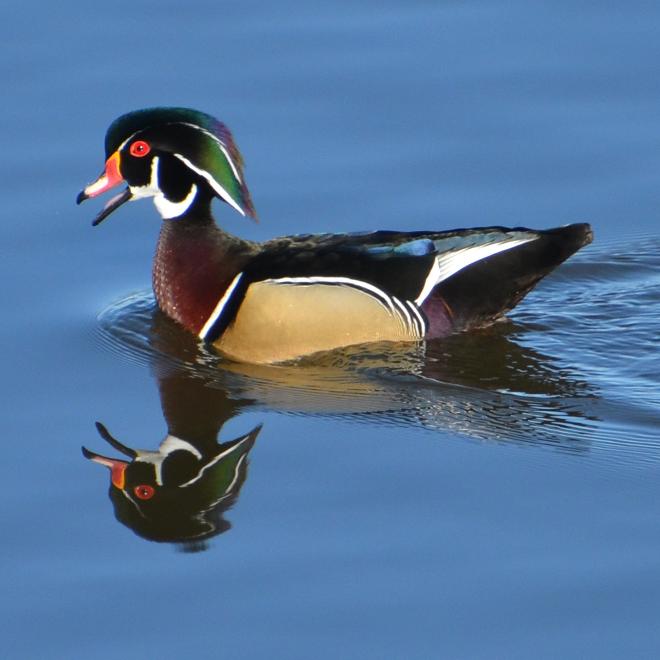
North American Bird Conservation Initiative
Winter 2020 US Committee Meeting
Coordinator Introduction
Dr. Judith Scarl, US NABCI Coordinator
5 February 2020
Counterclockwise from top right: California Quail, Alexandra MacKenzie; American Avocet, Srikanth Vk; Great Egret, Peter Massas; Meadowlark, John Carrel; Wood Duck, Rich L

Slide 2
Committee Member Overview
New NABCI Representatives
Todd Bishop (AFWA Resident Game Bird WG)
David Brakhage (Ducks Unlimited)
Dr. Scott Sillett (Smithsonian Migratory Bird Center)
North American Bird Conservation Initiative

Slide 3
Committee Member Overview
NABCI Executive Council
Jerome Ford, Co-Chair, ex officio
Gordon Myers, Co-Chair, ex officio
Greg Butcher, Federal Representative*
Vacant, State Representative
Tammy VerCauteren, NGO Representative*
Geoff Geupel, Bird Plan Partnerships Representative
Judith Scarl, Coordinator, staff
*Term ends at February 2020 meeting
North American Bird Conservation Initiative

Slide 4
Subcommittees
Awards- Dave Trevino, Chair
*Communications- EJ Williams, Chair
Scott Anderson, Co-Chair
Human Dimensions- Tammy VerCauteren, Chair
Jessica Barnes, Co-Chair
International- Greg Butcher, Chair
Deb Hahn, Co-Chair
Monitoring- (more information coming soon)
*Legislative and Policy- Jennifer Cipolletti, Chair
*Private and Working Lands- Todd Fearer, Chair
*State of the Birds- Ken Rosenberg, Chair

Slide 5
NABCI Strategic Plan
2017-2021
Mission: The U.S. NABCI Committee facilitates collaborative partnerships that advance biological, social, and scientific priorities for North American bird conservation.
Goal 1: Maintain a well-coordinated bird conservation community to achieve strategic conservation.
Goal 2: Facilitate science-based conservation efforts that support healthy bird populations.
Goal 3: Inform and support effective policy to advance bird conservation.
North American Bird Conservation Initiative

Slide 6
Meeting Overview
Overcoming barriers to Priority Actions
Expanding our Focus on Relevancy
Furthering major bird conservation opportunities
Subcommittee Successes
Broadening Connections for USGS and Waterbirds
Photo © Kuhnmi via Flickr

Slide 7
Leveraging our Resources
Embracing new Perspectives
Things to Consider
© Allan Hopkins

Slide 8
Embracing New Perspectives
© Chad Horwedel

Slide 9
Thank you for being here!

